Slide 1
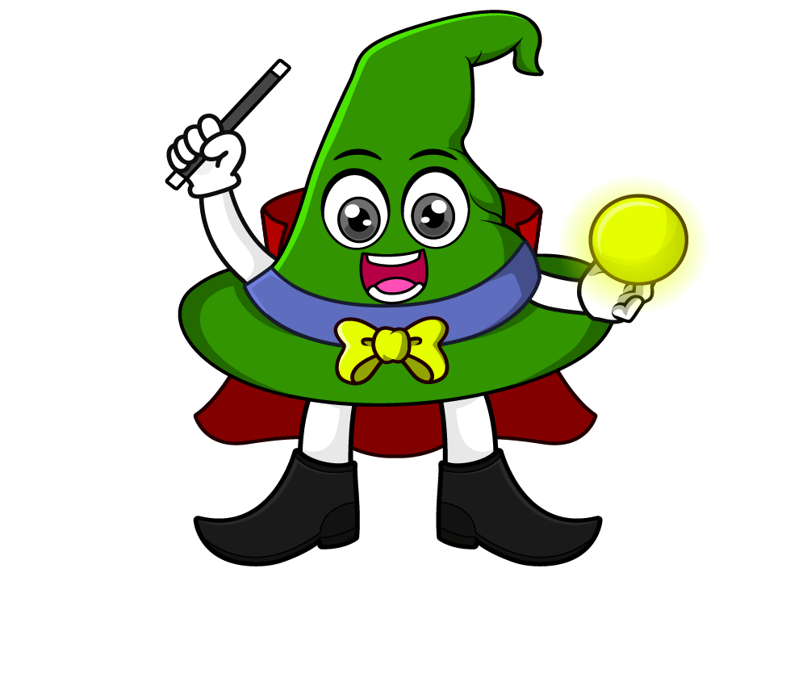
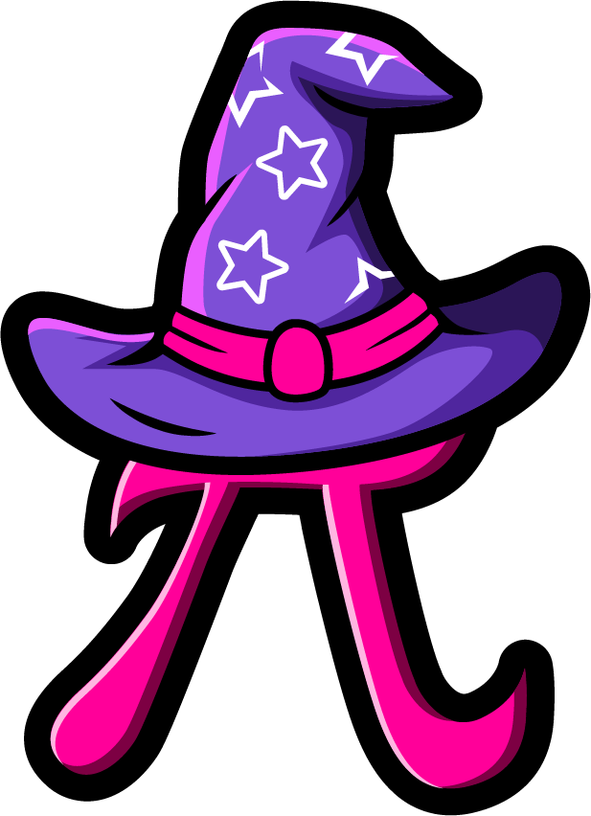
Lesson 2:
Word problems involving x10, x 100 & x1000
www.arithmagicians.com

Slide 2

Recap:
10
1) 4.2 x ? = 42
100
2) 0.36 x ? = 36
100
3) ? x 7.7 = 770
1000
4) ? x 0.9 = 900

Slide 3

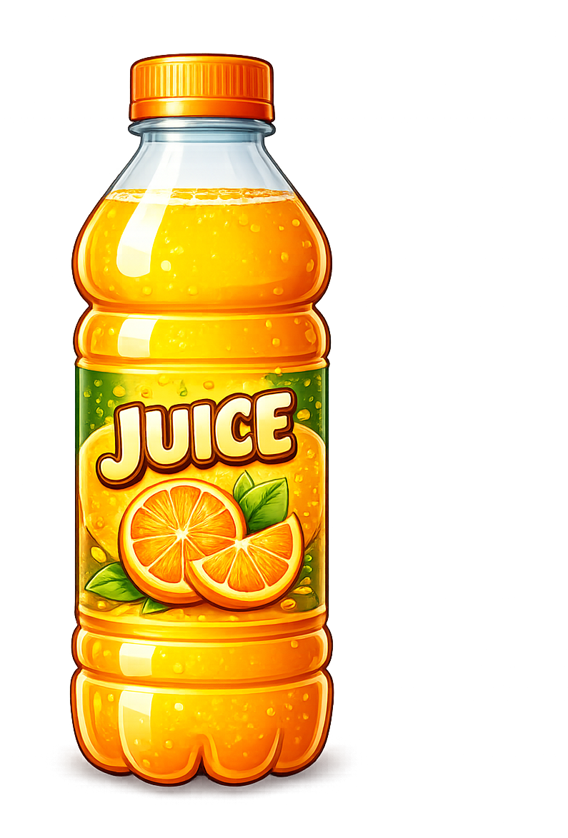
A bottle contains 2.6 litres of juice. A shop orders 10 bottles. How many litres of juice is that in total?
26
?
2.6 x 10 =

Slide 4

A sticker costs £0.36. A shop sells 100 stickers. How much money is collected?
36
?
0.36 x 100 =

Slide 5
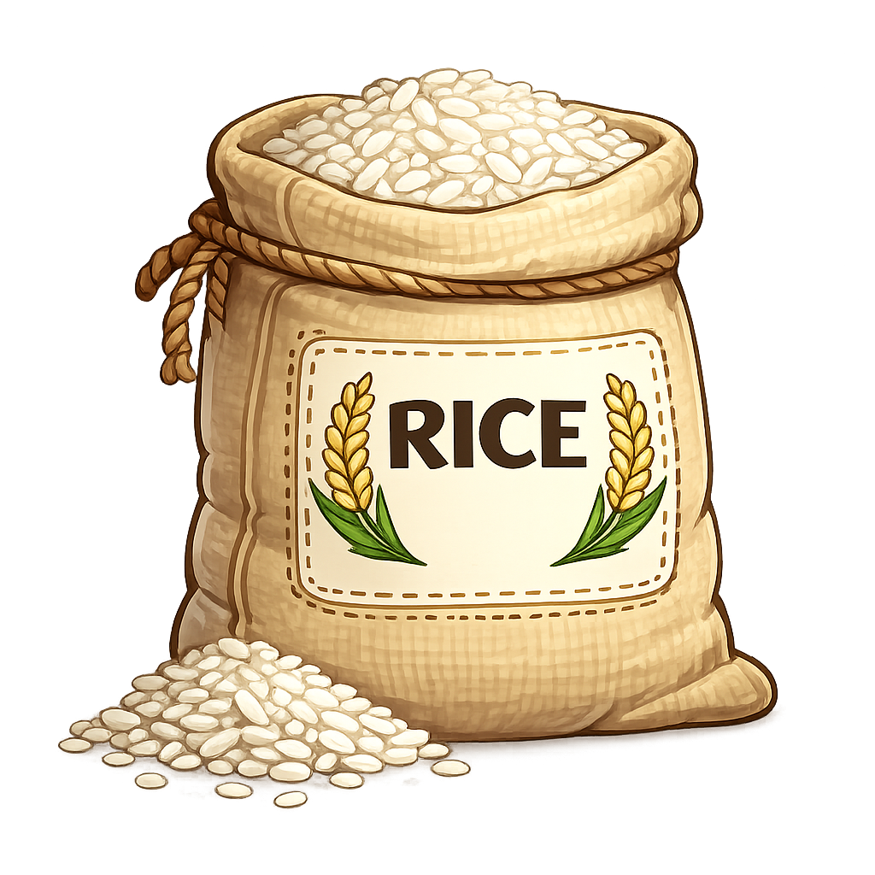
A grain of rice weighs 0.02 grams. There are 1,000 grains. What is the total weight?
?
20
0.02 x 1000 =

Slide 6
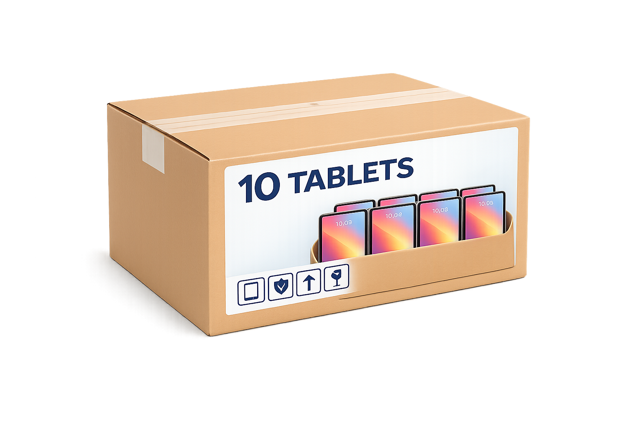
A tablet weighs 0.48 kg.
A shipment contains 10 tablets
in each box and 10 boxes.
What is the total weight of the shipment?
?
48
0.48 x 10 x 10 =

