Slide 1


Lesson 2:
Halving Word Problems (Within 10)
www.arithmagicians.com

Slide 2

🎵 Let’s Say
Our Halves to 10!
Halve 2 is 1 Halve 4 is 2 Halve 6 is 3 Halve 8 is 4 Halve 10 is 5

Slide 3

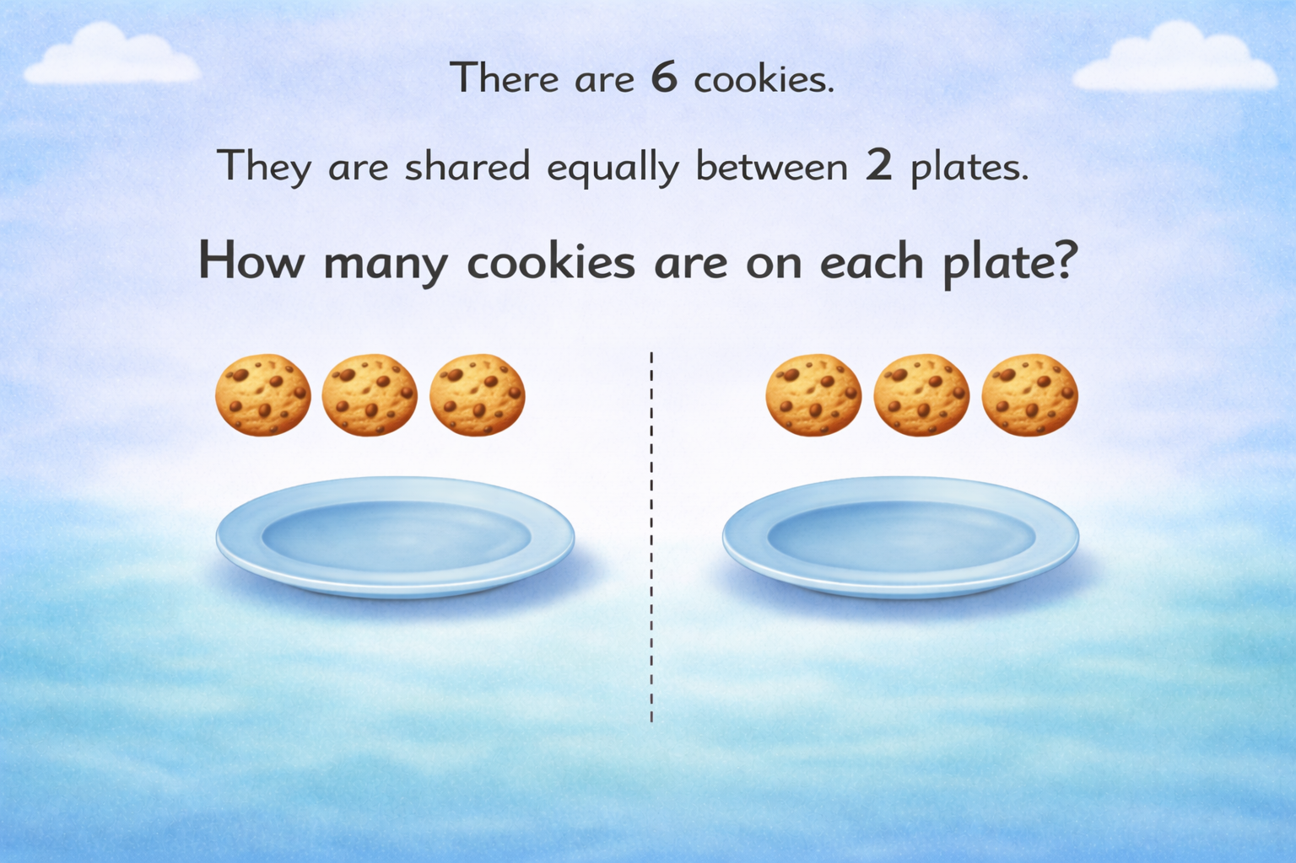
3
3

Slide 4
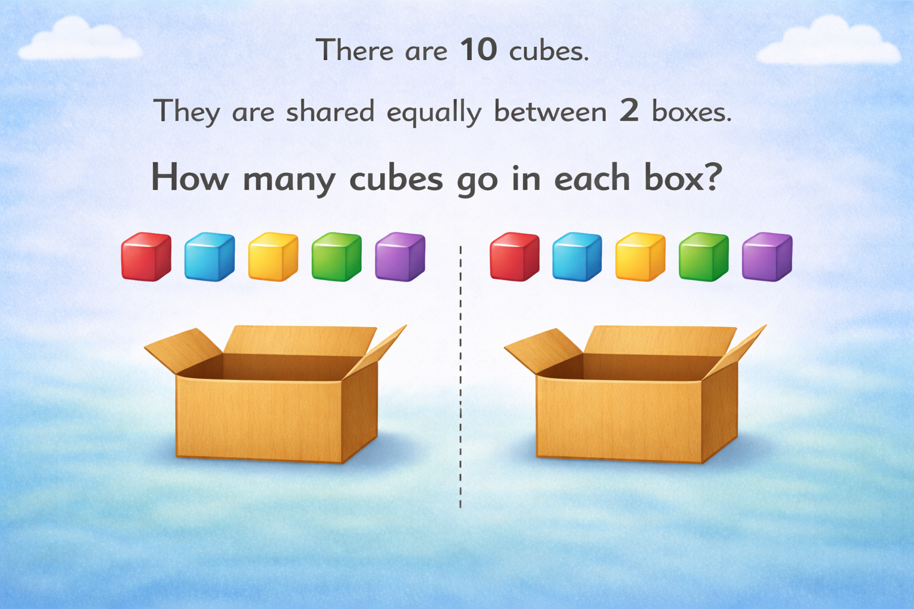
5
5

Slide 5
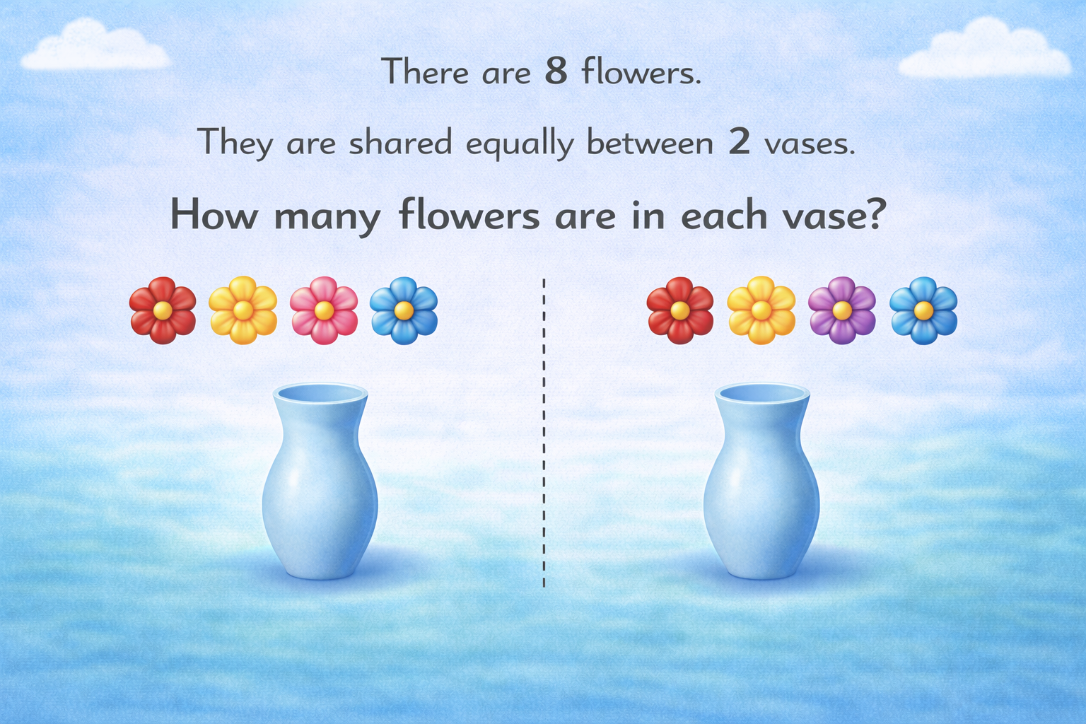
4
4

Slide 6


Your Turn
There are 4 hats. They are shared equally between 2 children. How many hats does each child get?
4
?
?
2
2

Slide 7
Your Turn
There are 6 frogs. They are shared equally between 2 logs. How many frogs are on each log?
6
?
?
3
3

