Slide 1


Lesson 3:
Word problems involving ÷10 & ÷100
www.arithmagicians.com

Slide 2

Recap:
10
1) 780 ÷ ? = 78
100
2) 1300 ÷ ? = 13
2200
3) ? ÷ 100 = 22
4800
4) ? ÷ 10 = 480

Slide 3


A shop has 800 apples. They are packed into bags of 10. How many bags are made?
?
80
800 ÷ 10 =

Slide 4
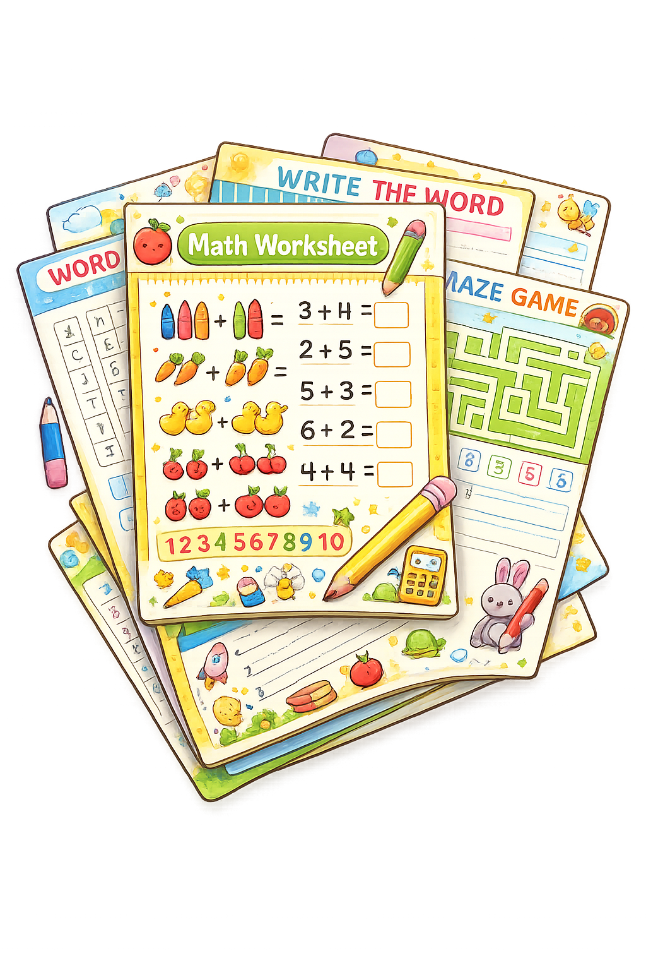
A school prints 900 worksheets. They are shared into packs of 100. How many packs are made?
9
?
900 ÷ 100 =

Slide 5

A factory produces 1200 cans. They are packed into crates of 100. How many crates are filled?
?
12
1200 ÷ 100 =

Slide 6

A shop has 1550 toys. They are packed into bags of 10. How many bags are made?
155
?
1550 ÷ 10 =

