Slide 1
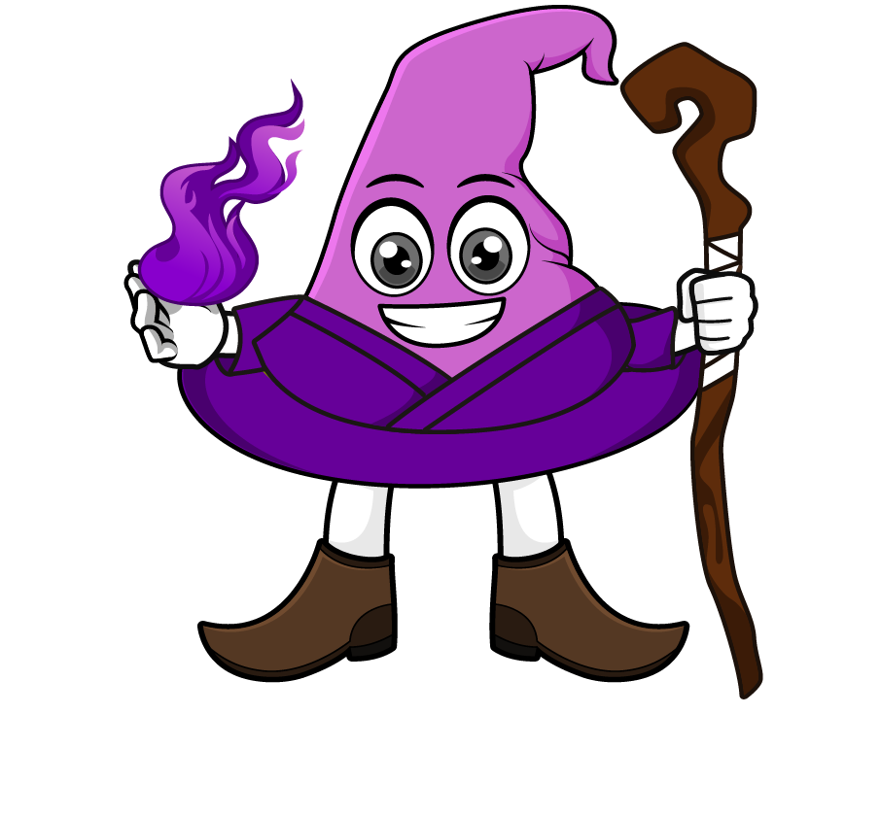

Lesson 3:
Word problems involving ÷10, ÷100 & ÷1000
www.arithmagicians.com

Slide 2

Recap:
7.8
1) 78 ÷ 10 = ?
0.13
2) 130 ÷ 1000 = ?
10
3) 78 ÷ ? = 7.8
100
4) 130 ÷ ? = 1.3

Slide 3

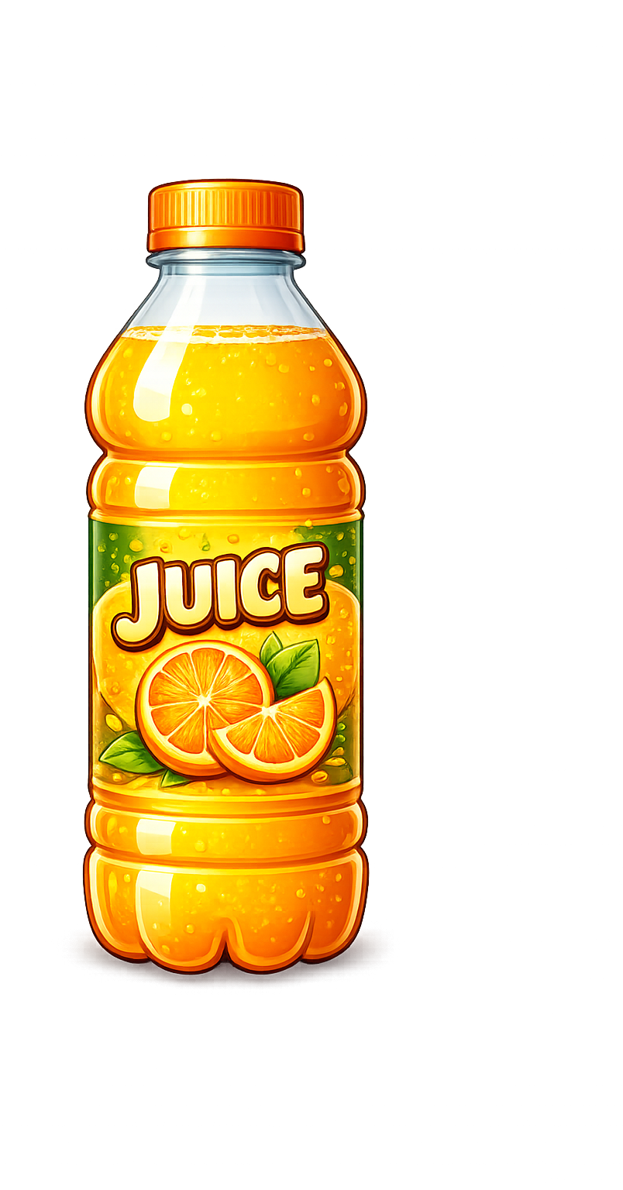
A bottle contains 3.5 litres of juice. It is shared equally into 10 cups. How many litres of juice are in each cup?
?
0.35
3.5 ÷ 10 =

Slide 4

A ribbon is 7.5 metres long. It is cut into 100 equal pieces. How long is each piece in metres?
?
0.075
7.5 ÷ 100 =

Slide 5

A wire is 9 metres long. It is cut into 1,000 equal pieces. How long is each piece in metres?
?
0.009
9 ÷ 1000 =

Slide 6
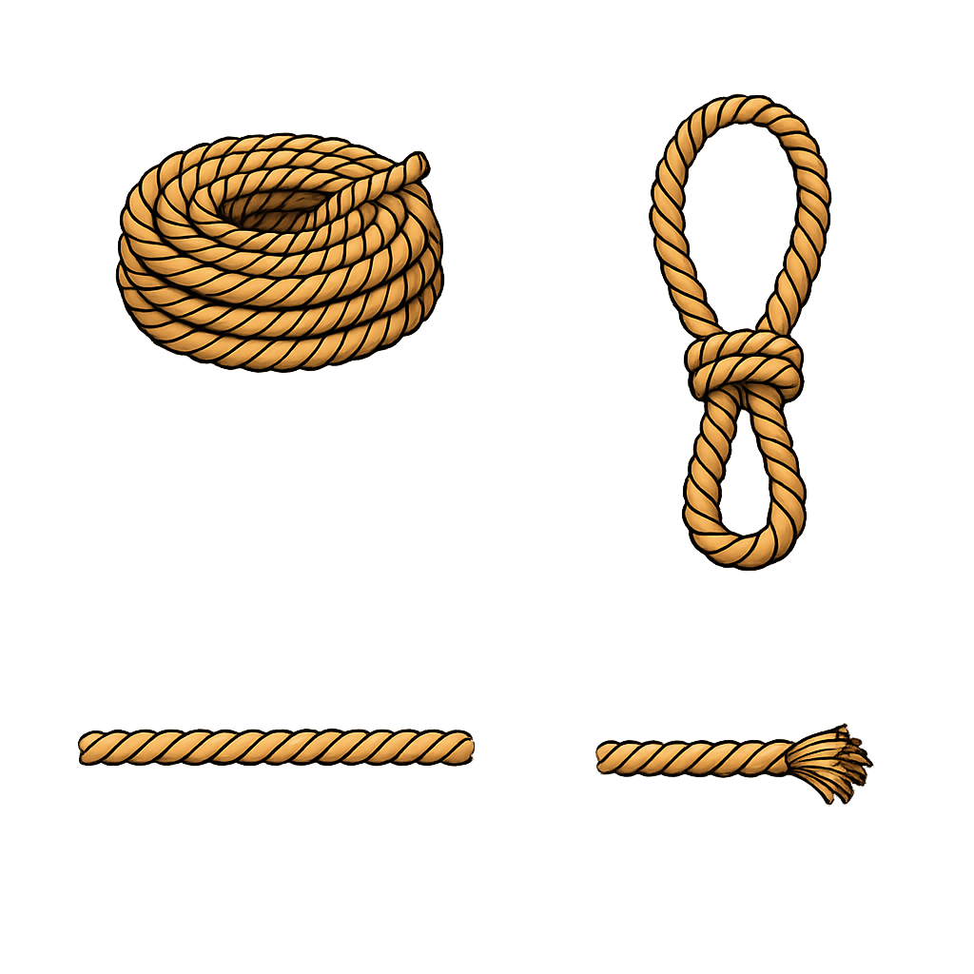
A rope is 84 metres long. It is first cut into 10 equal pieces, then each piece is cut into 10 more pieces. How long is each final piece in metres?
?
0.84
84 ÷ 10 ÷ 10 =

