Slide 1
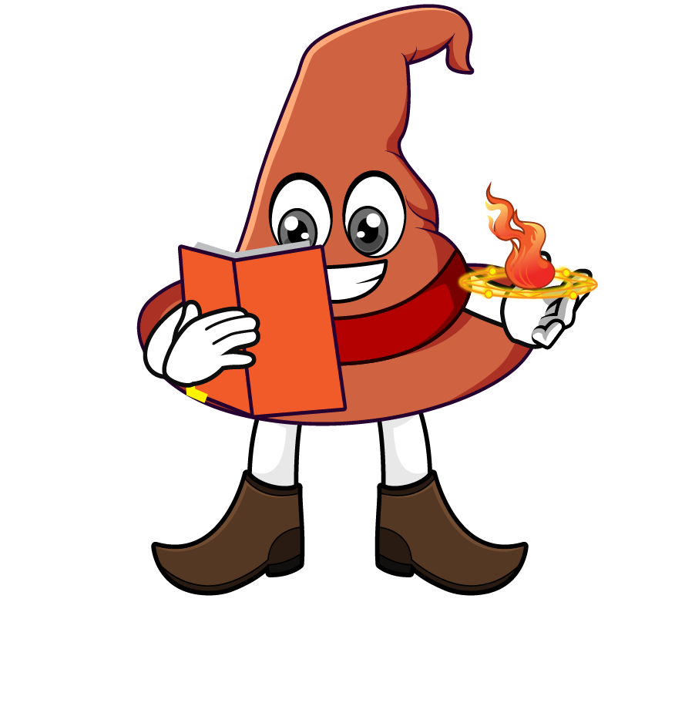

Lesson 4:
Word problems involving ÷10 & ÷100
www.arithmagicians.com

Slide 2

Recap:
10
1) 780 ÷ ? = 78
100
2) 1300 ÷ ? = 13
2200
3) ? ÷ 100 = 22
4800
4) ? ÷ 10 = 480

Slide 3

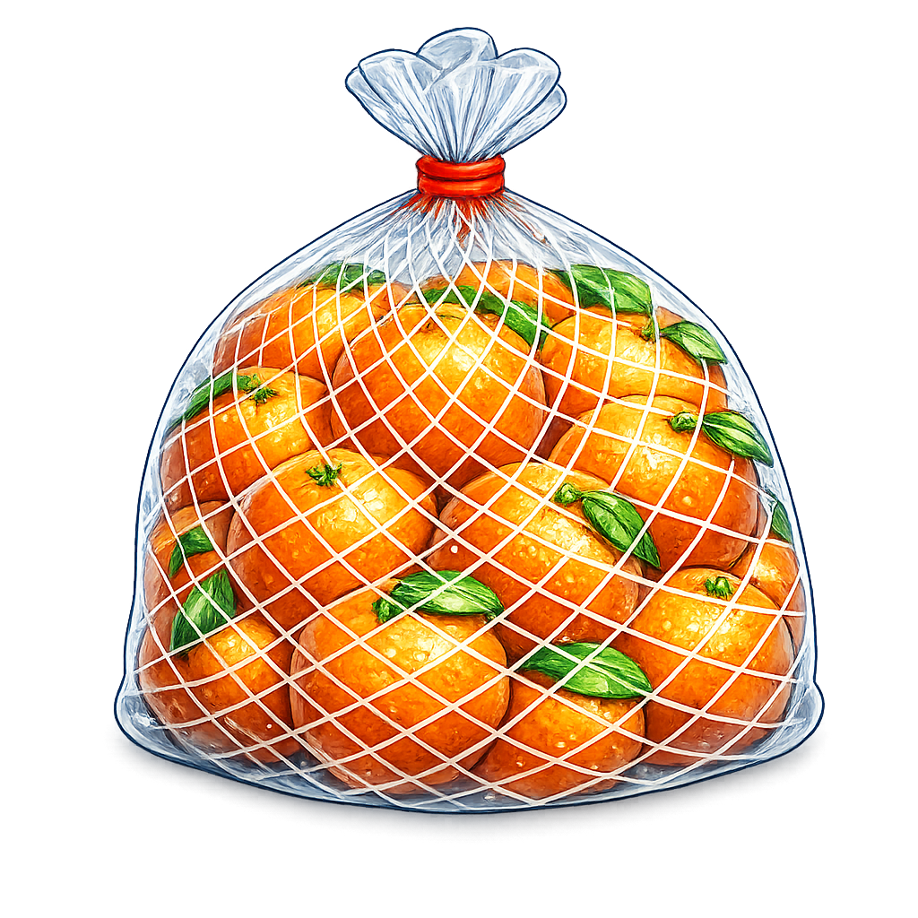
A shop has 1200 oranges. They are packed into bags of 10. How many bags are made?
?
120
1200 ÷ 10 =

Slide 4

A factory makes 42000 stickers. They are shared into packs of 100. How many packs are made?
420
?
42000 ÷ 100 =

Slide 5
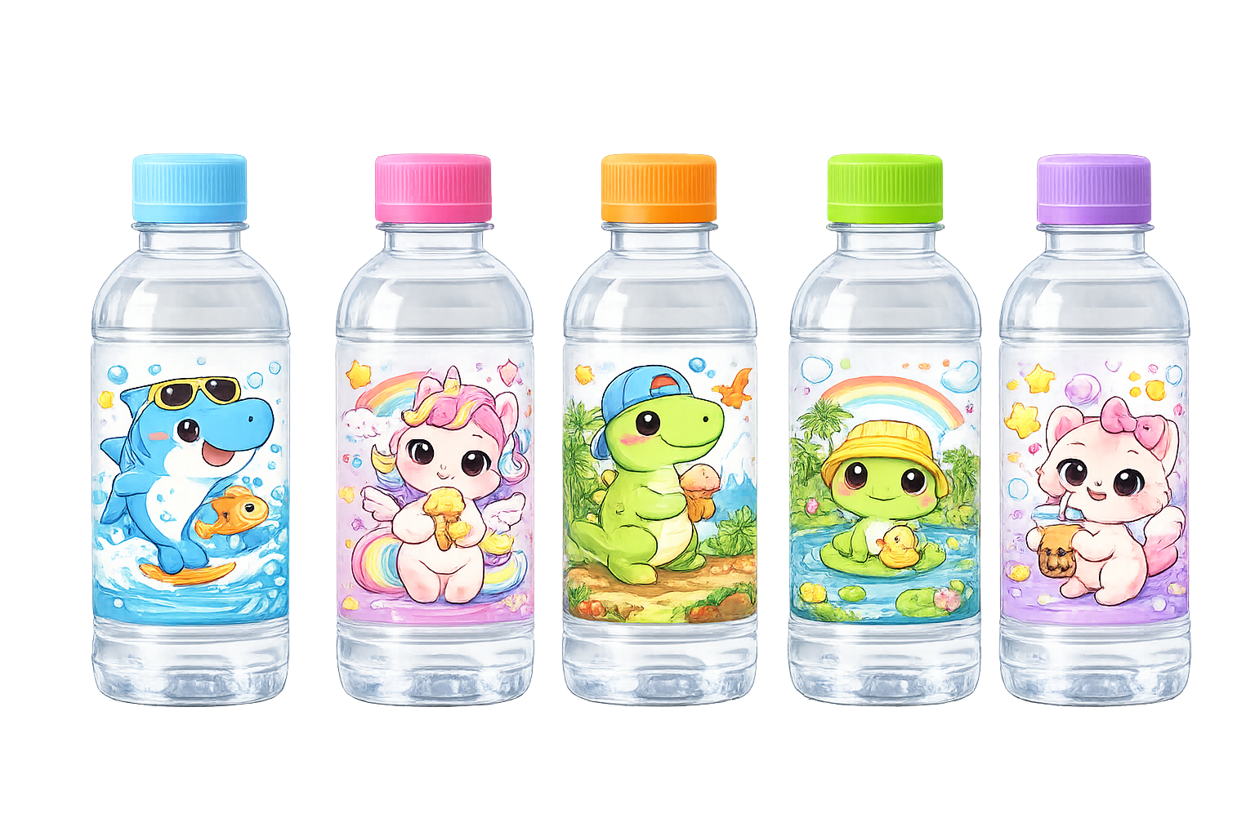
A factory produces 2600 bottles. They are packed into crates of 100. How many crates are filled?
?
26
2600 ÷ 100 =

Slide 6
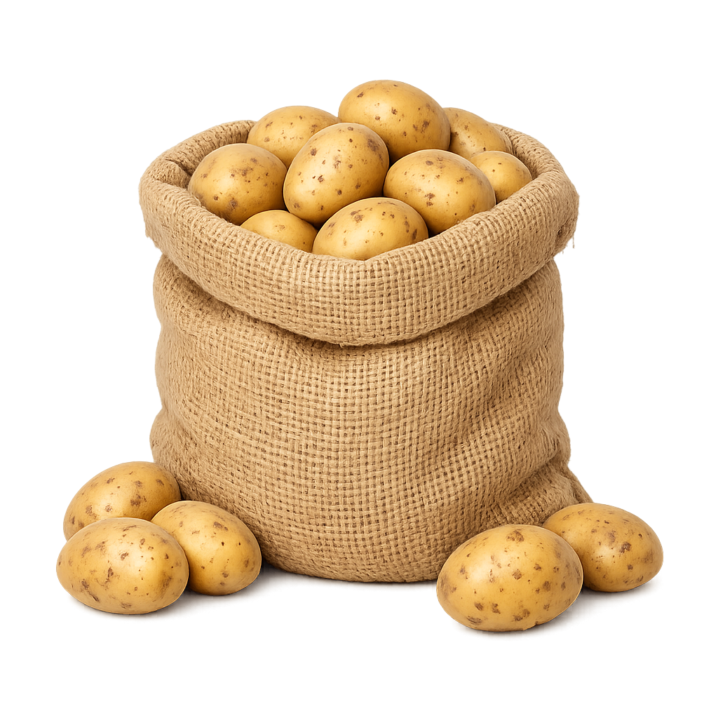
A farm collects 1600 potatoes. They are placed into bags of 100. How many bags are needed?
?
16
1600 ÷ 100 =

