Slide 1
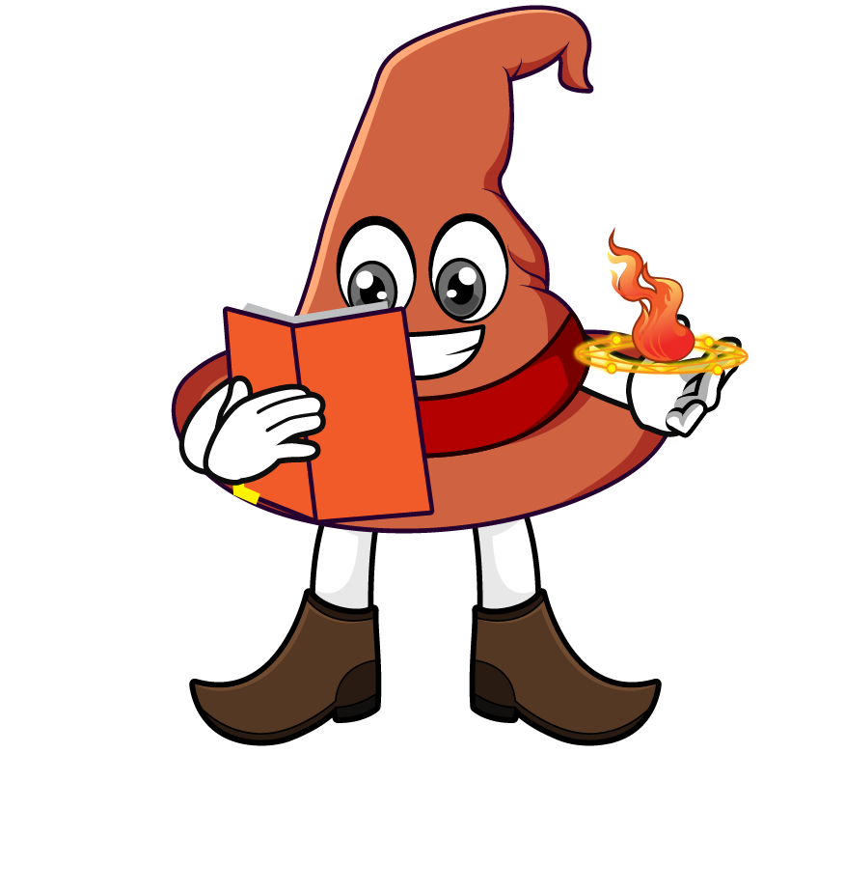

Lesson 4:
Word problems involving ÷10, ÷100 & ÷1000
www.arithmagicians.com

Slide 2

Recap:
5.6
1) 56 ÷ 10 = ?
2) 450 ÷ 1000 = ?
0.45
10
3) 93 ÷ ? = 9.3
100
4) 230 ÷ ? = 2.3

Slide 3

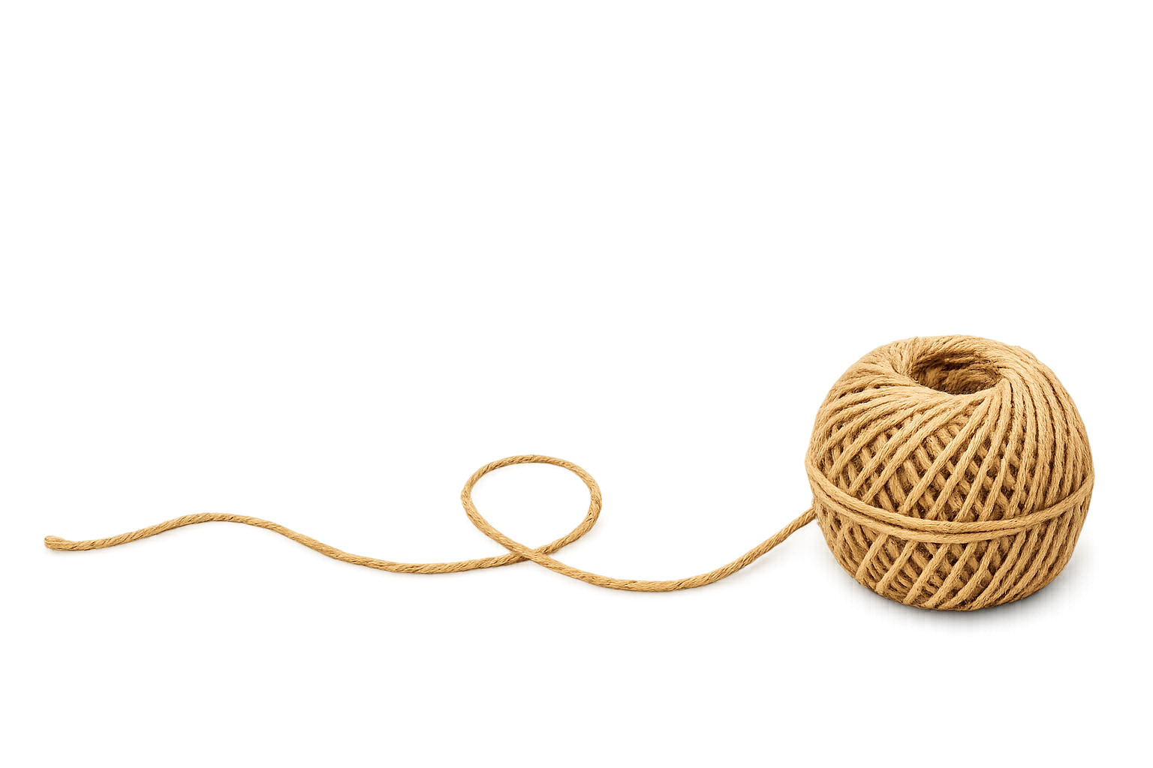
A string is 4.8 metres long. It is cut into 10 equal pieces. How long is each piece in metres?
?
0.48
4.8 ÷ 10 =

Slide 4
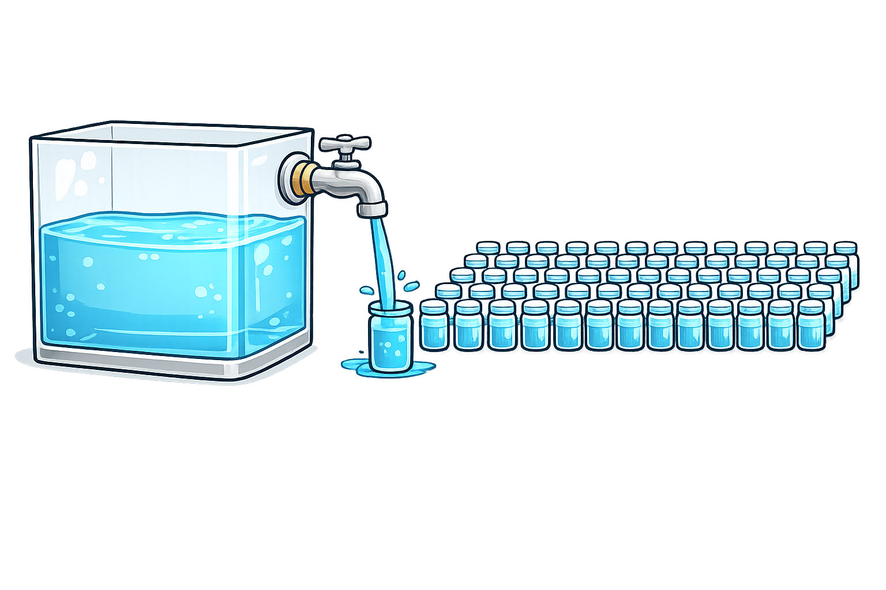
A tank holds 12.6 litres of water. It is poured equally into 100 small containers.
How many litres of water are in each container?
?
0.126
12.6 ÷ 100 =

Slide 5
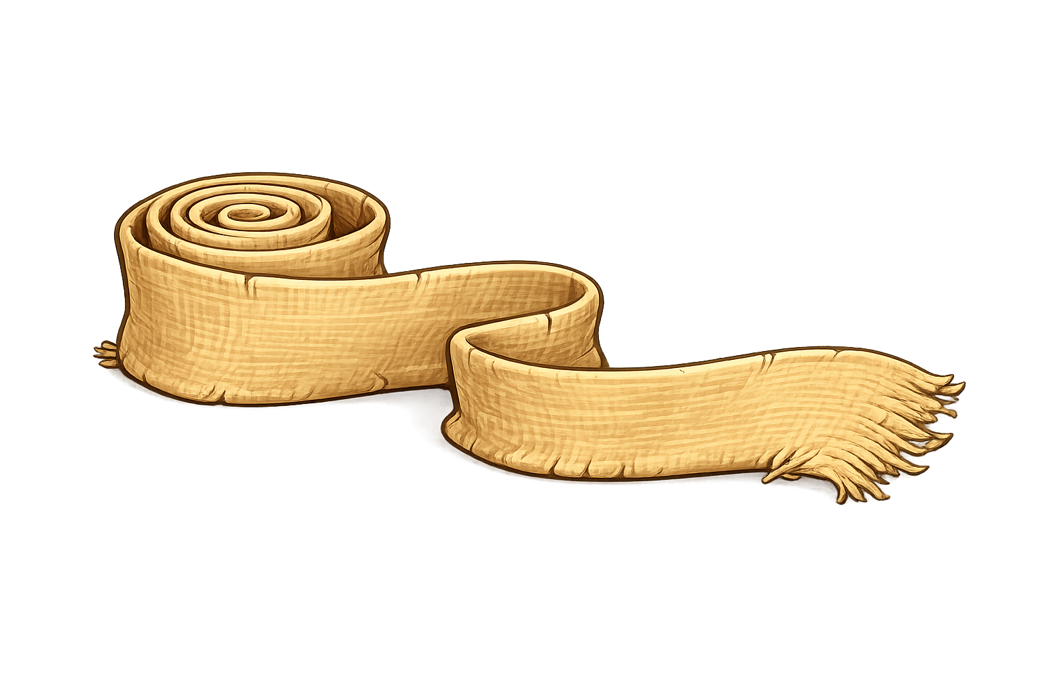
A strip of fabric is 54 metres long. It is
cut into 100 equal pieces, then each piece
is cut into 10 equal pieces. How long is each final piece in metres?
0.054
?
54 ÷ 100 ÷ 10 =

Slide 6
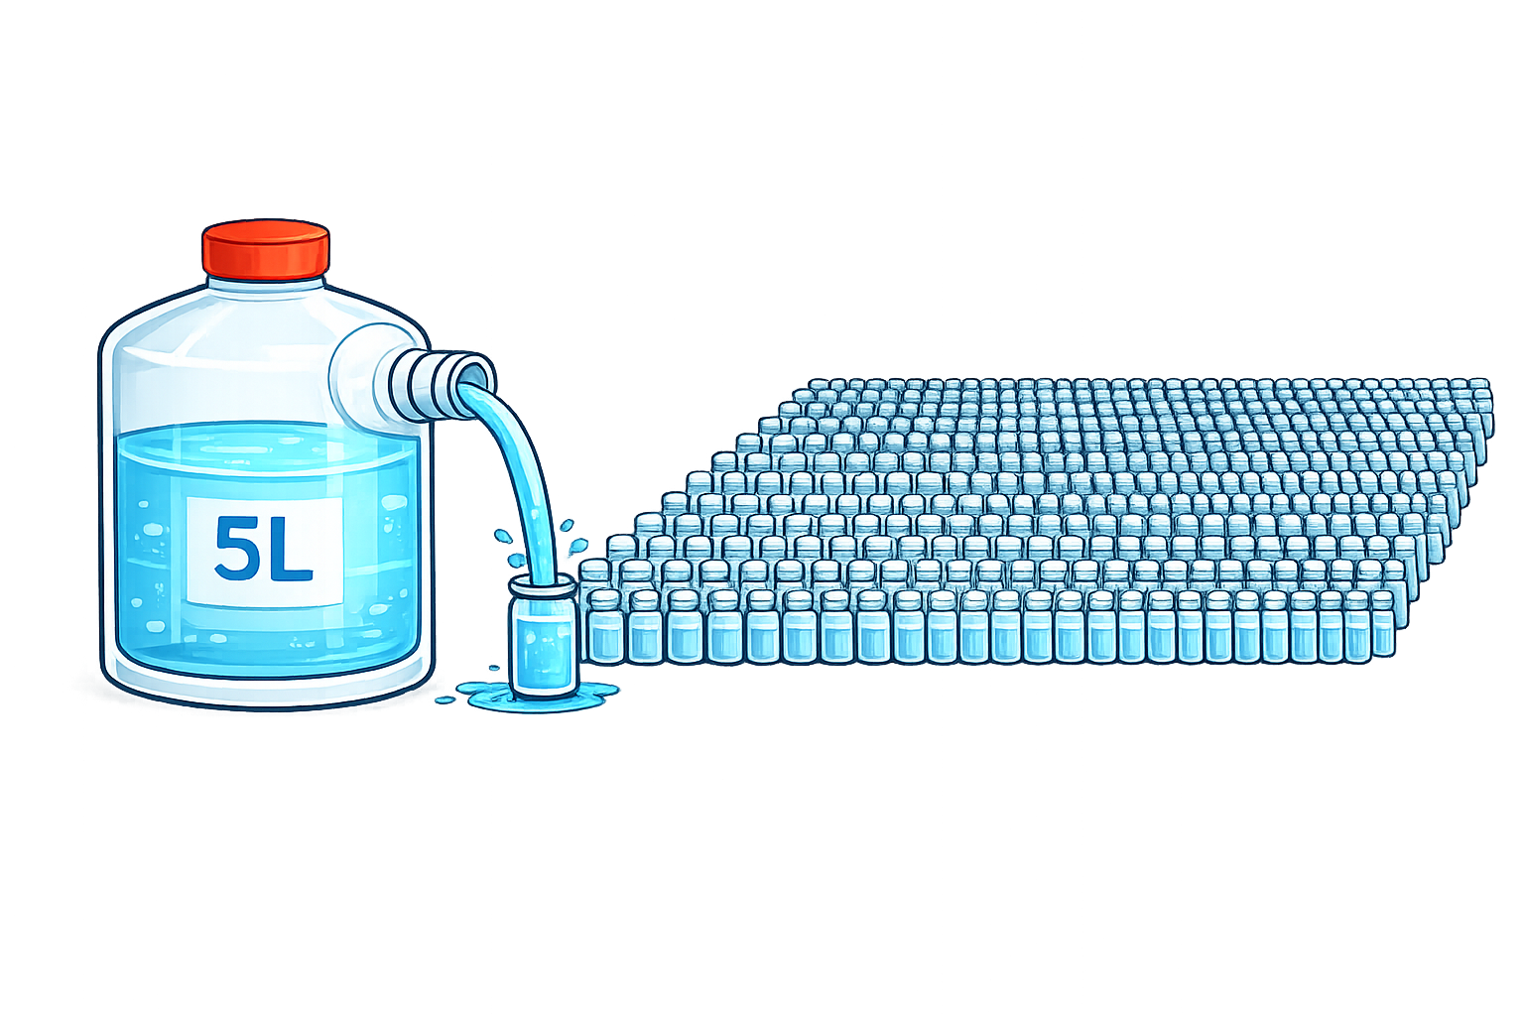
A container holds 5 litres of liquid. It is
divided equally into 1,000 tiny bottles.
How many litres of liquid are in each bottle?
0.005
?
5 ÷ 1000 =

