Slide 1


Lesson 5:
Assess and Review
www.arithmagicians.com

Slide 2

Recap:
10
1) 36 x ? = 360
100
2) 91 x ? = 9100
10
3) 780 ÷ ? = 78
100
4) 1300 ÷ ? = 13

Slide 3

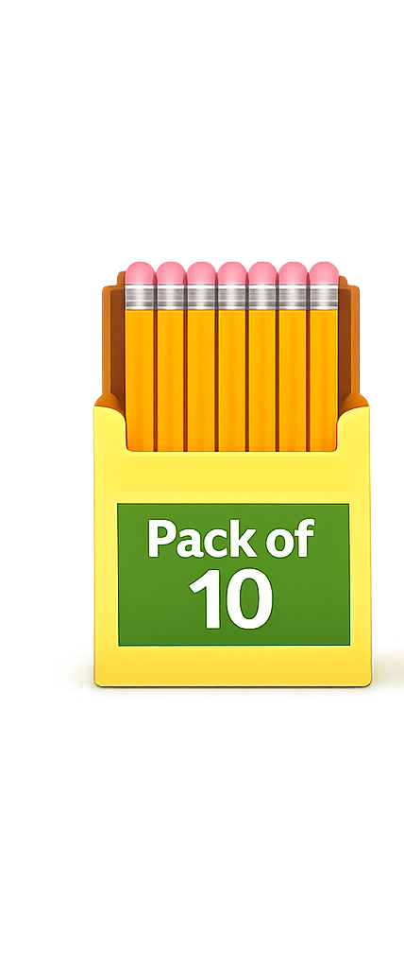
A shop sells pencils in packs of 10. If you buy 24 packs, how many pencils do you have?
240
?
10 x 24 =

Slide 4

A shop has 1320 toys. They are packed into bags of 10. How many bags are made?
132
?
1320 ÷ 10 =

Slide 5

A factory produces 1500 cans. They are packed into crates of 100. How many crates are filled?
?
15
1500 ÷ 100 =

Slide 6
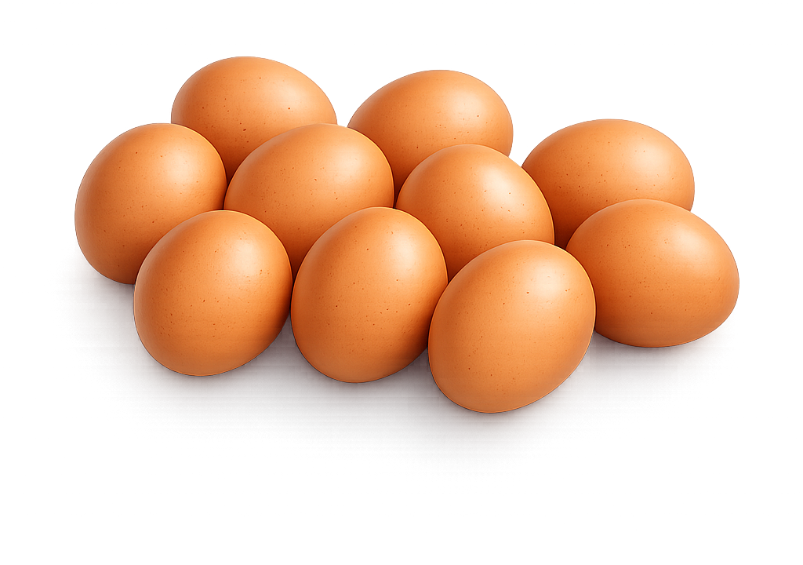
A farm packs 10 eggs in each box. There are 84 boxes. How many eggs are there in total?
840
?
10 x 84 =

