Slide 1


Lesson 5:
Assess and Review
www.arithmagicians.com

Slide 2

Recap:
10
1) 3.6 x ? = 36
100
2) 9.1 x ? = 910
10
3) 7.8 ÷ ? = 0.78
100
4) 13 ÷ ? = 0.13

Slide 3


A bottle contains 5.5 litres of juice. A shop orders 10 bottles. How many litres of juice is that in total?
55
?
5.5 x 10 =

Slide 4

A sticker costs £0.44 A shop sells 100 stickers. How much money is collected?
44
?
0.44 x 100 =

Slide 5

A wire is 15 metres long. It is cut into 1,000 equal pieces. How long is each piece in metres?
?
0.015
15 ÷ 1000 =

Slide 6
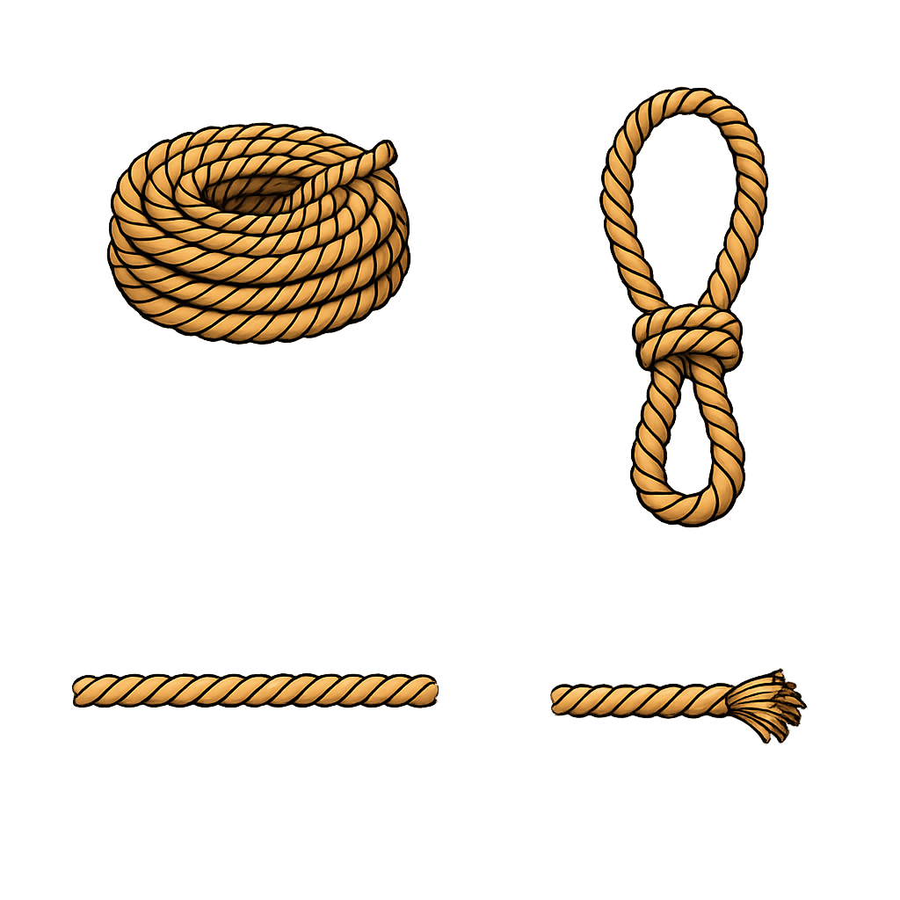
A rope is 95 metres long. It is first cut into 10 equal pieces, then each piece is cut into 10 more pieces. How long is each final piece in metres?
?
0.95
95 ÷ 10 ÷ 10 =

Slide 7
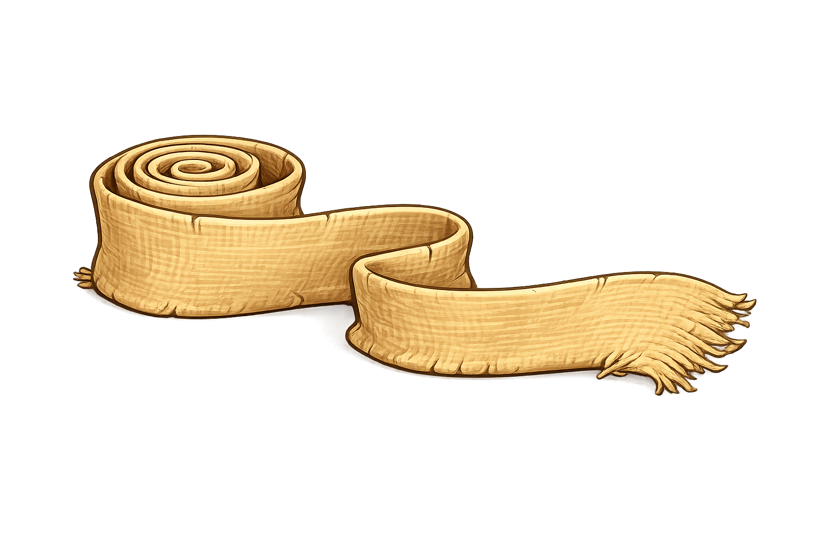
A strip of fabric is 175 metres long. It is
cut into 100 equal pieces, then each piece
is cut into 10 equal pieces. How long is each final piece in metres?
?
0.175
175 ÷ 100 ÷ 10 =

