Slide 1


Week 5:
Assess & Review
www.arithmagicians.com

Slide 2

🎵 Let’s Say
Our Halves to 10!
Halve 2 is 1 Halve 4 is 2 Halve 6 is 3 Halve 8 is 4 Halve 10 is 5

Slide 3

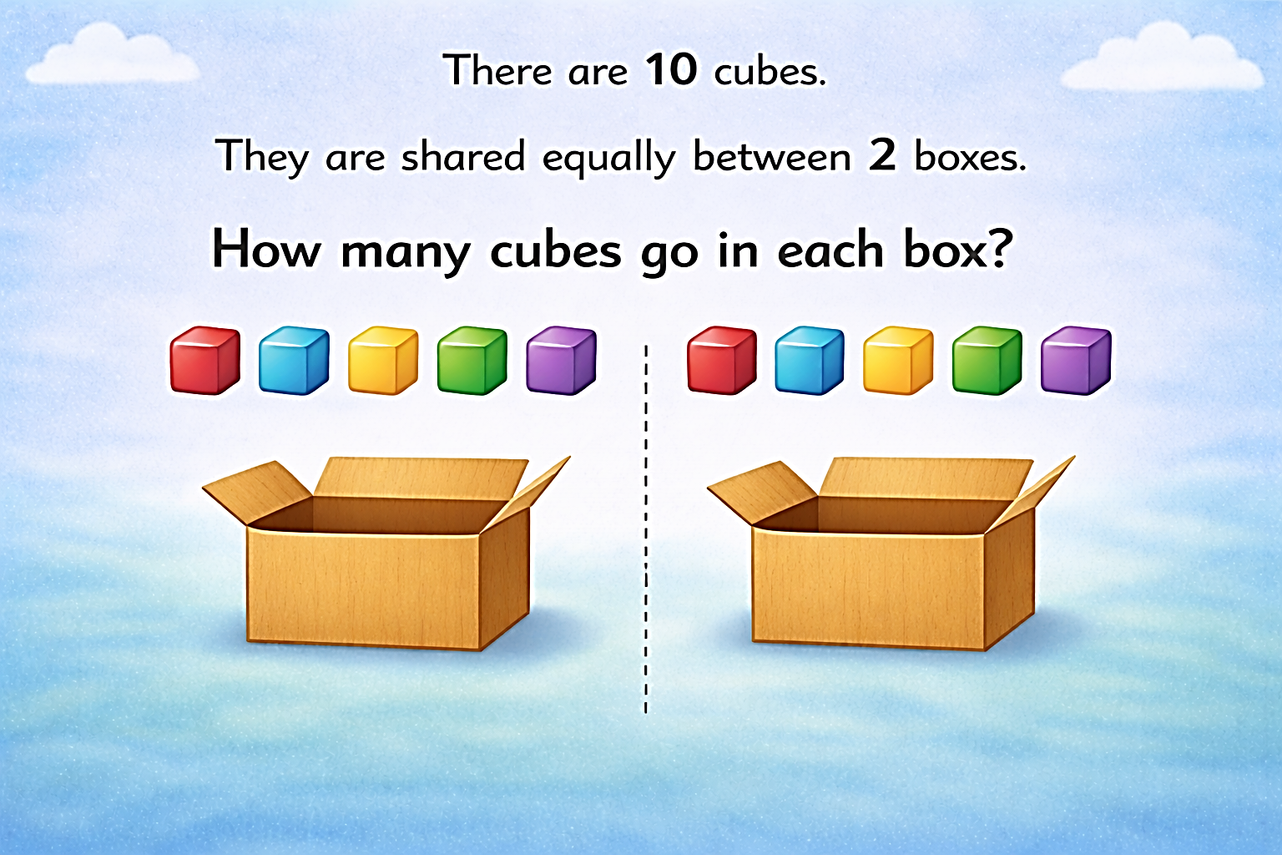
5
5

Slide 4
There are 4 crayons. They are shared equally between 2 boxes. How many crayons go in each box?
4
?
?
2
2

Slide 5
There are 6 oranges. They are shared equally between 2 bowls. How many oranges are in each bowl?
6
?
?
3
3

Slide 6


Your Turn
There are 10 counters. They are shared equally between 2 trays. How many counters are on each tray?
10
?
?
5
5

Slide 7
Your Turn
There are 8 pencils. They are shared equally between 2 pupils. How many pencils does each pupil get?
8
4
4

