Slide 1
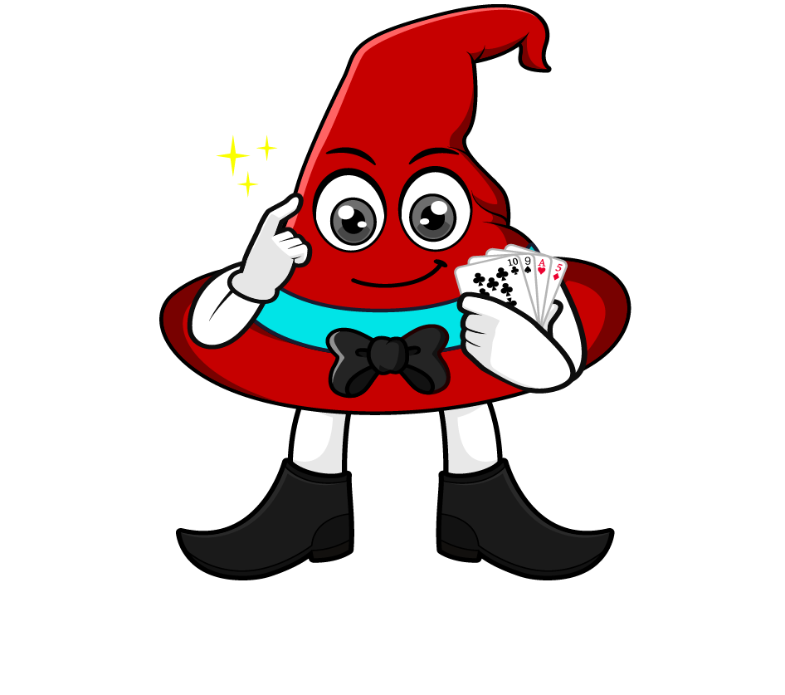

Lesson 1:
Recap: Multiply decimals by 10, 100 & 1000
www.arithmagicians.com

Slide 2

Let’s recap what we have learnt so far?
1) To multiply a number by 10 each digit moves
to the left on a place value grid.
1
2) To multiply a number by 100 each digit moves
to the left on a place value grid.
2
3) To multiply a number by 1,000 each digit moves
to the left on a place value grid.
3

Slide 3
Which number is bigger?
.
T
O
t
h
th
.
1
6
.
1
6
0
.
1
6
0
0
They are all the same. Can you explain why?

Slide 4


The place value chart shows the number 17.245
When we multiply by 10, every digit moves one place to the left.
So we now have 172.45
17.245 x 10 = 172.45
.
H
T
O
t
h
th
.
1
7
2
4
5

Slide 5
The place value chart shows the number 25.3
When we multiply by 100, every digit moves two place to the left.
Don’t forget to add a
place value holder
So we now have 2530
25.3 x 100 = 2530
.
Th
H
T
O
t
h
th
.
2
2
5
5
3
3
0

Slide 6
The place value chart shows the number 4.3
When we multiply by 1000, every digit moves three place to the left.
Don’t forget to add
place value holders
So we now have 4300
4.3 x 1000 = 4300
.
Th
H
T
O
t
h
th
.
4
4
3
0
4
0
3
3

Slide 7

12.345
4.99
6.1
4990
12345
6100
____ multiplied by 1000 is equal to _______

Slide 8


Your Turn
1) 2.8 x 10 =
28
2) 12.7 x 100 =
1270
3) 4.92 x 1000 =
4920
4) 5.007 x 100 =
500.7
5) 4.02 x 1000 =
4020
6) 6.1 x 1000 =
6100

