Slide 1
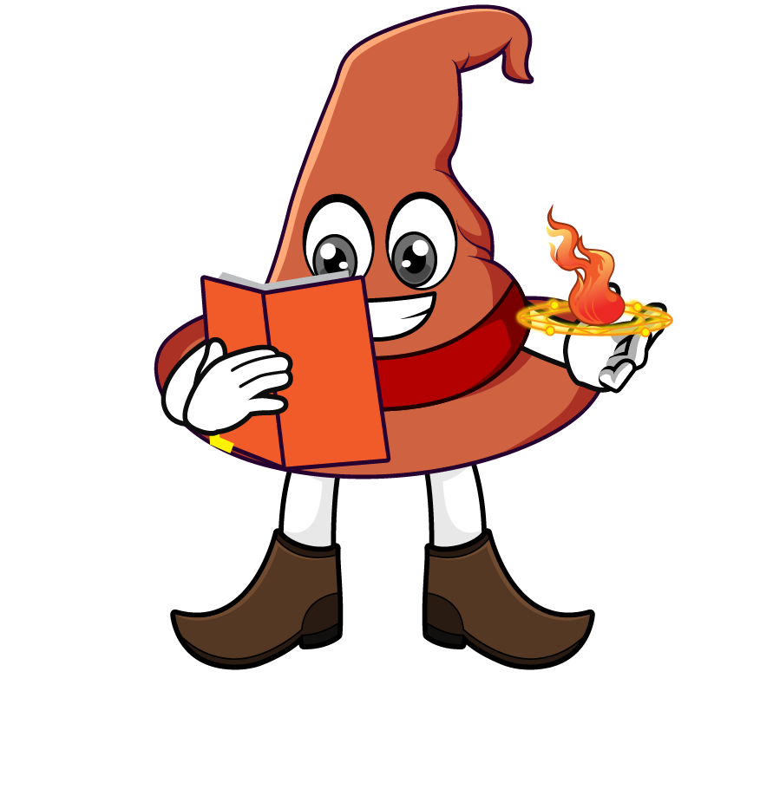

Lesson 4:
Recap: Repeated division by 10
(÷ 10 ÷ 10)
www.arithmagicians.com

Slide 2

Complete the sequence
3300
_________
÷ 10
330
_________
÷ 10
33
_________
What do you notice?

Slide 3
Are these equal? Explain why.
8000 ÷ 100
= 80
8000 ÷ 10 ÷ 10
= 80

Slide 4

Dividing by ____ is the
same as dividing by
___ and then dividing by ___ again.
100
10
10

Slide 5
10
10
1) 1900 ÷ ___ ÷ ___ = 19
100
2) 1900 ÷ ___ = 19
100
3) 7400 ÷ ____ = 74
10
10
4) 7400 ÷ ___ ÷ ___ = 74

Slide 6


Your Turn
93
1) 9300 ÷ 10 ÷ 10 =
2) 9300 ÷ 100 =
93
3) 64,000 ÷ 10 ÷ 10 =
640
4) 64,000 ÷ 100 =
640
2500
5) _____ ÷ 10 ÷ 10 = 25

Slide 7

True or False
7 = 700 ÷ 10 ÷ 10
True

