Slide 1
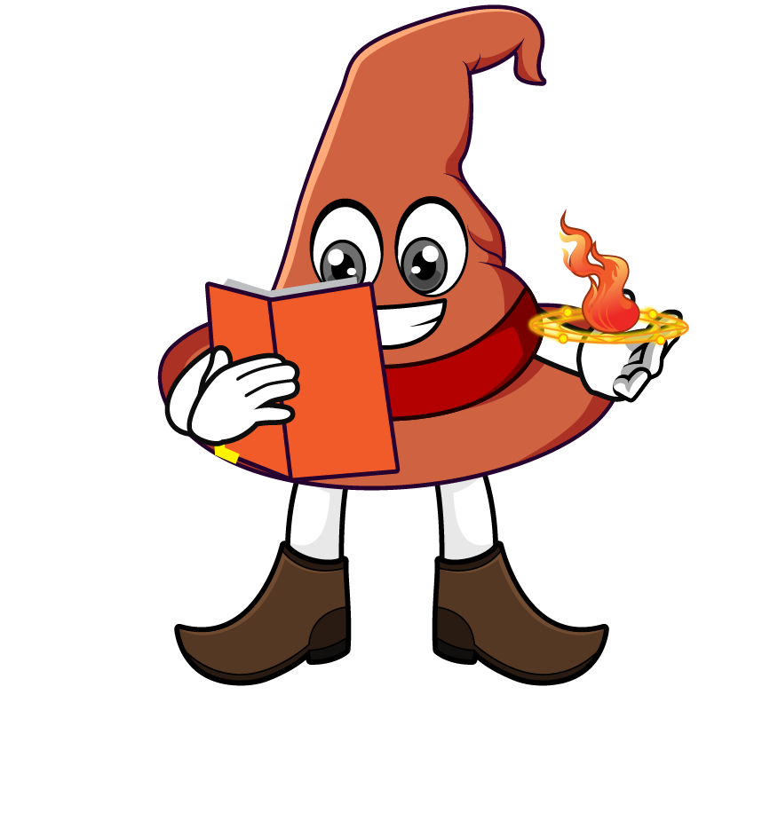

Lesson 4:
Recap: Repeated division
by 10
www.arithmagicians.com

Slide 2

Complete the sequence
450
________
÷ 10
45
_________
÷ 10
4.5
_________
What do you notice?

Slide 3

Dividing by ____ is the
same as dividing by
___ and then dividing by ___ again.
100
10
10

Slide 4
Dividing by ____ is the
same as dividing by
___ , then ___ , and then ___ again.
1000
10
10
10

Slide 5
10
10
1) 290 ÷ ___ ÷ ___ = 2.9
100
2) 290 ÷ ___ = 2.9
1000
3) 840 ÷ ____ = 0.84
10
10
10
4) 840 ÷ ___ ÷ ___ ÷ ___ = 0.84

Slide 6


Your Turn
7.3
1) 730 ÷ 10 ÷ 10 =
2) 730 ÷ 100 =
7.3
3) 64 ÷ 10 ÷ 10 ÷ 10 =
0.064
4) 64 ÷ 1000 =
0.064
550
5) _____ ÷ 10 ÷ 10 = 5.5

