Slide 1


Lesson 1:
Recap - Double numbers to 15
www.arithmagicians.com

Slide 2

🎵 Let’s Chant
Our Doubles to 10!
Double 1 is 2
Double 2 is 4
Double 3 is 6
Double 4 is 8
Double 5 is 10
Double 6 is 12
Double 7 is 14
Double 8 is 16
Double 9 is 18
Double 10 is 20

Slide 3


+
11
11
+
+
20
+
2
22

Slide 4
+
12
12
+
+
20
+
4
24

Slide 5

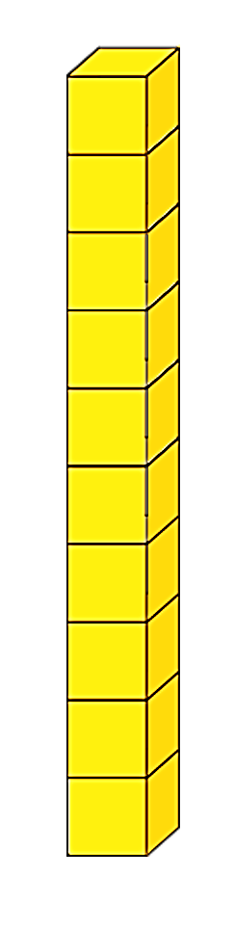
Double 14
+
= 28
8
+
20

Slide 6


Double 15
+
= 30
10
+
20

Slide 7


Your Turn
24
12 + 12 = ?
28
2) 14 + 14 = ?
22
3) 11 + 11 = ?
30
4) 15 + 15 = ?
26
5) 13 + 13 = ?

