Slide 1


Lesson 2:
Recap - Double numbers to 20
www.arithmagicians.com

Slide 2

🎵 Let’s Chant
Our Doubles!
Double 11 is 22
Double 12 is 24
Double 13 is 26
Double 14 is 28
Double 15 is 30

Slide 3
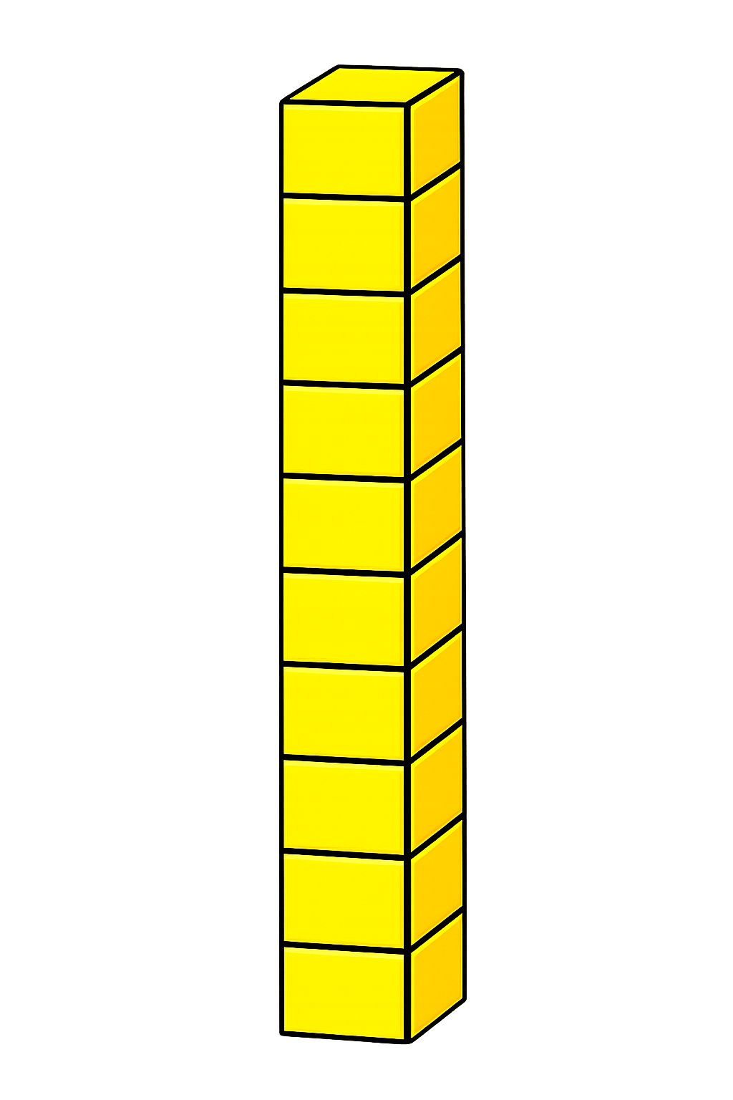

+
16
16
+
+
20
+
12
32

Slide 4

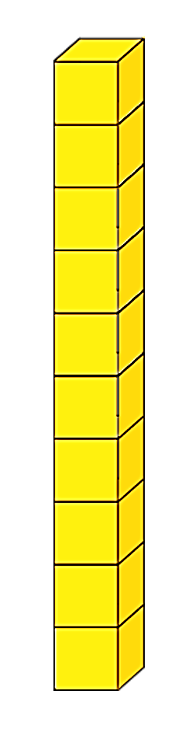
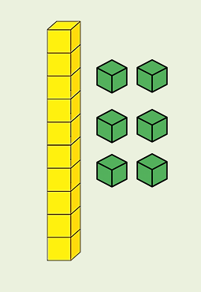
Double 18
+
= 36
16
+
20

Slide 5
+
19
19
+
+
20
+
18
38

Slide 6
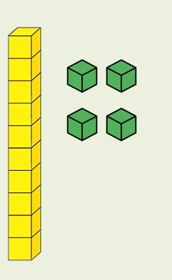
Double 17
+
= 34
14
+
20

Slide 7


Your Turn
20
Double ? = 40
16
2) Double ? = 32
18
3) Double ? = 36
4) Double ? = 34
17
19
5) Double ? = 38

