Slide 1

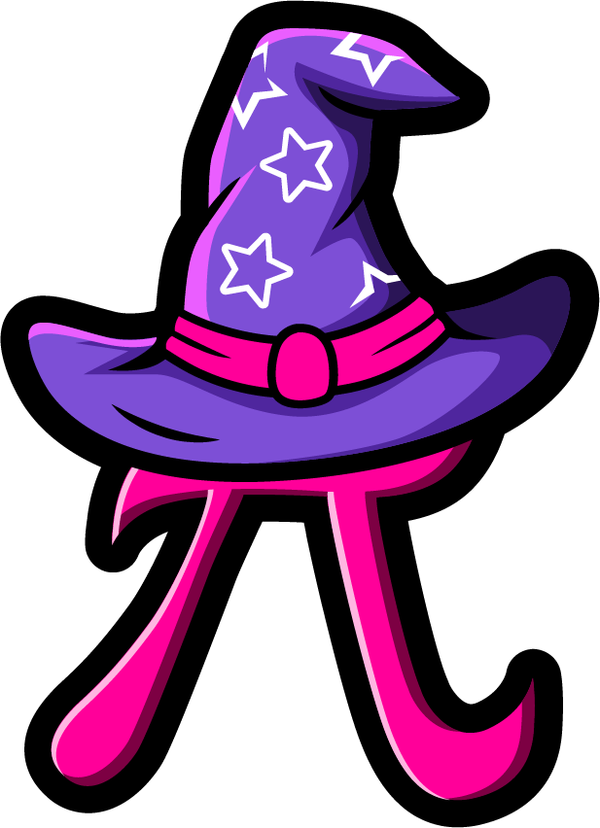
Lesson 4:
Recap: Doubles Within 20 – Word Problems
www.arithmagicians.com

Slide 2

🎵 Let’s Chant
Our Doubles!
Double 11 is 22 Double 12 is 24 Double 13 is 26 Double 14 is 28 Double 15 is 30
Double 16 is 32 Double 17 is 34 Double 18 is 36 Double 19 is 38 Double 20 is 40

Slide 3

There are 14 hats on one peg. There are 14 hats on another peg. How many hats are there altogether?
?
28
14
14

Slide 4
There are 17 books on one shelf. There are 17 books on another shelf. How many books are there altogether?
?
34
17
17

Slide 5
There are 16 shells on one beach. There are 16 shells on another beach. How many shells are there altogether?
?
32
16
16

Slide 6


Your Turn
There are 19 cars in one car park. There are 19 cars in another car park. How many cars are there altogether?
38
19
19

Slide 7
Your Turn
There are 18 ducks in one pond. There are 18 ducks in another pond. How many ducks are there altogether?
36
18
18

