Slide 1


Lesson 4:
Recap: Doubles Within 10 - Word Problems
www.arithmagicians.com

Slide 2

🎵 Let’s Chant
Our Doubles to 10!
Double 1 is 2 Double 2 is 4 Double 3 is 6 Double 4 is 8 Double 5 is 10
Double 6 is 12 Double 7 is 14 Double 8 is 16 Double 9 is 18 Double 10 is 20

Slide 3

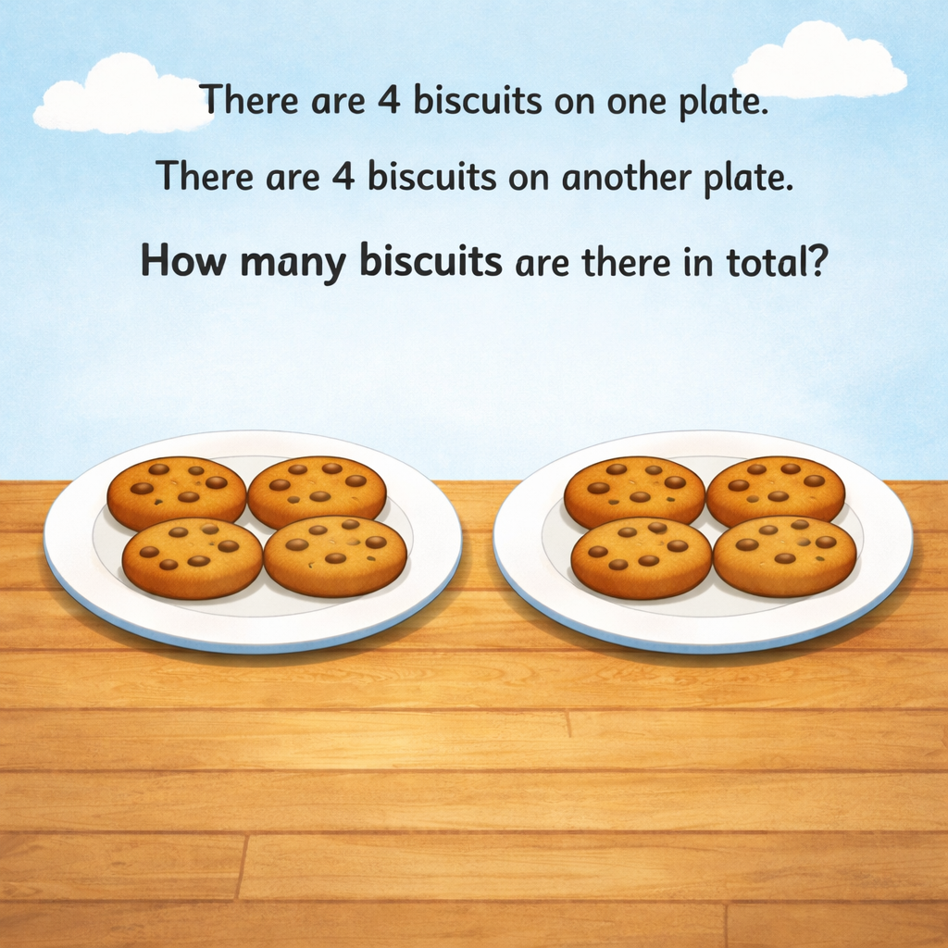
8
4
4

Slide 4
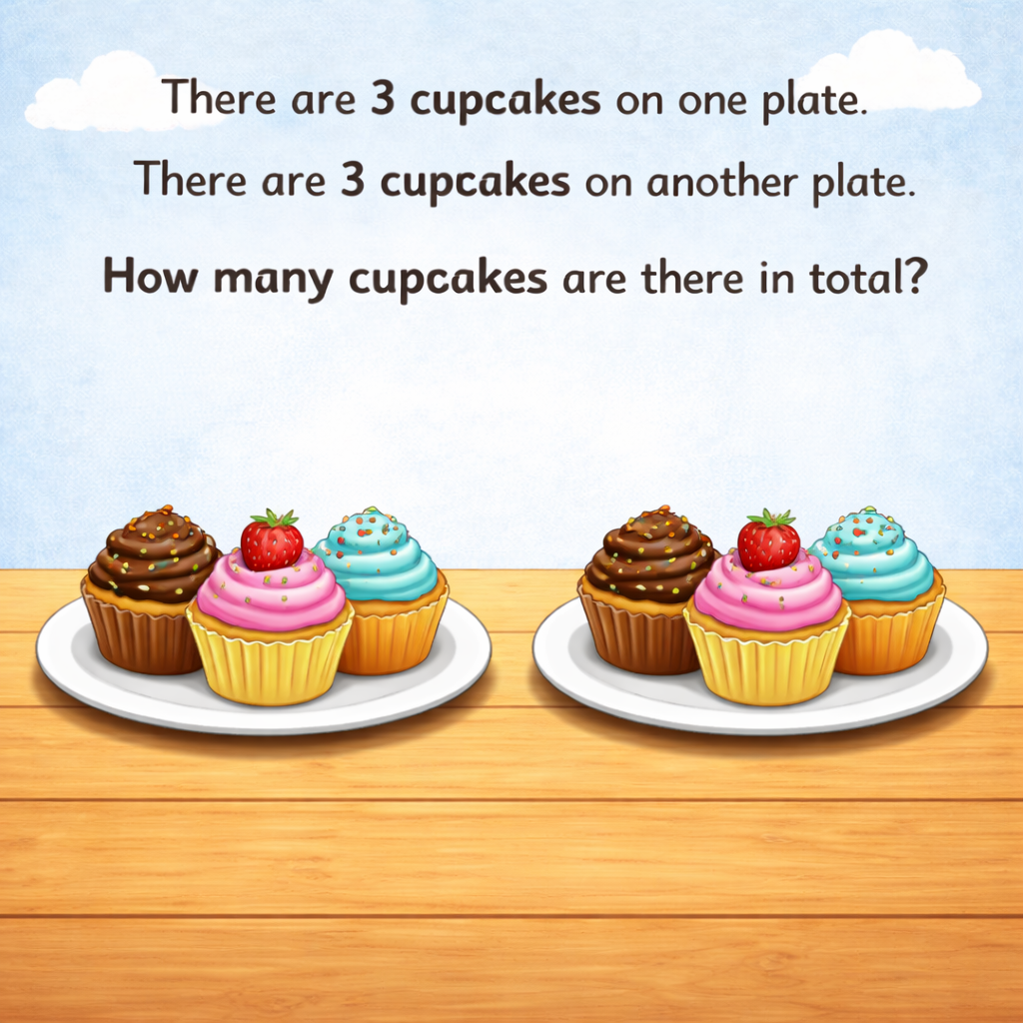
6
3
3

Slide 5
There are 5 books on one shelf. There are 5 books on another shelf. How many books are there in total?
?
10
5
5

Slide 6


Your Turn
There are 7 ladybirds on one leaf. There are 7 ladybirds on another leaf. How many ladybirds are there altogether?
14
7
7

Slide 7
Your Turn
There are 9 cars in one car park. There are 9 cars in another car park. How many cars are there in total?
18
9
9

