Slide 1
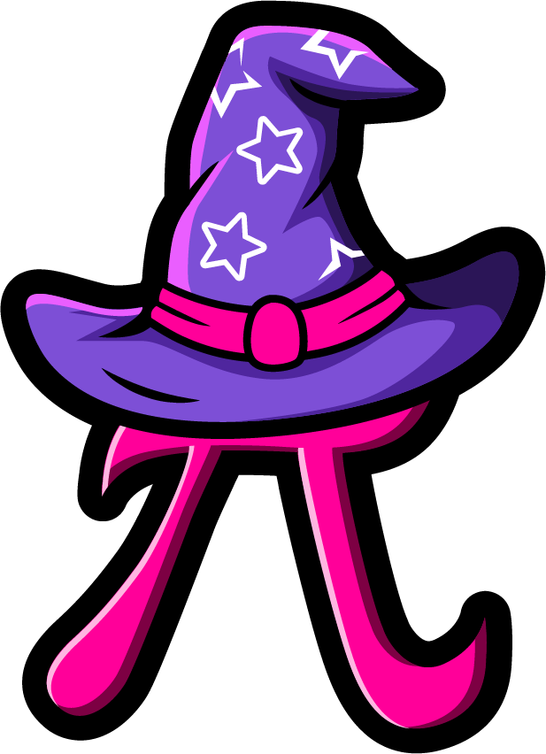
Lesson 2:
Find the missing part.
www.arithmagicians.com

Slide 2

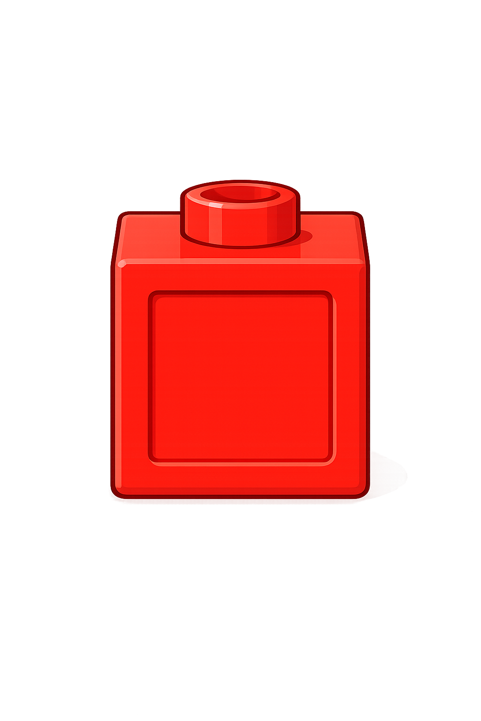

So,
? = 2
I have 5 counters
The whole is 5
3 is a part
The other part is 2
+
2
3
?
= 5
Whole
3
2
3
?

Slide 3
So,
? = 1
I have 5 counters
The whole is 5
4 is a part
The other part is 1
+
1
4
?
= 5
Whole
?
4
1
4

Slide 4


Your Turn
What is the missing part?
A
B
C
5
5
5
4
1
3
?
5
0
2
?
?

Slide 5

True or False
There are two missing parts.
One part could be 6.
5
?
?
False: Can you explain why?

