Slide 1

Week 4:
Assess & Review
www.arithmagicians.com

Slide 2



So,
? = 2
I have 5 counters
The whole is 5
3 is a part
The other part is 2
+
2
3
?
= 5
Whole
3
2
3
?

Slide 3

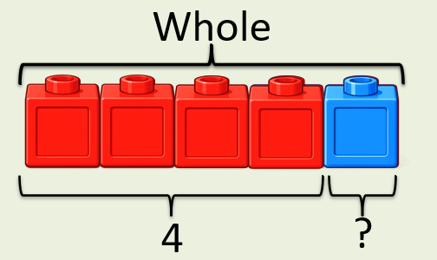
+
4
?
1
= 5
If the whole is and ___ is a part, then the other part is
5
4
1
5
4
?

Slide 4


Your Turn
What is the missing part?
+
5
0
A)
?
= 5
+
4
1
B)
?
= 5
+
3
2
?
C)
= 5
2
+
?
3
D)
= 5

