Slide 1

Lesson 3:
Recap: Find the missing part
www.arithmagicians.com

Slide 2

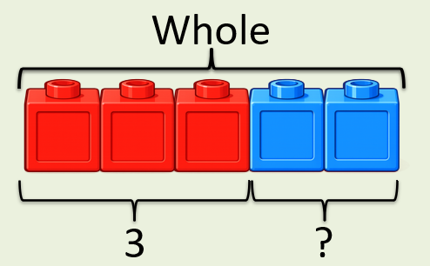
+
3
?
2
= 5
If the whole is and ___ is a part, then the other part is
5
3
2
5
3
?

Slide 3
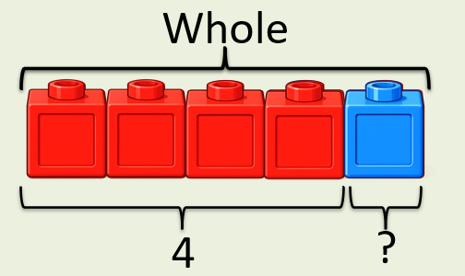
+
4
?
1
= 5
If the whole is and ___ is a part, then the other part is
5
4
1
5
4
?

Slide 4


Your Turn
What is the missing part?
+
4
1
A)
?
= 5
+
3
2
B)
?
= 5
+
5
0
?
C)
= 5
1
+
?
4
D)
= 5

Slide 5
True or False
The missing part can be 3.
+
1
?
= 5
False: Can you explain why?

