Slide 1

Lesson 4:
What's missing from 10
www.arithmagicians.com

Slide 2

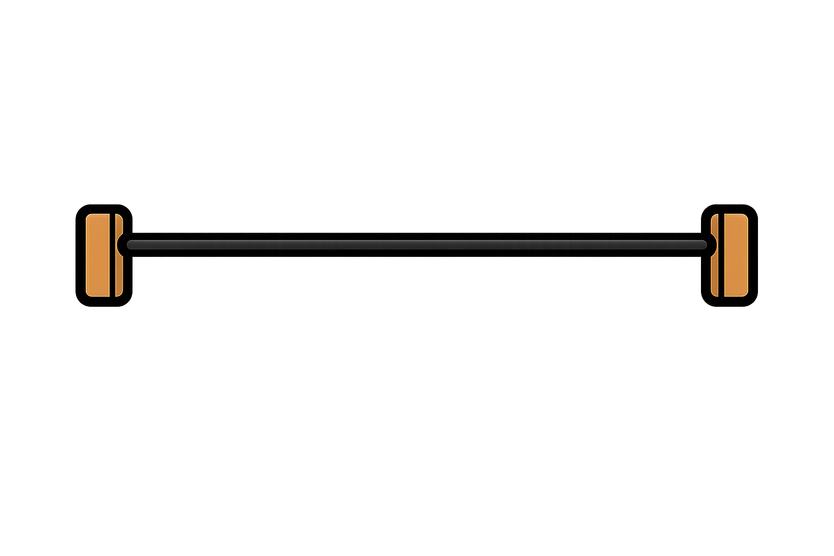
How many beads can you see?
10
I can see ___

Slide 3


There are 10 beads.
How many are missing?
10
7
3

Slide 4
There are 10 beads.
How many are missing?
10
5
5

Slide 5
There are 10 beads.
How many are missing?
10
6
4

Slide 6
There are 10 beads.
How many are missing?
10
8
2

Slide 7

