Slide 1

Week 2:
Assess & Review
www.arithmagicians.com

Slide 2

How many can you see?
10
I can see ___

Slide 3


There are 10 counters
How many counters are missing?
10
7
3
How did you know?

Slide 4
There are 10 counters
How many counters are missing?
10
9
1
How did you know?

Slide 5
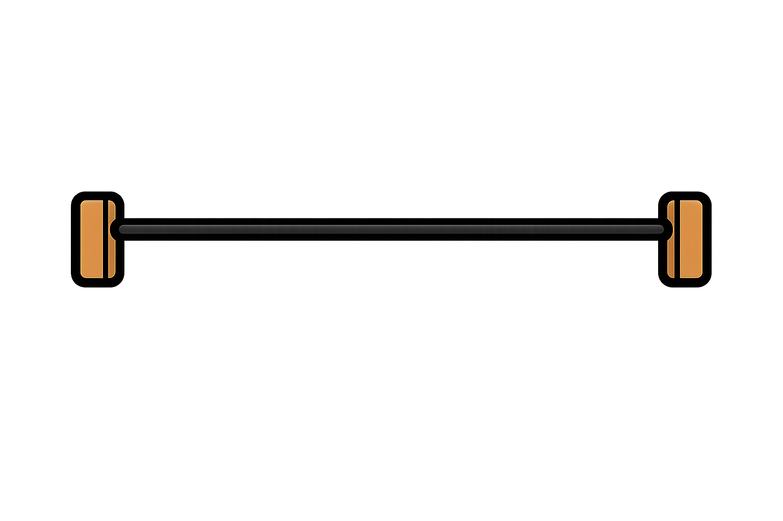
How many beads can you see?
10
I can see ___

Slide 6
There are 10 beads.
How many are missing?
10
5
5

Slide 7
There are 10 beads.
How many are missing?
10
6
4

Slide 8

