Slide 1

Lesson 1:
Part whole models
www.arithmagicians.com

Slide 2

There are ___ red counters.
There are ___ yellow counters.
There are ___ counters altogether
8
2
10

Slide 3
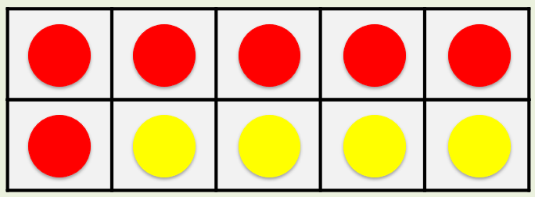
is a part.
?
6
10
is a part.
?
4
6
4
10
is the whole.
?
6 + 4 = 10

Slide 4


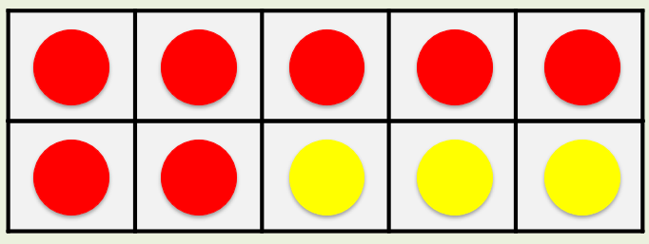
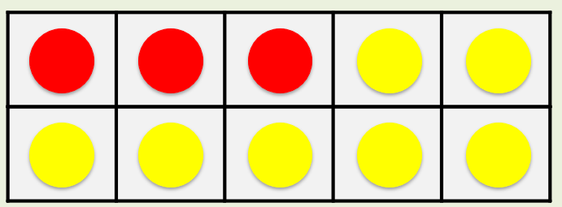
Complete the part-whole
models to match the counters.
10
10
7
3
3
7

Slide 5
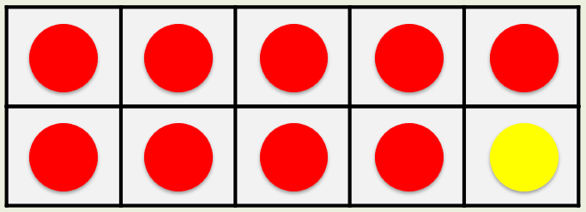
Complete the
addition sentences.
+
10
9
1
=
+
10
1
9
=

Slide 6
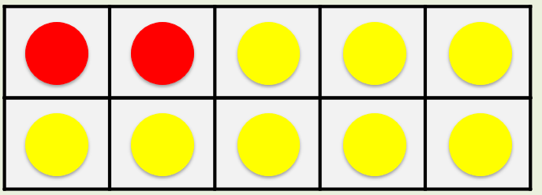
Your Turn
Complete the part-whole
models to match the counters
10
10
2
8
10
+
=
8
2
2
8
+
10
8
2
=

Slide 7
True or False
6 + 4 is the same as 4 + 6
True

