Slide 1

Lesson 2:
Part whole models
www.arithmagicians.com

Slide 2

There are ___ red counters.
There is ___ yellow counter.
There are ___ counters altogether.
6
4
10

Slide 3
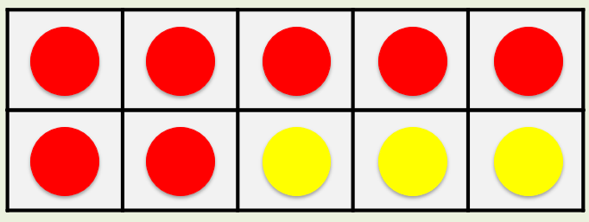
is a part.
7
?
10
is a part.
3
?
7
3
10
is the whole.
?
7 + 3 = 10

Slide 4


Your Turn
The whole is 10
Complete the part-whole models in different ways
2
10
10
10
6
4
9
1
8

Slide 5
True or False
The part-whole model is correct.
False
9
10
1

