Slide 1

Lesson 3:
Write number sentences
www.arithmagicians.com

Slide 2

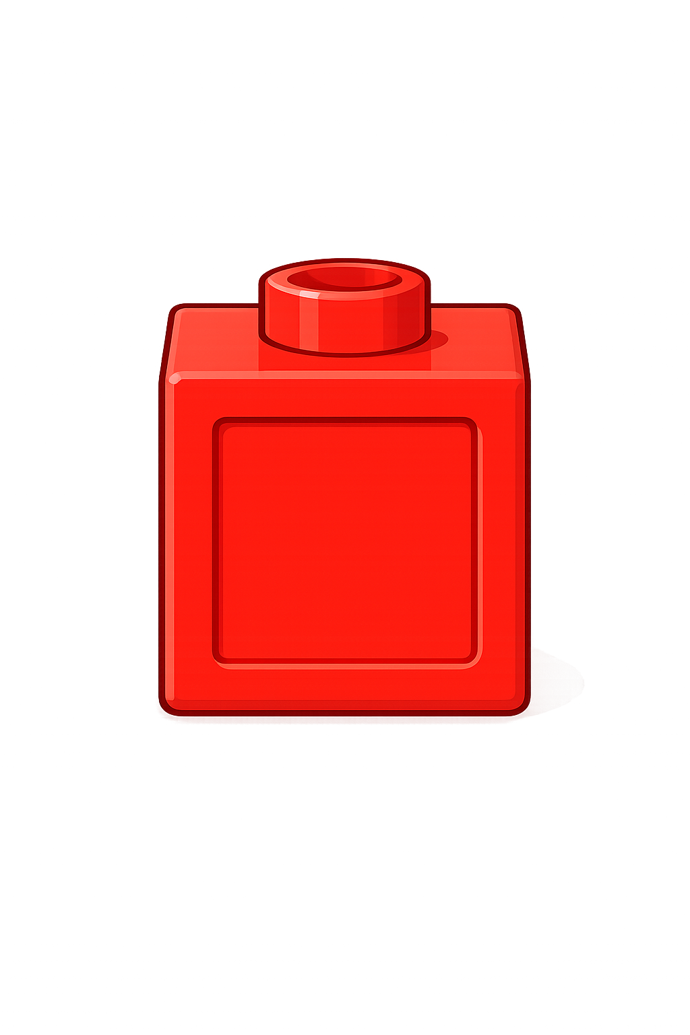
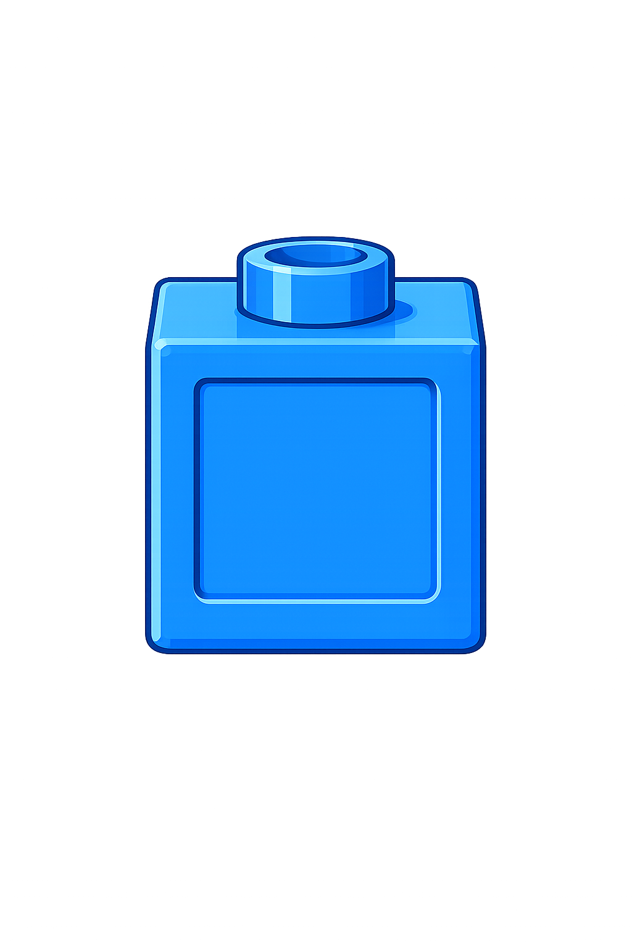
Whole
Part
Part
+
=
6
4
10
+
=
4
6
10

Slide 3

Whole
Part
Part
+
=
8
2
10
+
=
2
8
10

Slide 4


Your Turn
Whole
Part
Part
+
=
3
7
10
+
=
7
3
10

Slide 5
Your Turn
Whole
Part
Part
+
=
9
1
10
+
=
1
9
10

Slide 6
True or False
The part-whole model is correct.
+
=
False
3
10
7

