Slide 1

Lesson 4:
Write number sentences
www.arithmagicians.com

Slide 2

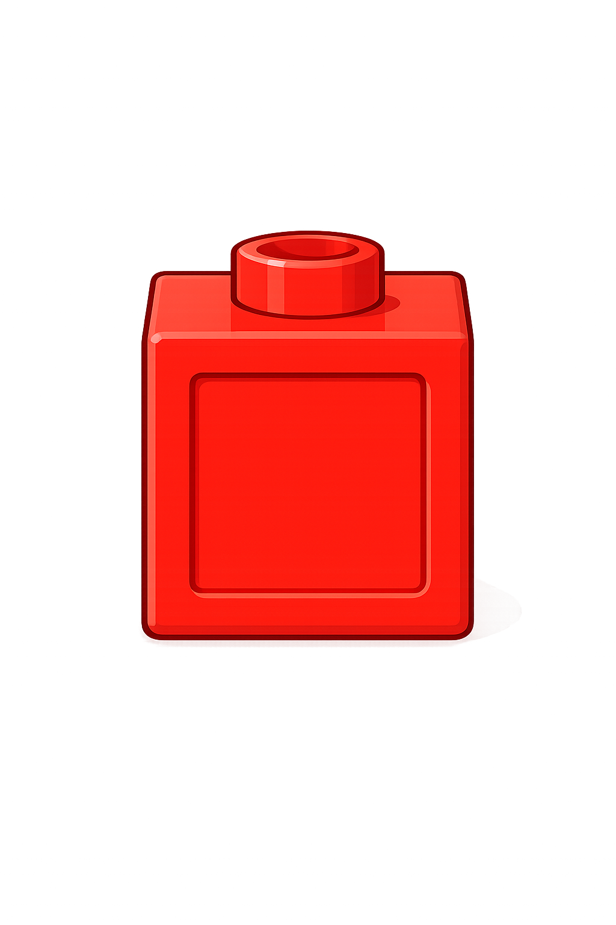
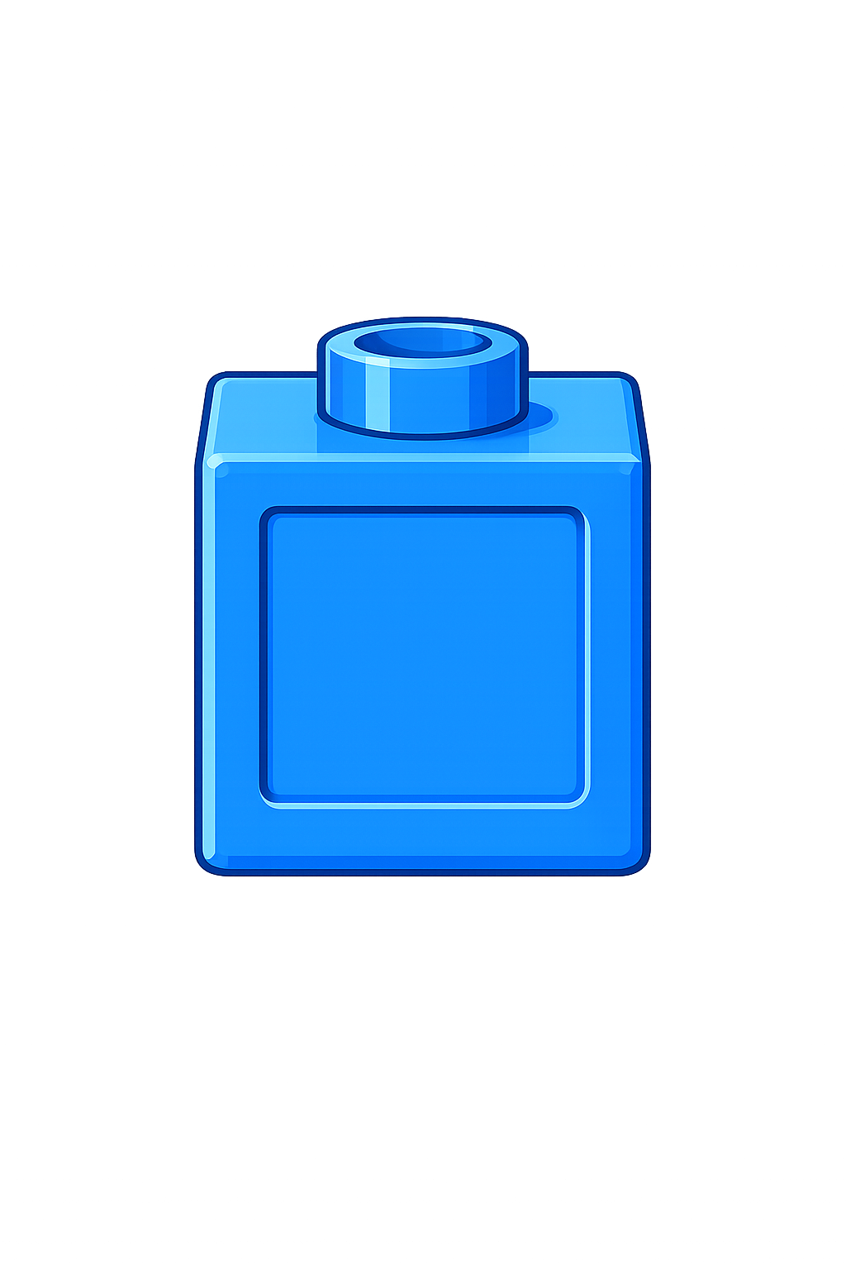
Whole
Part
Part
+
=
6
4
10
+
=
4
6
10

Slide 3


Your Turn
Find different ways of making 10
+
=
+
=
1
9
10
4
6
10
10
+
=
+
=
2
8
10
5
5
+
=
+
=
3
7
10
10
0
10

Slide 4

True or False
=
+
10
7
3
The part-whole model is correct.
True

