Slide 1

Week 3:
Assess & Review
www.arithmagicians.com

Slide 2

There are ___ red counters.
There are ___ yellow counters.
There are ___ counters altogether
8
2
10

Slide 3
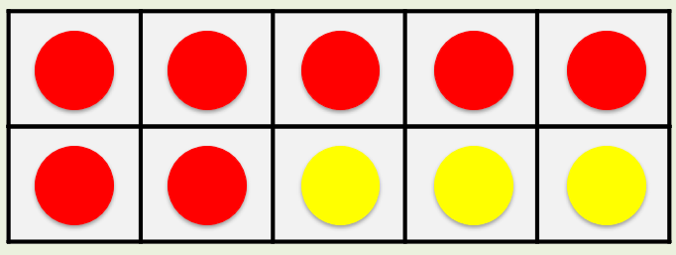
is a part.
7
?
10
is a part.
3
?
7
3
10
is the whole.
?
7 + 3 = 10

Slide 4


Your Turn
The whole is 10
Complete the part-whole models in different ways.
10
10
10
1
9
2
8
0
10
10
10
10
3
7
4
6
5
5

Slide 5
True or False
The part-whole model is correct.
False
9
1
10

