Slide 1
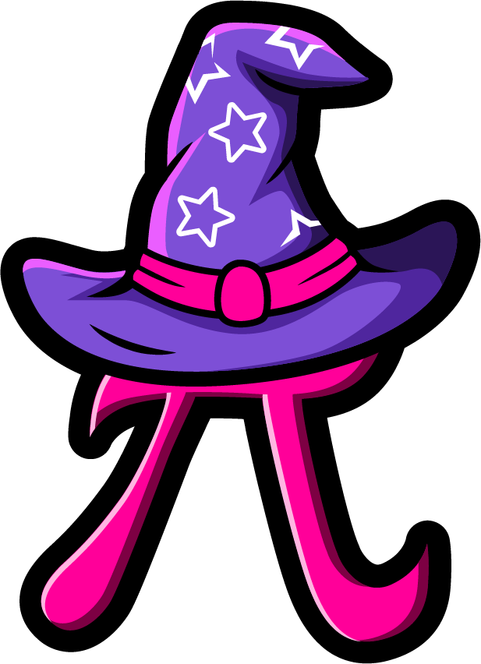
Lesson 2:
Find the missing part.
www.arithmagicians.com

Slide 2

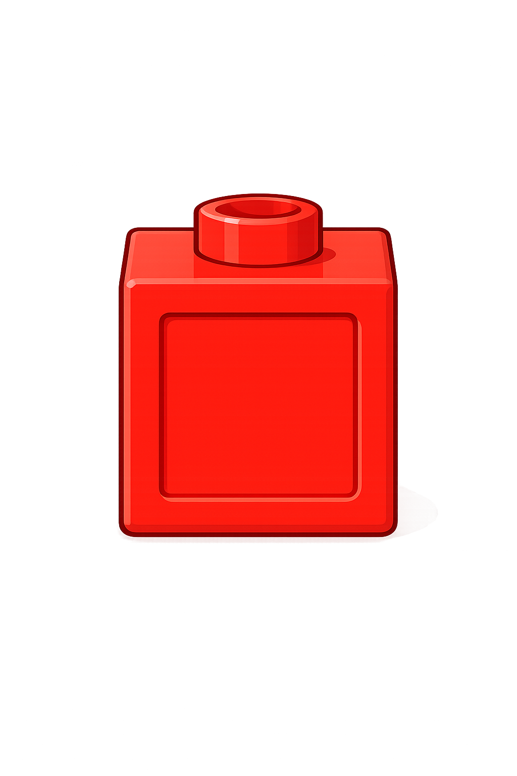
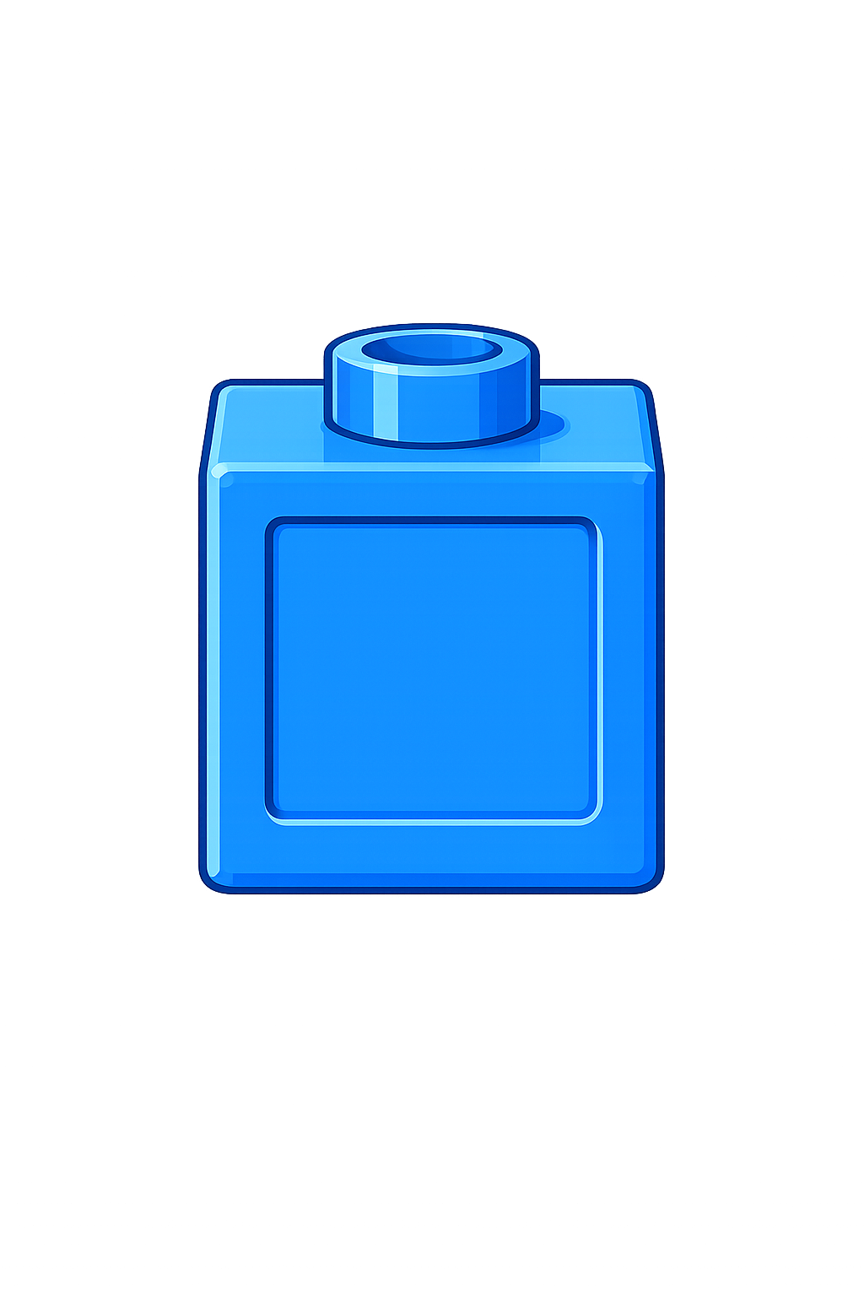

So,
? = 7
The whole is 10
3 is a part
The other part is 7
+
3
?
7
= 10
Whole
3
?

Slide 3

So,
? = 4
The whole is 10
6 is a part
The other part is 4
4
?
+
6
= 10
Whole
6
?

Slide 4


Your Turn
What is the missing part?
A
B
C
10
10
10
2
8
3
?
4
6
7
?
?

Slide 5

True or False
There are two missing parts.
One part could be 11.
10
?
?
False: Can you explain why?

