Slide 1
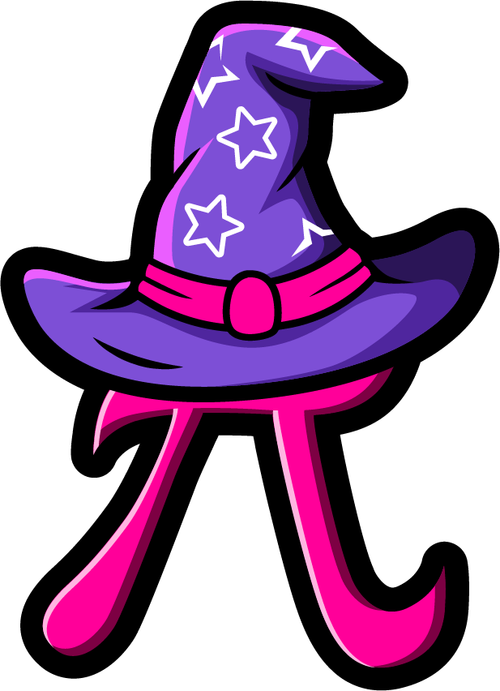
Lesson 3:
Find the missing part.
www.arithmagicians.com

Slide 2


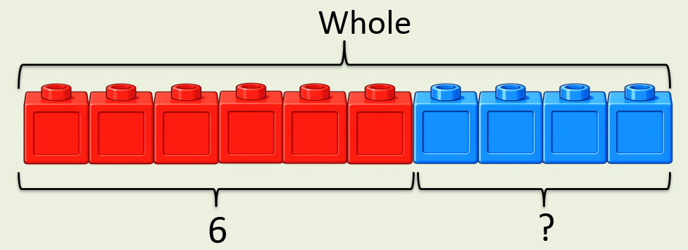
+
4
?
6
= 10
If the whole is ____ and ___ is a part, then the other part is
10
6
4
10
6
?

Slide 3
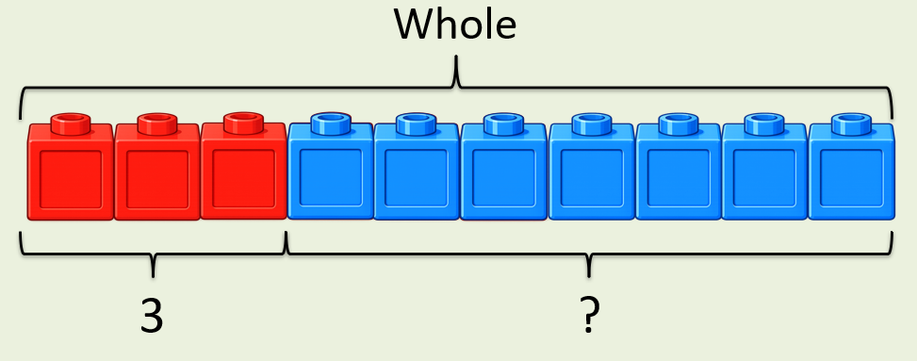
+
3
?
7
= 10
If the whole is ____ and ___ is a part, then the other part is
10
3
7
10
3
?

Slide 4


Your Turn
What is the missing part?
+
1
?
A)
9
= 10
+
2
?
B)
8
= 10
+
5
?
C)
5
= 10
0
+
= 10
?
D)
10

Slide 5
True or False
The missing part can be 3.
+
8
?
= 10
False: Can you explain why?

