Slide 1
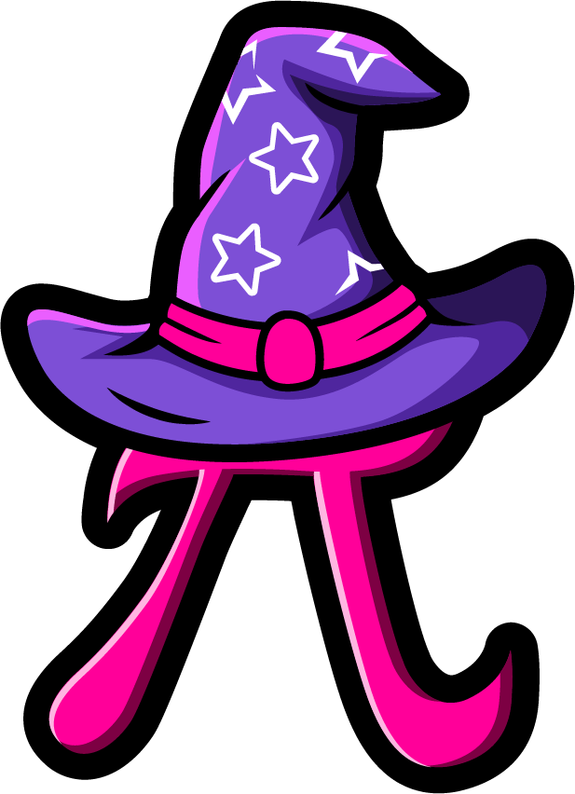
Lesson 4:
Find the missing part.
www.arithmagicians.com

Slide 2

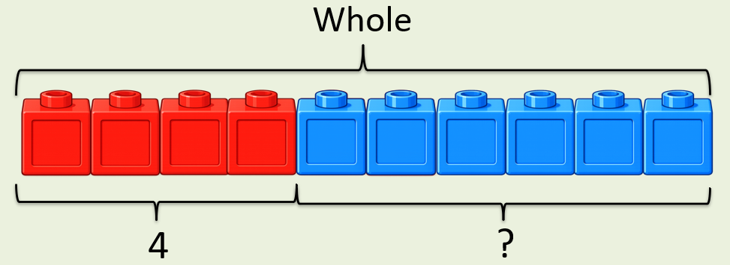
?
+
4
= 10
6
If the whole is ____ and ___ is a part, then the other part is
10
4
6
10
4
?

Slide 3
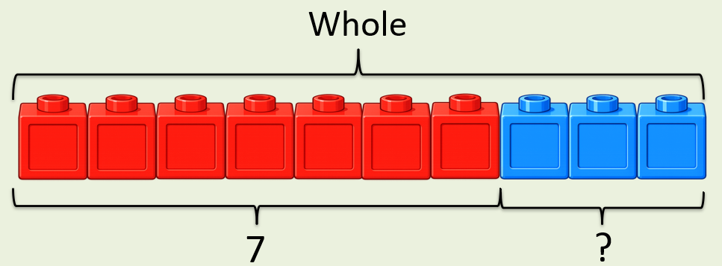
+
?
7
3
= 10
If the whole is ____ and ___ is a part, then the other part is
10
7
3
10
7
?

Slide 4


Your Turn
What is the missing part?
+
8
2
A)
?
= 10
6
4
+
?
B)
= 10
+
7
3
?
C)
= 10
9
+
?
= 10
D)
1

Slide 5
True or False
The missing part is 10.
+
10
?
= 10
False: Can you explain why?

