Slide 1

Week 4:
Assess & Review
www.arithmagicians.com

Slide 2




So,
? = 7
The whole is 10
3 is a part
The other part is 7
+
3
?
7
= 10
Whole
3
?

Slide 3

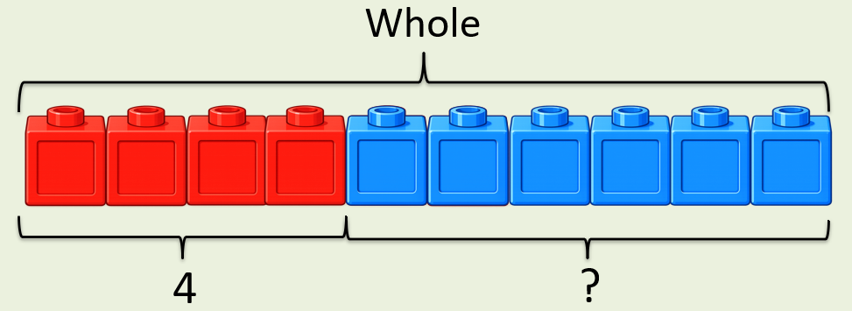
?
+
4
= 10
6
If the whole is ____ and ___ is a part, then the other part is
10
4
6
10
4
?

Slide 4


Your Turn
What is the missing part?
+
10
0
?
A)
= 10
+
5
= 10
5
B)
?
+
9
= 10
1
C)
?
2
+
= 10
?
D)
8

