Slide 1

Lesson 1:
Subtract from 10
www.arithmagicians.com

Slide 2

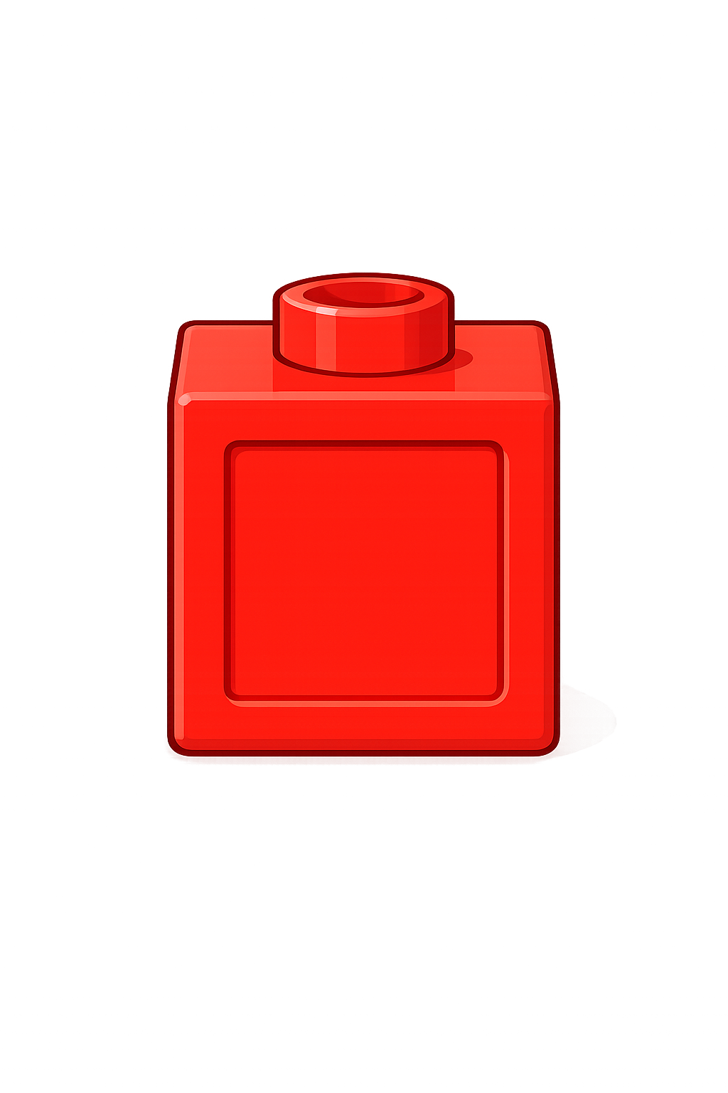
10
-
2
=
8
?

Slide 3
10
-
4
=
6
?

Slide 4
10
-
7
=
?
3

Slide 5


Your Turn
7
-
= ?
10
A)
3
5
-
= ?
10
B)
5
= ?
-
2
10
C)
8
= ?
-
10
10
D)
0

Slide 6

Always / Sometimes / Never
If you start with 10 and subtract a number, the answer is always less than 10.
Sometimes

