Slide 1

Lesson 2
Subtract from 10
www.arithmagicians.com

Slide 2

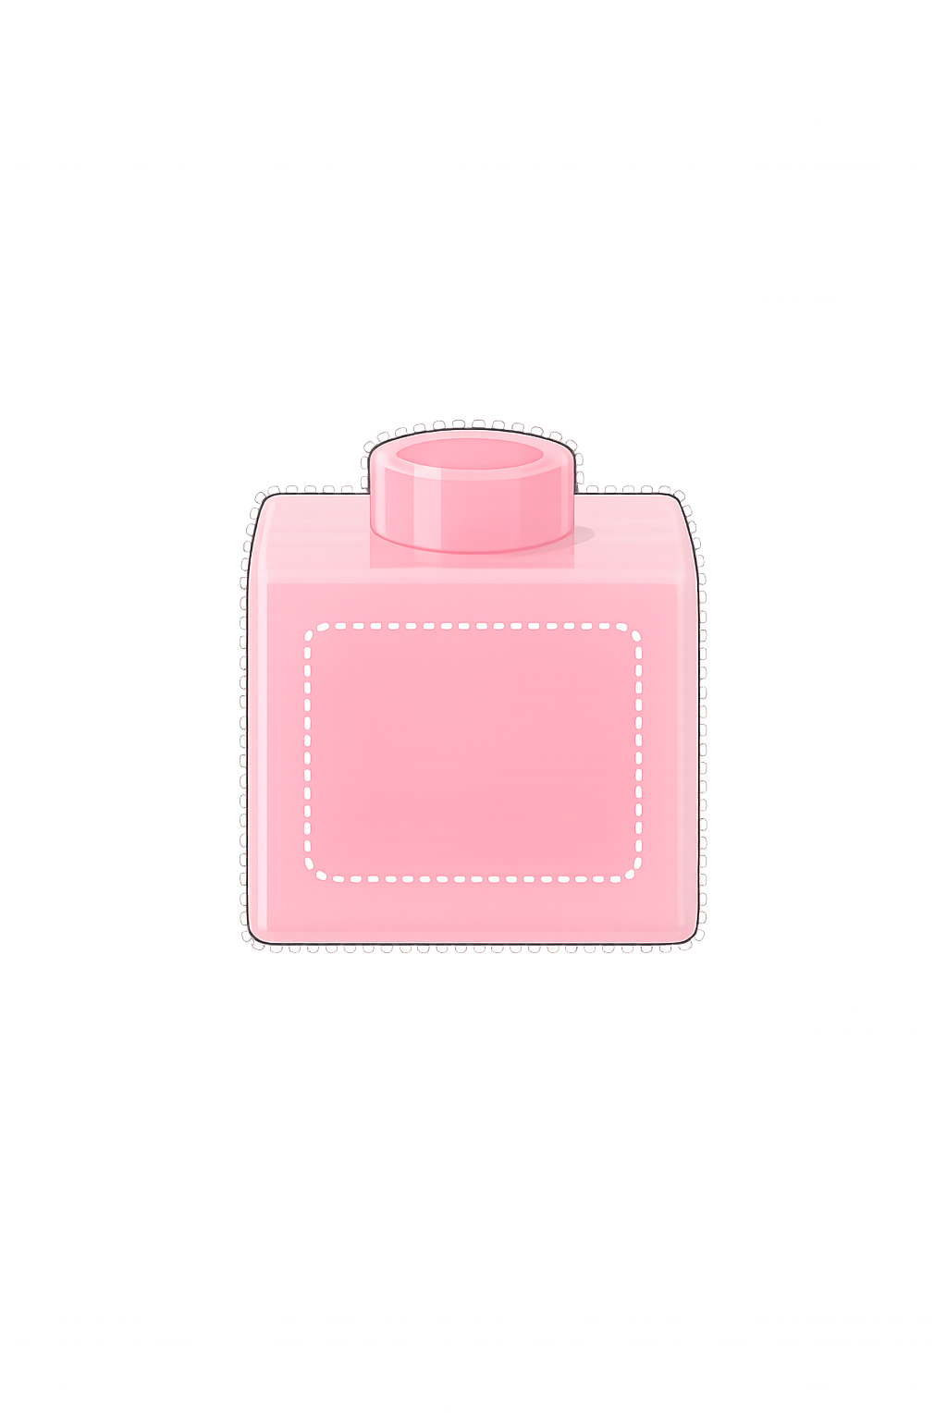
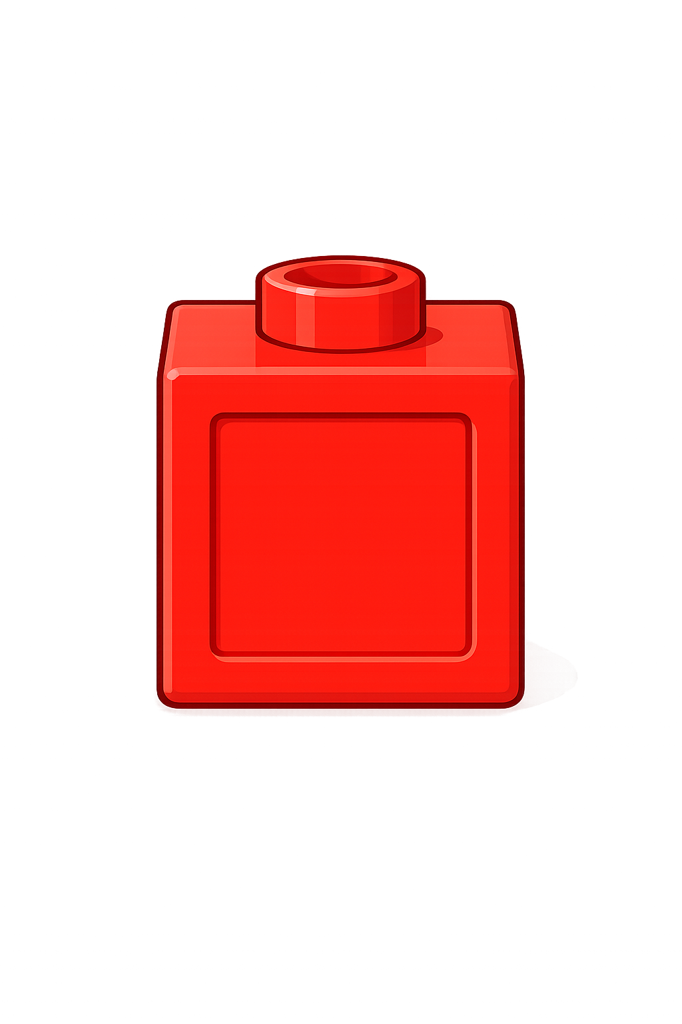

10
-
?
=
8
2
Whole
8
?
8
+
2
=
10
?

Slide 3


10
-
?
=
6
4
Whole
6
?
6
+
4
=
10
?

Slide 4
What do you notice?
What is the same and what is different?
10
-
?
=
8
2
10
-
?
=
6
4
8
+
2
=
10
6
+
4
=
?
?
10

Slide 5


Your Turn
-
8
10
?
A)
= 2
-
6
= 4
10
B)
?
-
7
= 3
10
C)
?
-
10
= 0
10
D)
?

Slide 6
True or False
The missing part is 10.
-
10
?
= 10
False: Can you explain why?

