Slide 1

Lesson 3:
Subtract from 10
www.arithmagicians.com

Slide 2

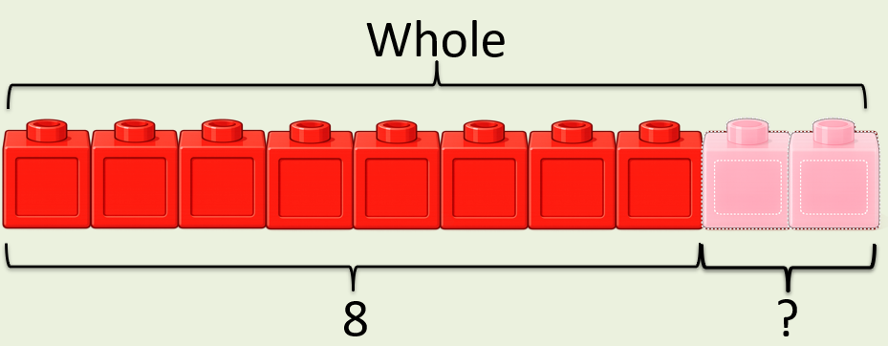
10
-
?
=
8
2
10
8
?

Slide 3
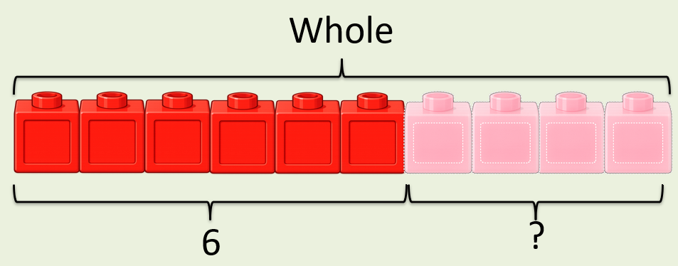
10
-
4
?
=
6
10
6
?

Slide 4


Your Turn
-
6
10
= 4
A)
?
-
7
= 3
10
B)
?
-
10
= 0
10
C)
?
-
8
= 2
10
D)
?

Slide 5
True or False
If
10
-
?
=
3
?
Then
3
+
?
=
?
10
True

