Slide 1
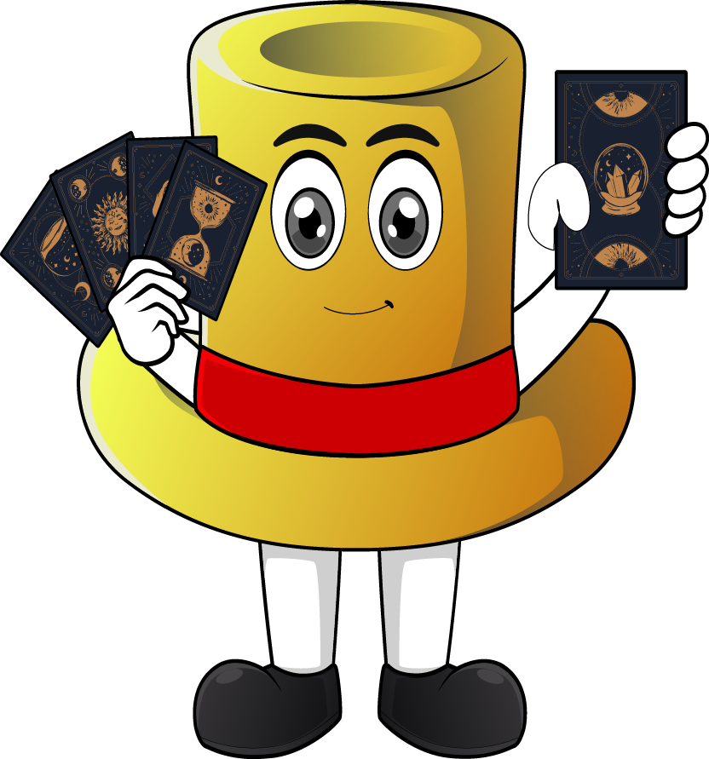

Lesson 4:
x 8 Missing numbers
www.arithmagicians.com

Slide 2

+8
+8
+8
+8
+8
+8
+8
+8
+8
+8
0
8
16
24
32
40
48
56
64
72
80
Get ready to count up in 8s

Slide 3
-8
-8
-8
-8
-8
-8
-8
-8
-8
8
16
24
32
40
48
56
64
72
80
Get ready to count back in 8s

Slide 4


Recap
2
1) 8 x ? = 16
8
2) ? x 5 = 40
3
3) ? x 8 = 24
8
4) ? x 8 = 64

Slide 5
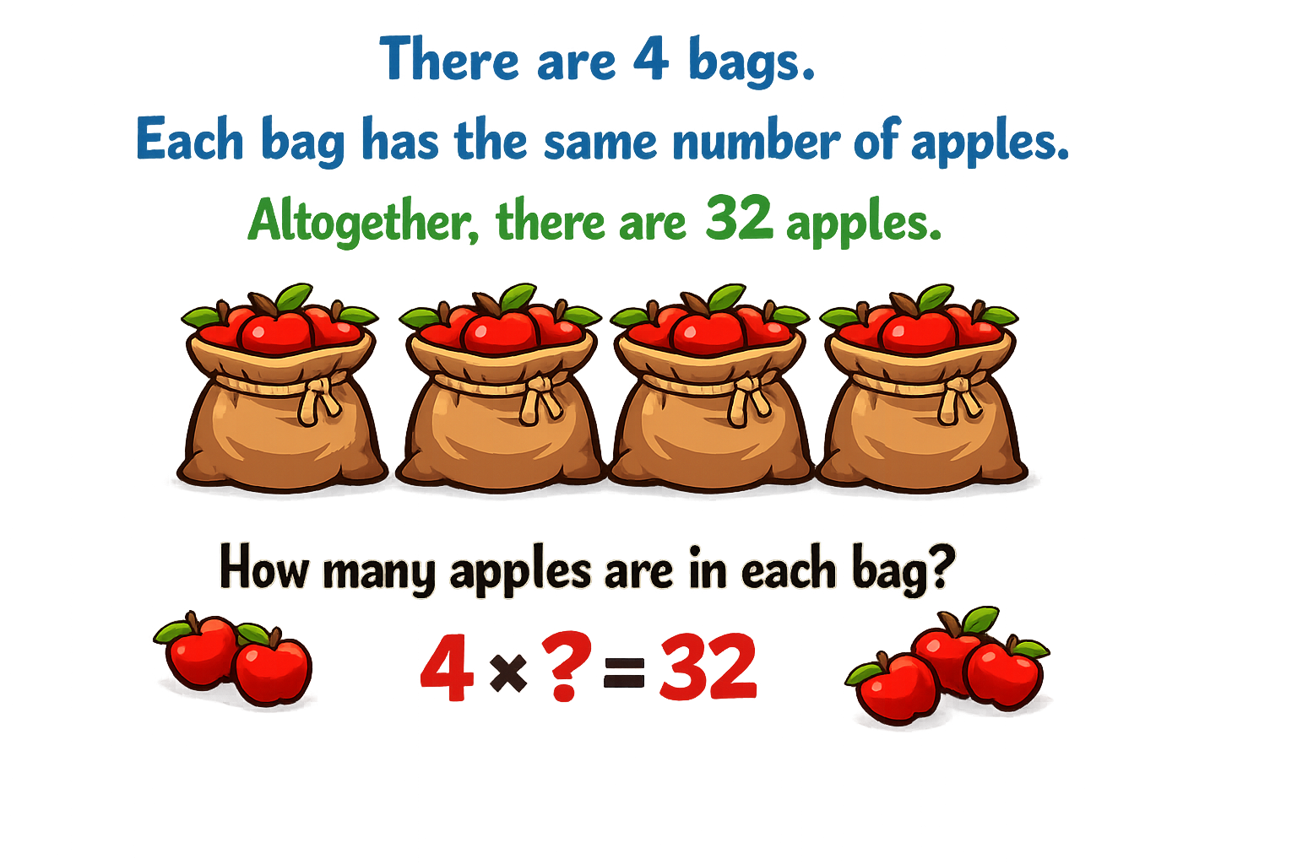
Your Turn
8
8
8
8

Slide 6
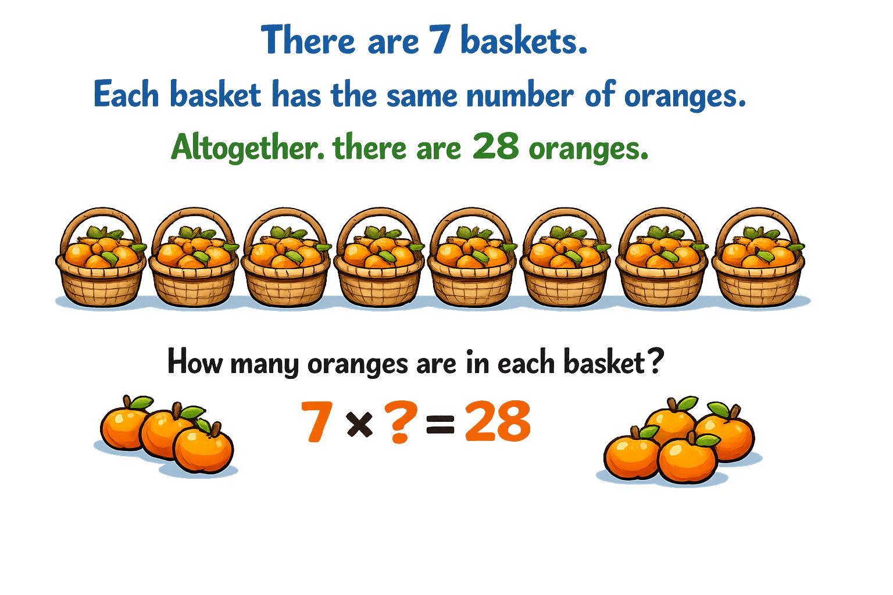
Your Turn
There are 8 baskets.
Each basket has the same number of oranges. Altogether, there are 64 oranges.
8
8
8
8
8
8
8
8
How many oranges are in each basket?
8 x ? = 64

Slide 7


True or False
8 x 11 = 8 x 10 + 10
False: What mistake did Novice make?

