Slide 1

Lesson 1:
Add 1 to any number
www.arithmagicians.com

Slide 2

+1
+1
+1
+1
+1
+1
+1
+1
+1
+1
0
1
2
3
4
5
6
7
8
9
10
Get ready to count up in 1s

Slide 3

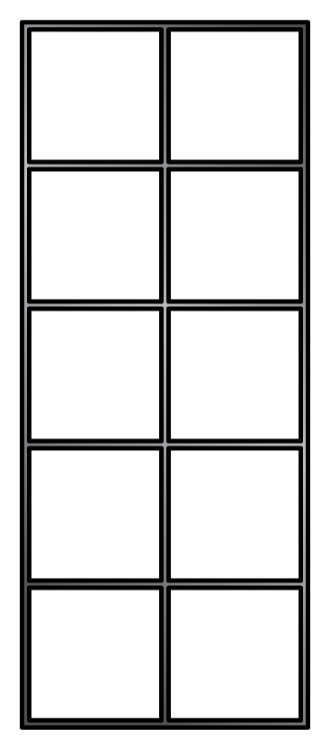
7
+
1
=
8

Slide 4
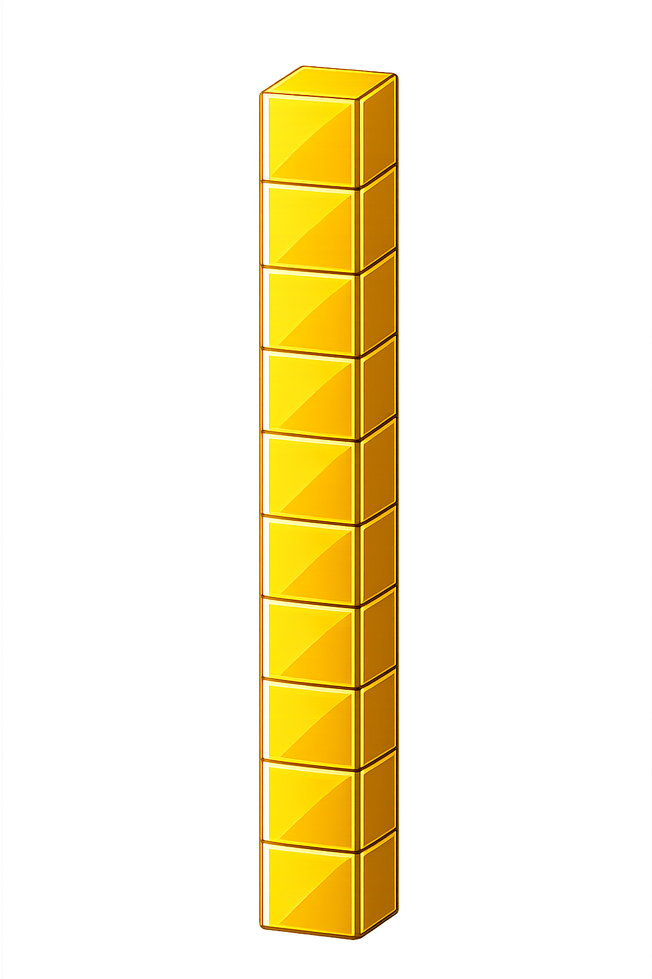

What number is shown below?
25
26
+ 1 = ?

Slide 5
What number is shown below?
33
34
+ 1 = ?

Slide 6

60
61
62
63
64
?
66
67
68
69
70
65
64
+
1
=
65

Slide 7


Your Turn
26 + 1 = ?
27
38
2) 37 + 1 = ?
19
3) 18 + 1 = ?
85
4) 84 + 1 = ?
5) 50 + 1 = ?
51

Slide 8

Always, Sometimes or Never
When you add 1 to any number, the answer is the next number on the number line.
Always

