Slide 1
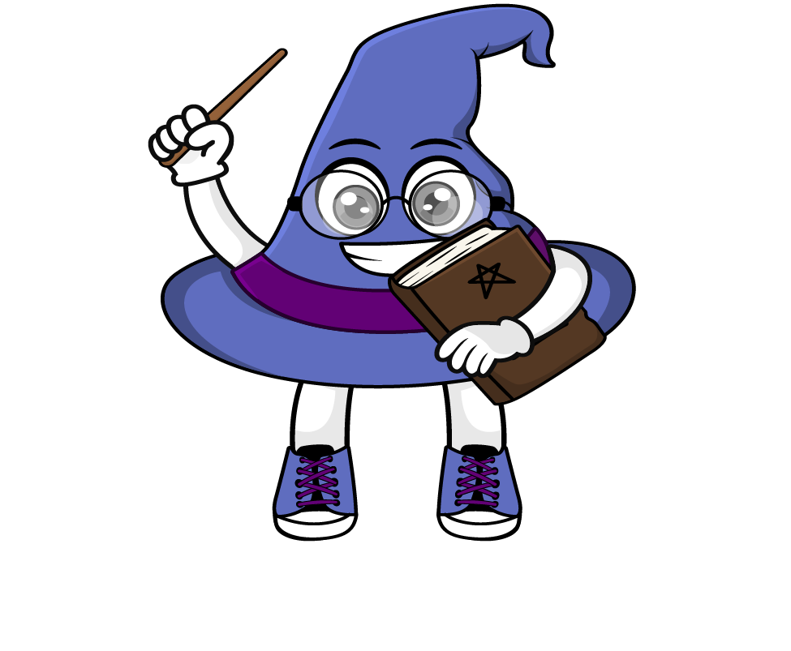
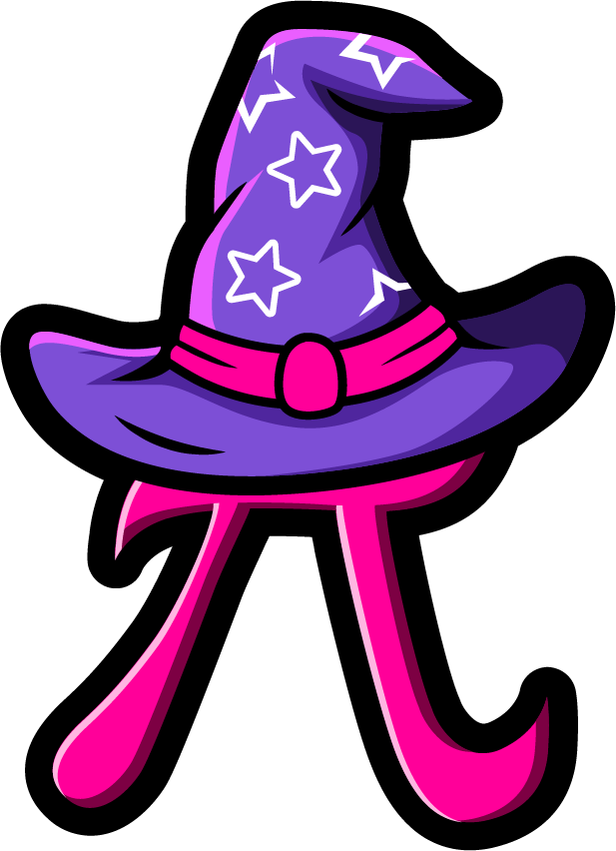
Lesson 1:
To understand what metric measures are and when we use them.
www.arithmagicians.com

Slide 2

Metric measures are standard
units we use to measure things.
They help us answer questions like:
How long? → length
How heavy? → mass / weight
How much liquid? → capacity

Slide 3
Why is it called “metric”?
The metric system uses multiples of 10.
For example:
10 mm = 1 cm
100 cm = 1 m
1000 m = 1 km
This makes converting easy.

Slide 4

Match the measure to its definition.
A
1) The maximum amount that a container can hold.
Length
B
Capacity
2) The amount of stuff (called matter) inside an object or substance.
C
3) The distance from one end of something to the other.
Mass

Slide 5
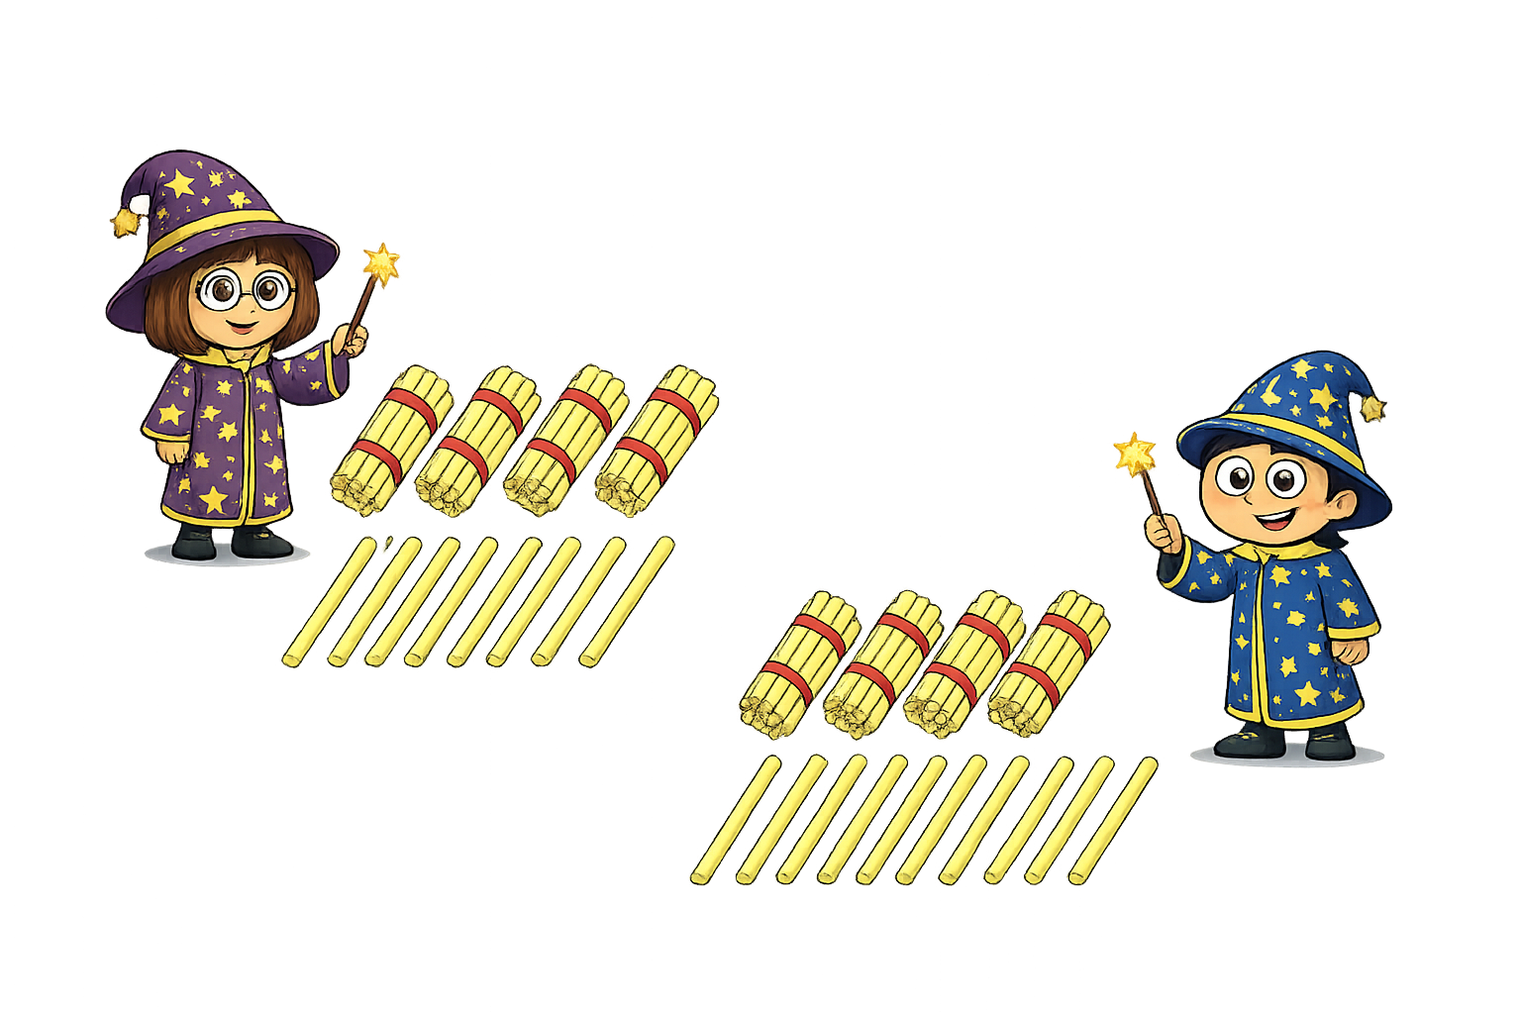
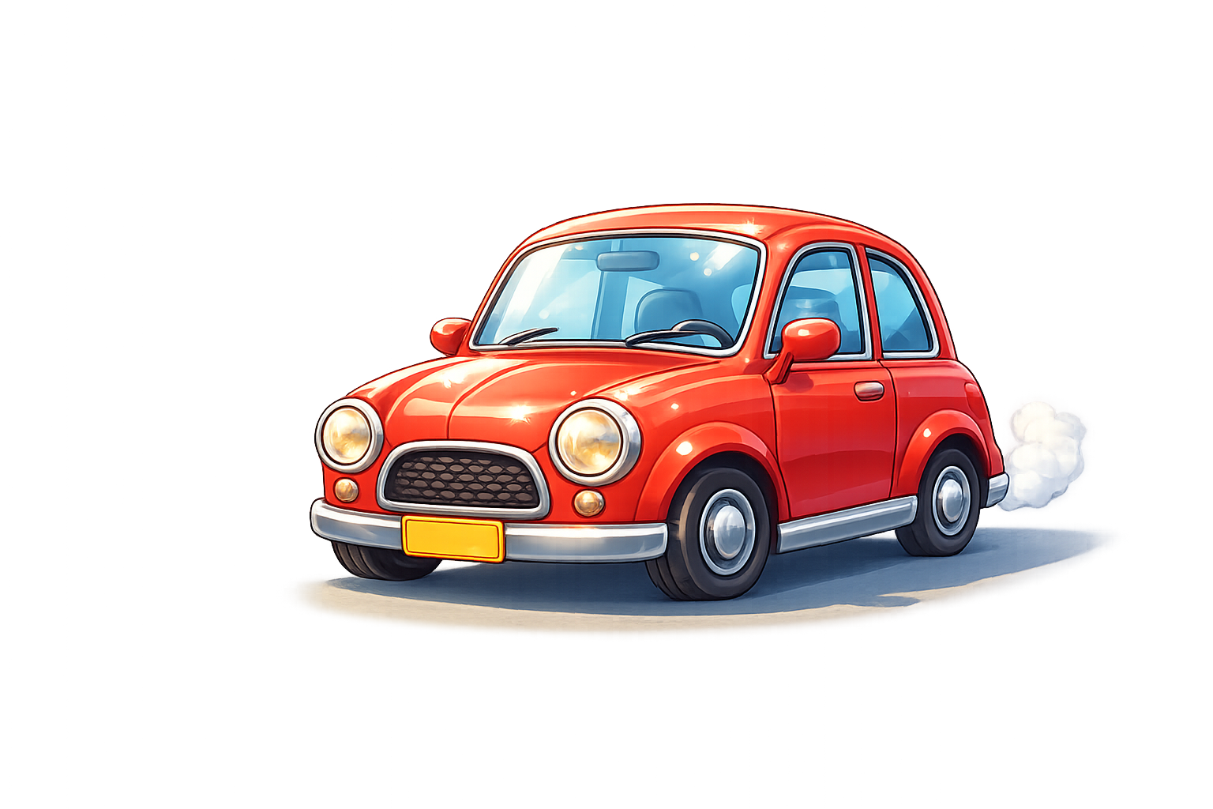
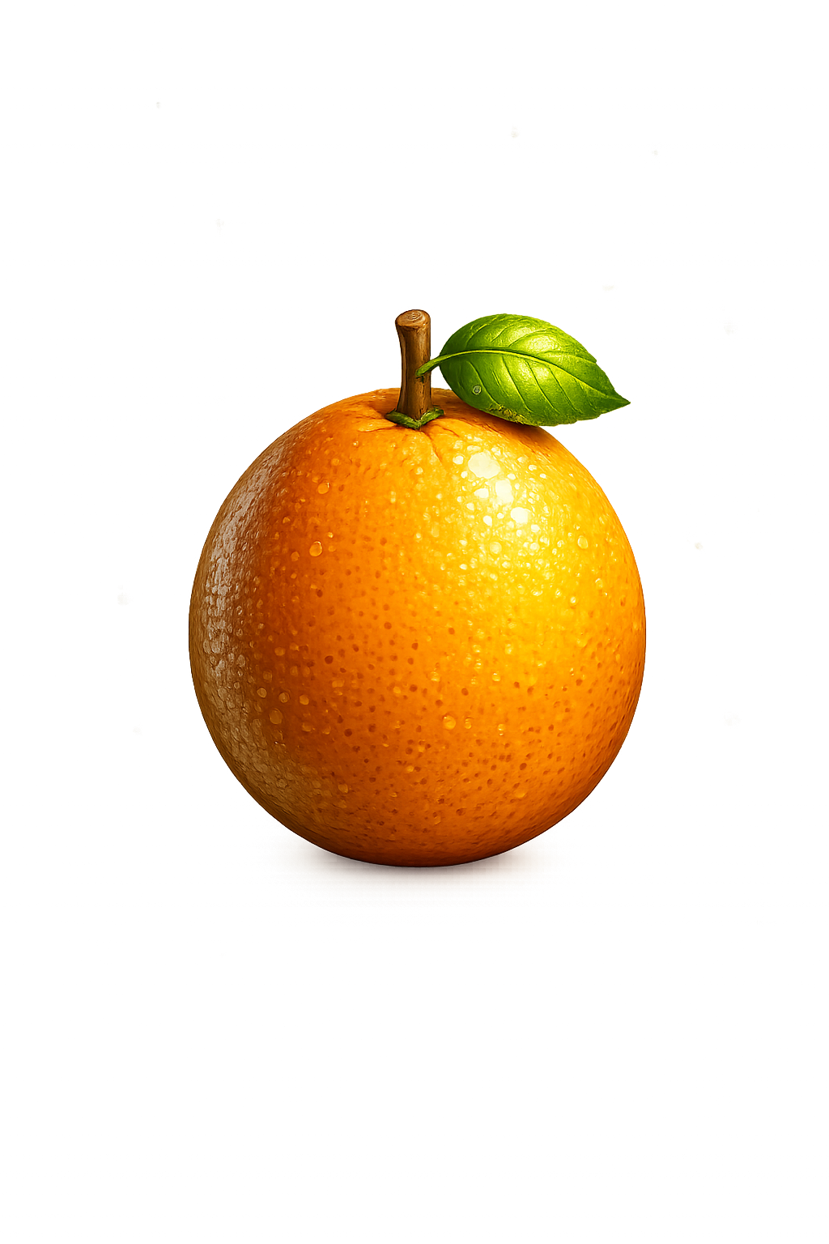

What is the most appropriate unit to measure the mass of each object?
g
tonne
kg

Slide 6

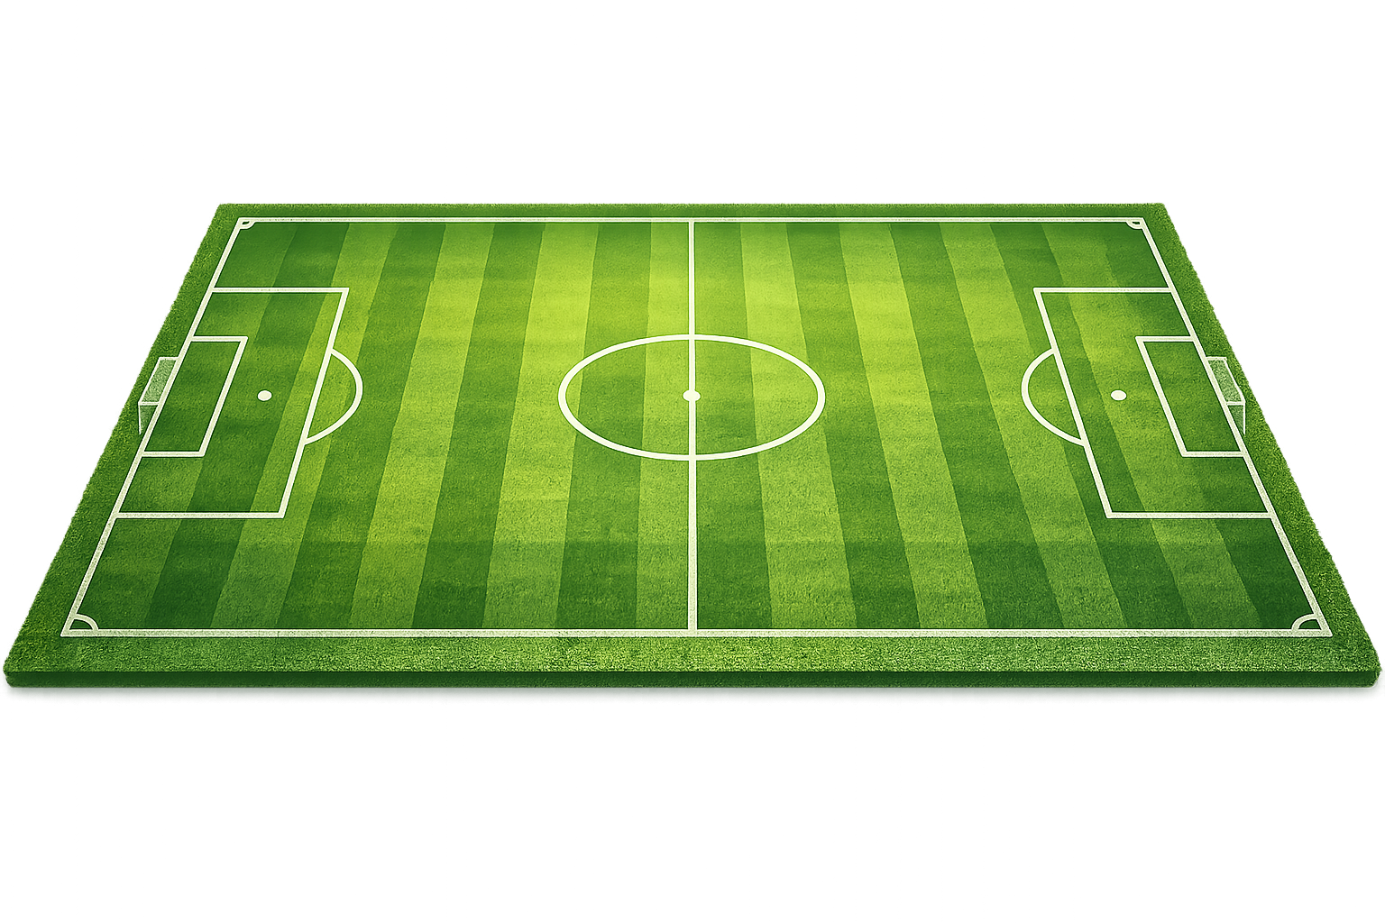
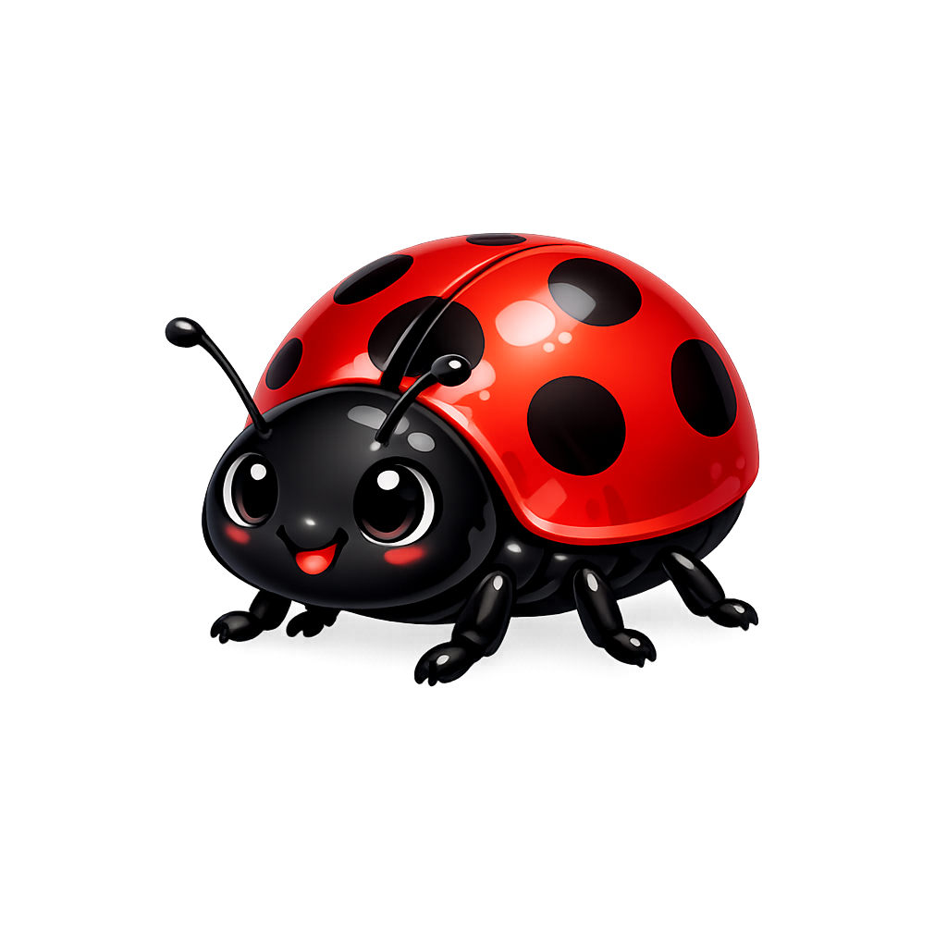
What is the most appropriate unit to measure the length of each object?
cm
mm
m

Slide 7


Your Turn
Sort the metric units into the correct categories.
Length | Capacity | Mass
cm
ml
g
tonne
L
mm
kg
km
m

Slide 8
True or False
A swimming pool is best
measured in centimetres.
False: Can you explain why?

