Slide 1


Lesson 1:
Read Roman numerals to 12
www.arithmagicians.com

Slide 2


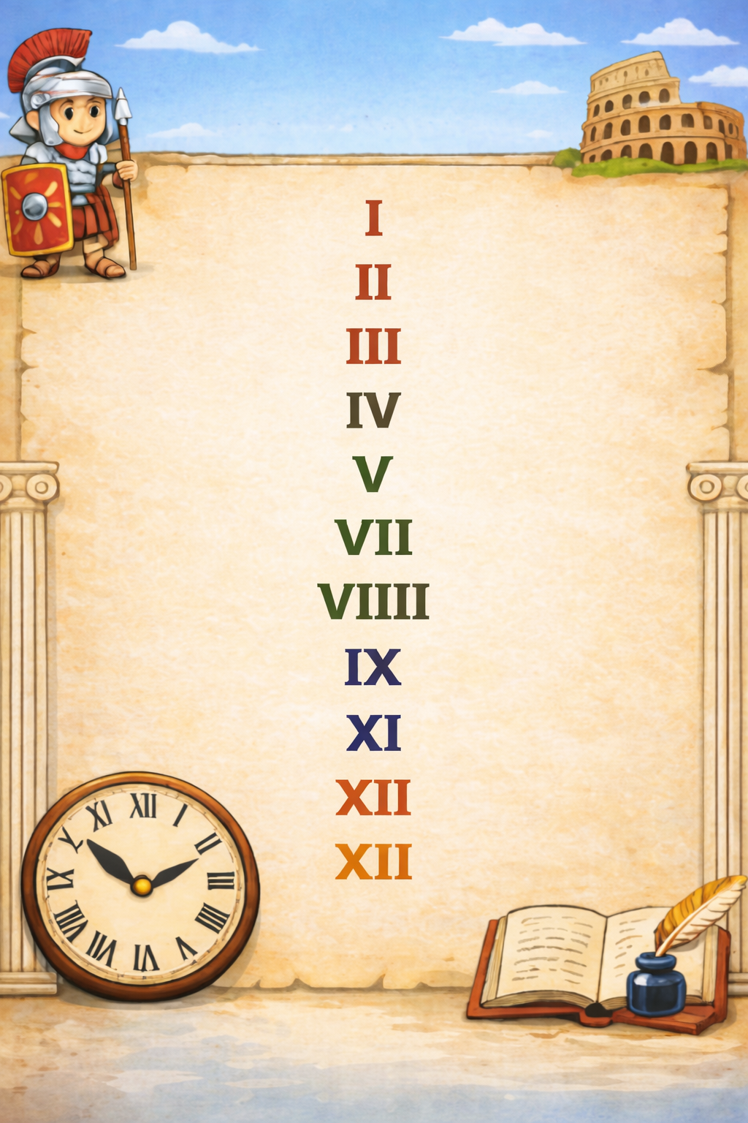
Where have you seen these before?

Slide 3
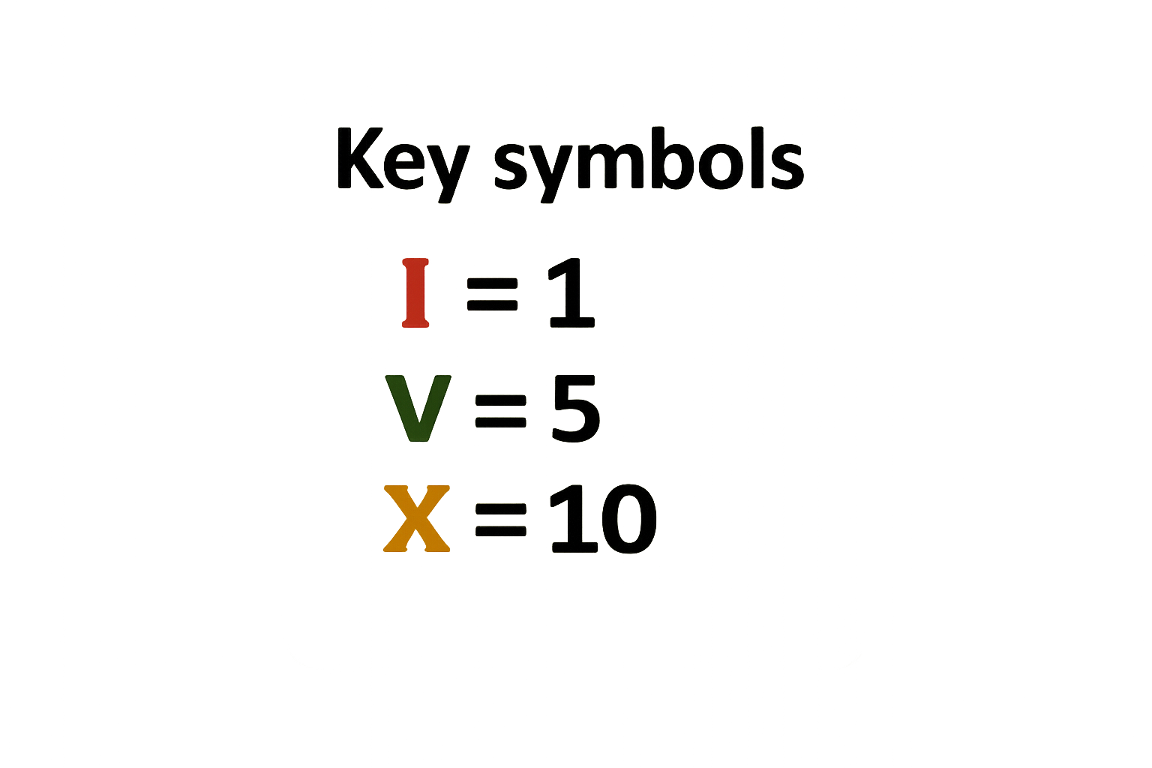
Roma numerals use letters
With just these 3 symbols, we can make all the numbers up to 12.

Slide 4
When numerals are repeated, we add their values together.
I I = 2 → 1 + 1
I I I = 3 → 1 + 1 + 1
X X = 20 → 10 + 10

Slide 5
When a smaller numeral comes after a bigger one, we add.
VI = 6 → 5 + 1
XI = 11 → 10 + 1
VII = 7 → 5 + 1 + 1

Slide 6
When a smaller numeral comes before a bigger one, we subtract.
IV = 4 → 5 take away 1
IX = 9 → 10 take away 1

Slide 7

Your Turn
3 → 1 + 1 + 1
a) III =
b) VI =
6 → 5 + 1
c) IX =
9 → 10 - 1
12 → 10 + 1 + 1
d) XII =

Slide 8

IIIIII
We should use the key symbols efficiently. Instead of writing six 1s,
we use V for 5 and then add I for 1 more.
This is how you write 6 in Roman numerals.
Do you agree?
VI

