Slide 1


Lesson 1:
What are decimals?
www.arithmagicians.com

Slide 2


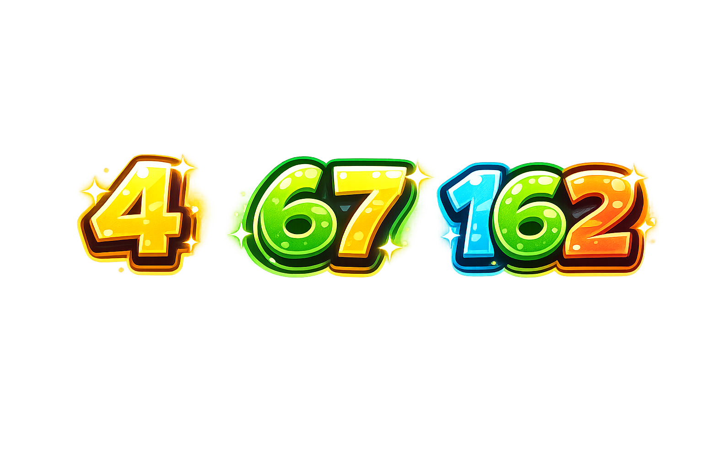
What is a whole number?

Slide 3
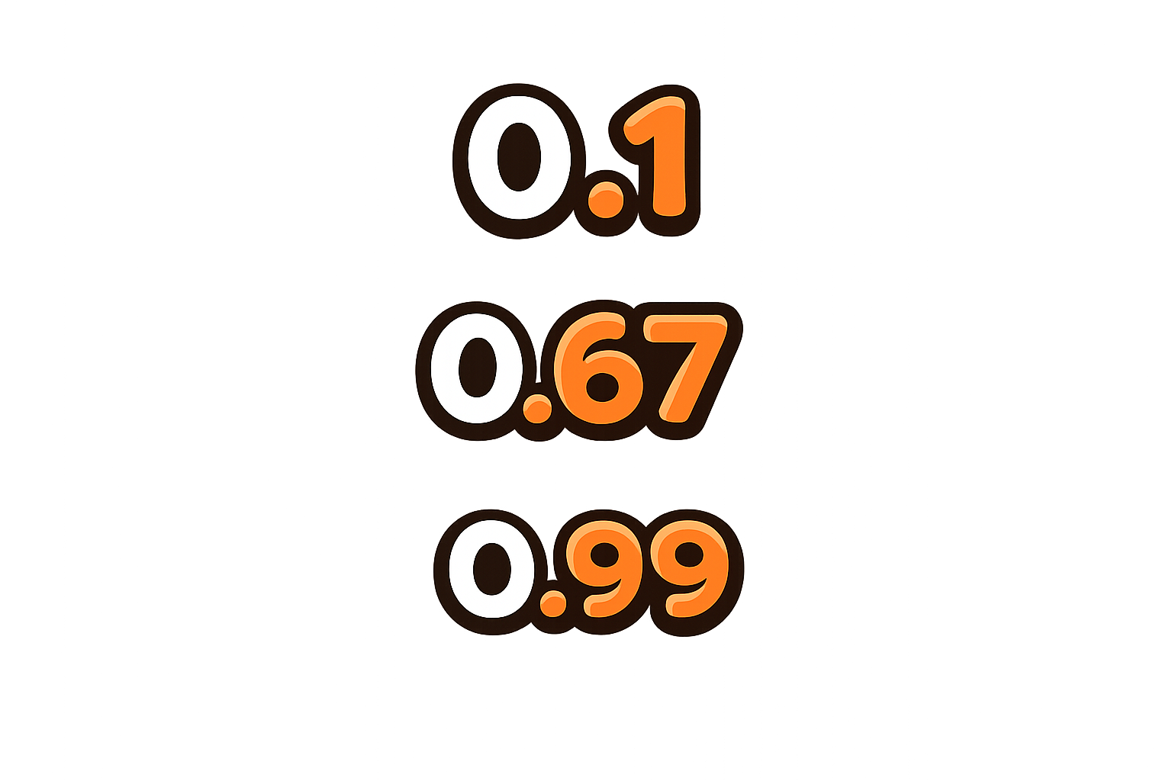
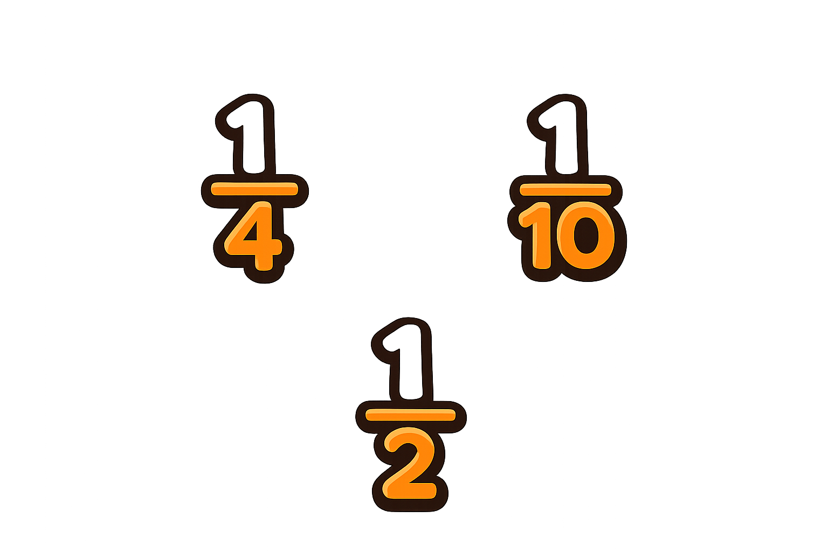
What happens when something is split into parts?

Slide 4
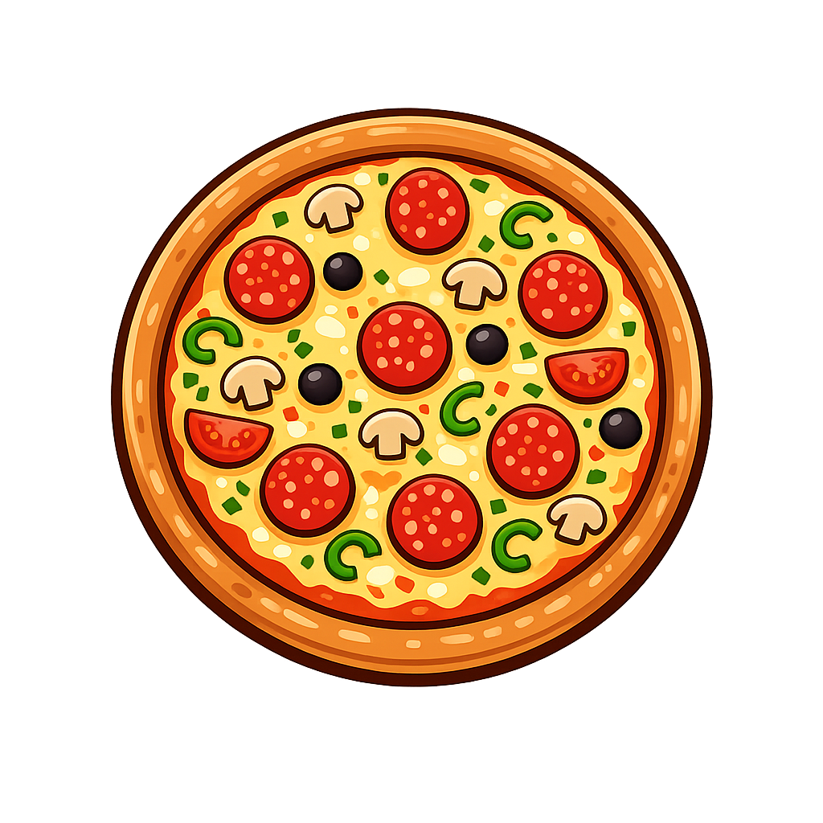
If I cut a pizza into 10 equal pieces and eat 1 piece, how much have I eaten?

Slide 5
Decimals show parts of a whole.
= 1 whole
= 1.0

Slide 6
Decimals are numbers between whole numbers
one part out of 10
=
= 0.1

Slide 7
Decimals are numbers between whole numbers
one part out of 100
=
= 0.01

Slide 8


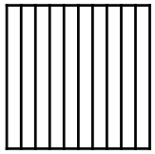

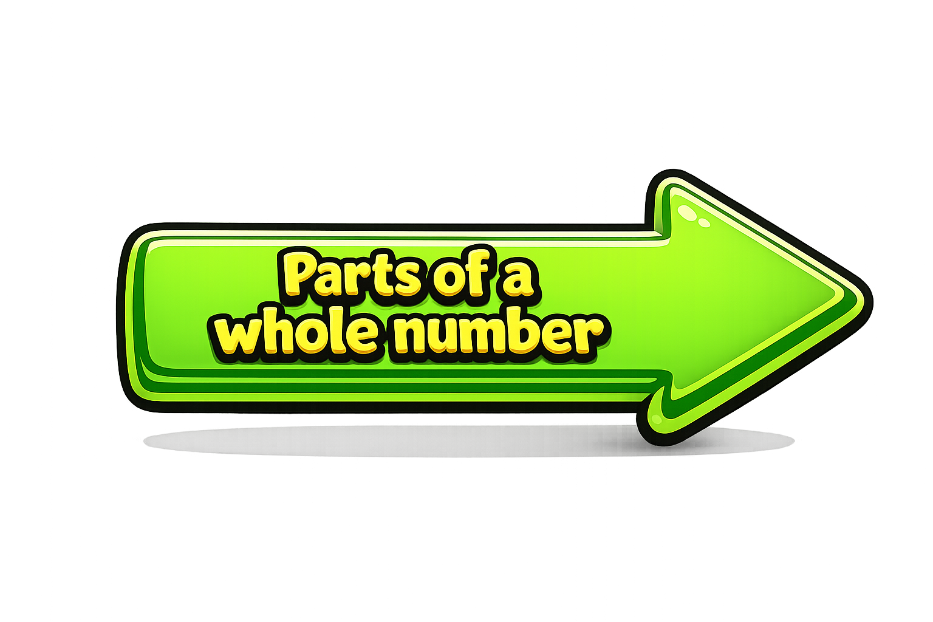
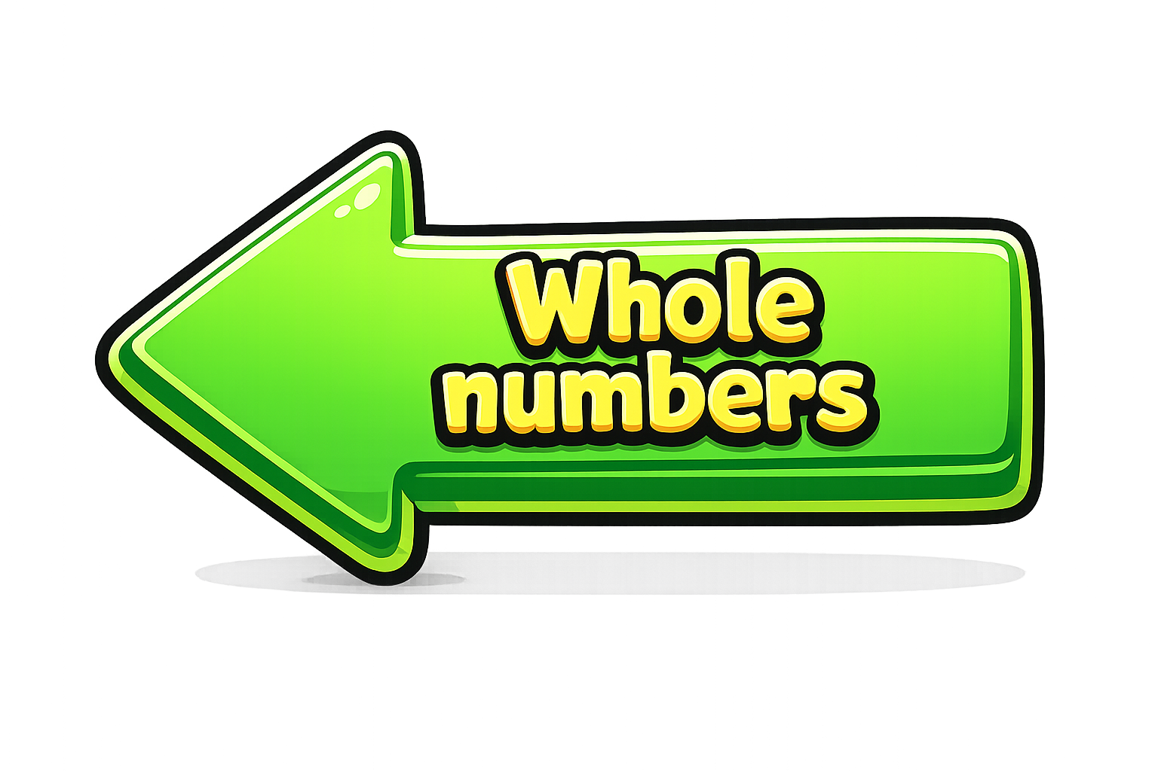
The decimal point separates:
Whole numbers (left)
Parts (right)
Ones | Tenths | Hundredths

Slide 9
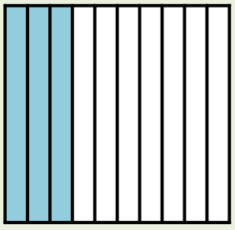
What number is represented on the place value chart?
Ones | Tenths | Hundredths
1
3
7

Slide 10


Your Turn
What decimals are shown?
A
B
C
0.9
0.3
0.35

Slide 11
True or False
>
0.4
0.40
False: Can you explain why?

