Slide 1

Lesson 2:
Add 2 to any number
www.arithmagicians.com

Slide 2

+1
+1
+1
+1
+1
+1
+1
+1
+1
+1
0
1
2
3
4
5
6
7
8
9
10
Get ready to count up in 1s

Slide 3

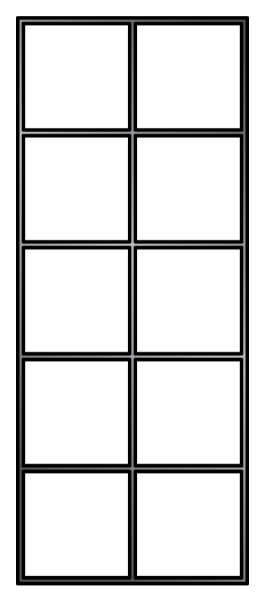
6
+
2
=
8

Slide 4
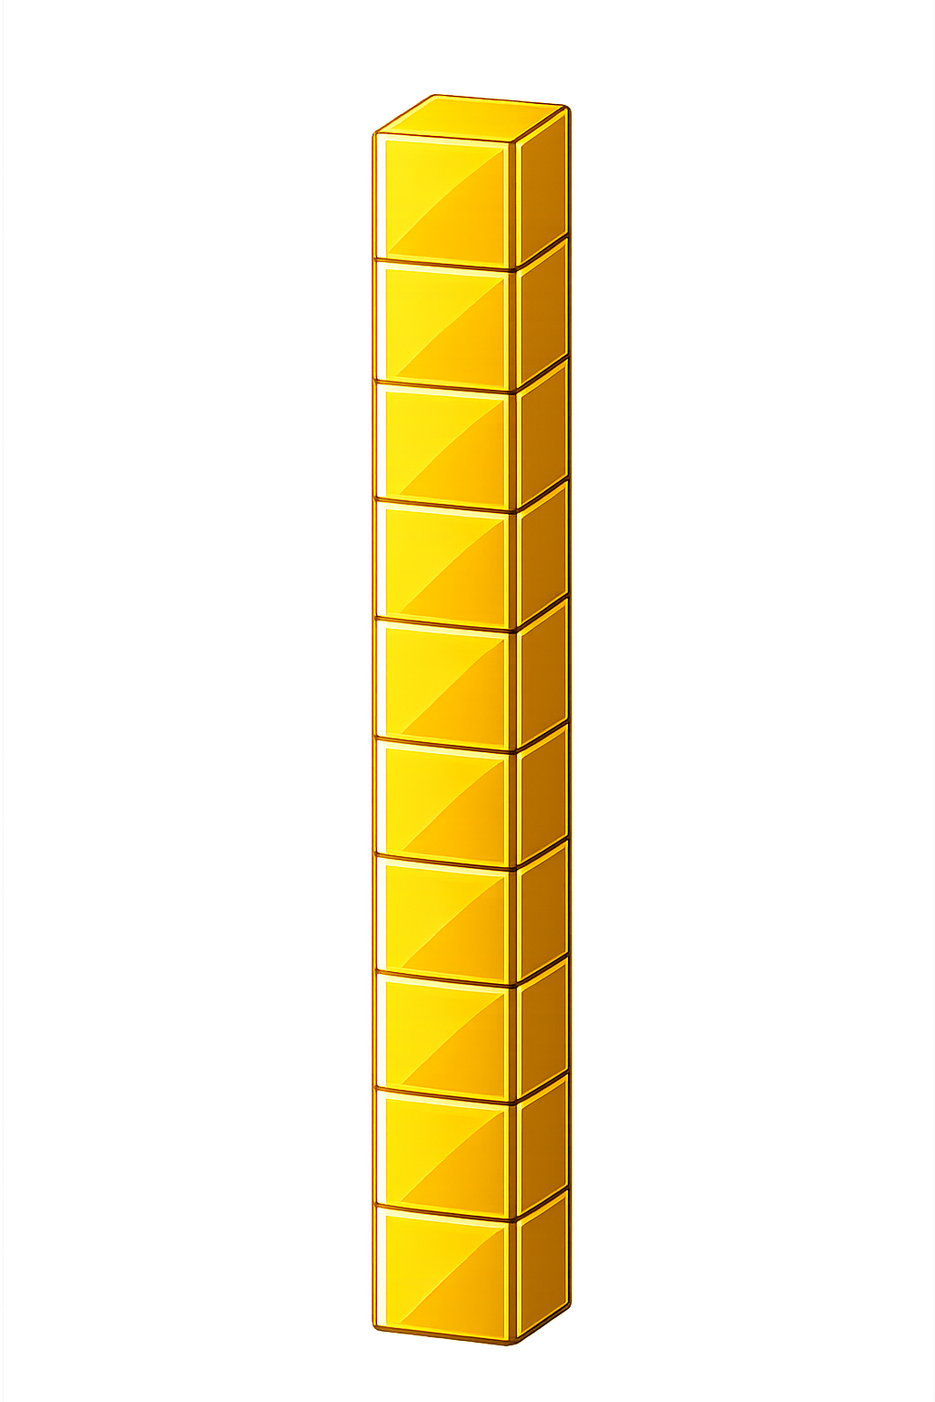

What number is shown below?
25
27
+ 2 = ?

Slide 5
What number is shown below?
33
35
+ 2 = ?

Slide 6

60
61
62
63
64
65
66
?
?
67
68
69
70
+
=
64
2
66

Slide 7


Your Turn
26 + 2 = ?
28
39
2) 37 + 2 = ?
19
3) 17 + 2 = ?
86
4) 84 + 2 = ?
5) 50 + 2 = ?
52

Slide 8

True or False
Adding 2 means jumping two spaces forward on the number line.
True

