Slide 1
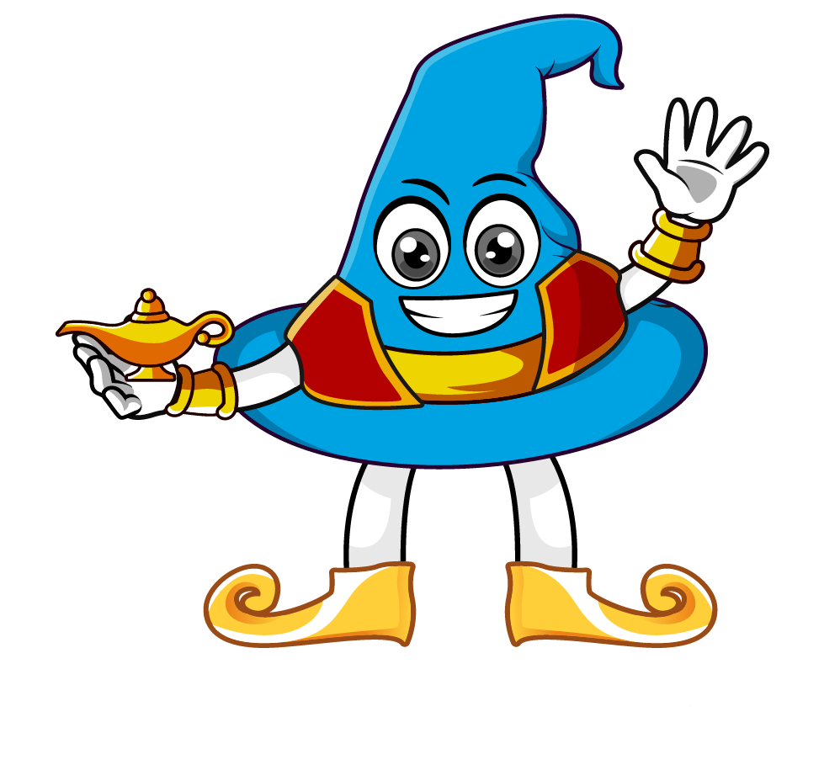

Lesson 2:
Convert units of length
(cm & mm)
www.arithmagicians.com

Slide 2

Which is bigger:
1 cm or 1 mm?
What is the same and what is different?

Slide 3
10
1 cm = ? mm
Tip: Use the ruler to help you
What do you notice?

Slide 4
2
20 mm = ? cm
Tip: Use the ruler to help you
What do you notice?

Slide 5

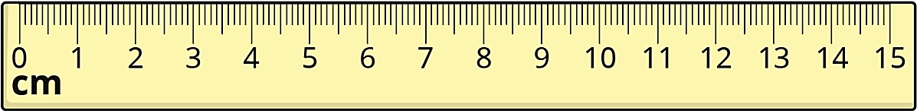
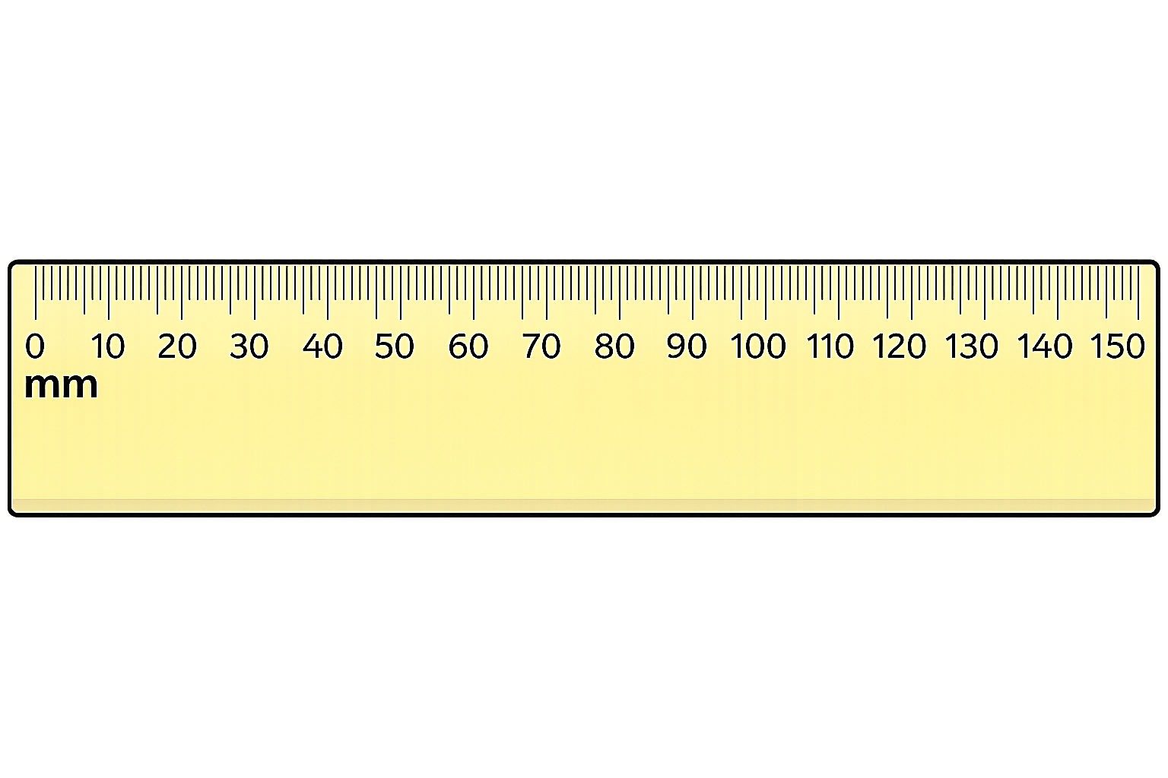
Key Fact:
1cm = 10mm
This is the most important fact
.
Every centimetre is made up
of 10 little millimetres.

Slide 6


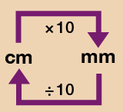
Your Turn
Solve:
a) 3 cm = ? mm
b) 5.5 cm = ? mm
c) 60 mm = ? cm
d) 105 mm = ? cm
e) 0.9 cm = ? mm
30
55
Use the conversion chart to help you.
6
10.5 cm
9

Slide 7
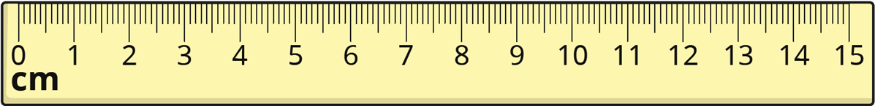



How long is this line?
Amy:
5 cm and 6 mm
Ben:
56 mm
Lucy:
5.6 cm
Who is correct?
They are all correct! Why?

