Slide 1


Lesson 2:
Write Roman numerals to 12
www.arithmagicians.com

Slide 2


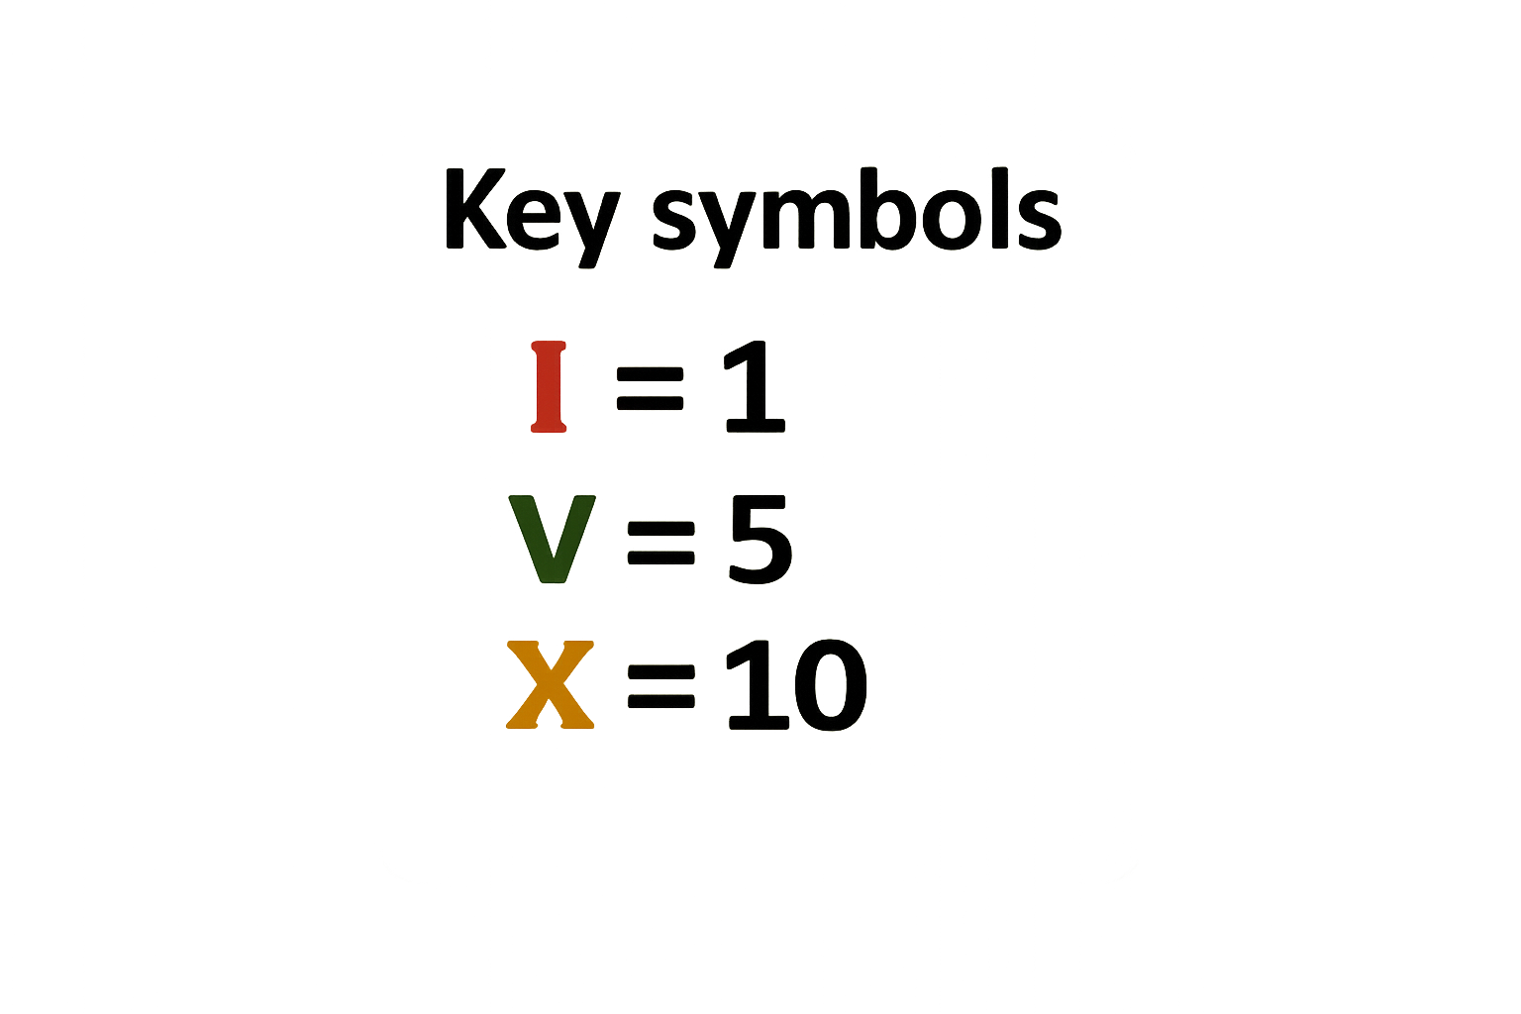
Roma numerals use letters
With just these 3 symbols, we can make all the numbers up to 12.

Slide 3
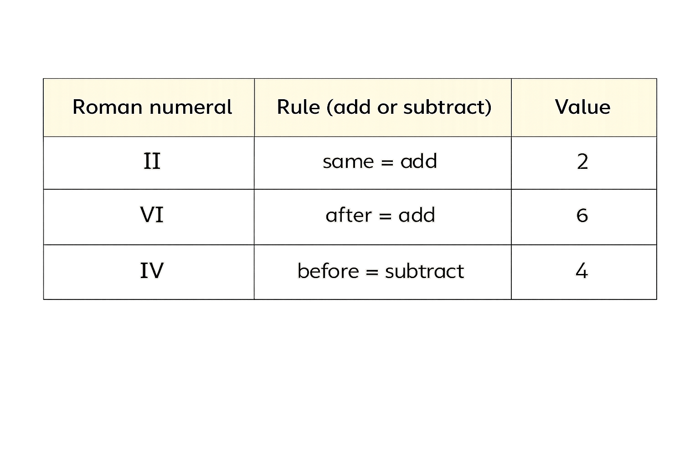
Use these rules to work out the value of Roman numerals.

Slide 4

Match the numbers to the Roman numerals
8
XII
4
VIII
12
IV

Slide 5


Your Turn
Write the numbers in Roman numerals
a) 4 = IV → 5 - 1
b) 7 = VII → 5 + 1 + 1
c) 9 = IX → 10 - 1
d) 11 = XI → 10 + 1

Slide 6
True or False:
8 can be written as IIX
You can only put one smaller numeral
before a bigger numeral
when subtracting.
IX = 9 ✅ IIX = 8 ❌
False: VIII

