Slide 1


Lesson 2:
Tenths as fraction
www.arithmagicians.com

Slide 2


1
?
ten
When a whole is split into _____ equal parts, one of those parts is worth _____
$\frac{\text{1}}{\text{10}}$

Slide 3

Get ready to
count up in tenths
0
1
$\frac{\text{0}}{\text{10}}$
$\frac{\text{1}}{\text{10}}$
$\frac{\text{2}}{\text{10}}$
$\frac{\text{3}}{\text{10}}$
$\frac{\text{4}}{\text{10}}$
$\frac{\text{5}}{\text{10}}$
$\frac{\text{6}}{\text{10}}$
$\frac{\text{7}}{\text{10}}$
$\frac{\text{8}}{\text{10}}$
$\frac{\text{9}}{\text{10}}$
$\frac{\text{10}}{\text{10}}$

Slide 4


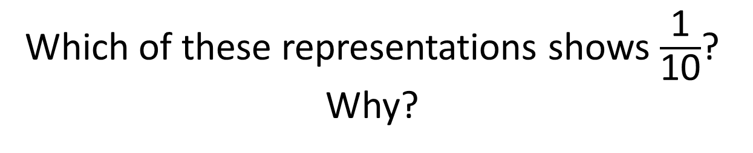
Which of these representations shows $\frac{\text{1}}{\text{10}}$? Why?

Slide 5


Tenths
?
$\frac{\text{4}}{\text{10}}$
What fraction is shaded?

Slide 6

Tenths
?
$\frac{\text{9}}{\text{10}}$
What fraction is shaded?

Slide 7


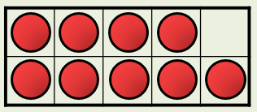
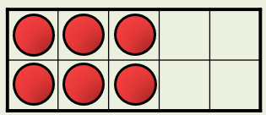
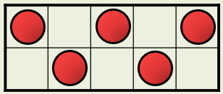
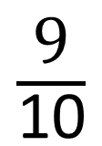
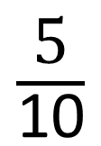
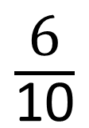
Your Turn
A full ten frame represents 1 whole.
What fractions are shown?
A
B
C
$\frac{\text{9}}{\text{10}}$
$\frac{\text{6}}{\text{10}}$
$\frac{\text{5}}{\text{10}}$

Slide 8

True or False
$\frac{\text{10}}{\text{10}}$
<
1 whole
False: Can you explain why?

