Slide 1

Lesson 3:
Subtract 1 from
any number
www.arithmagicians.com

Slide 2


-1
-1
-1
-1
-1
-1
-1
-1
-1
-1
0
1
2
3
4
5
6
7
8
9
10
Get ready to count back in 1s

Slide 3

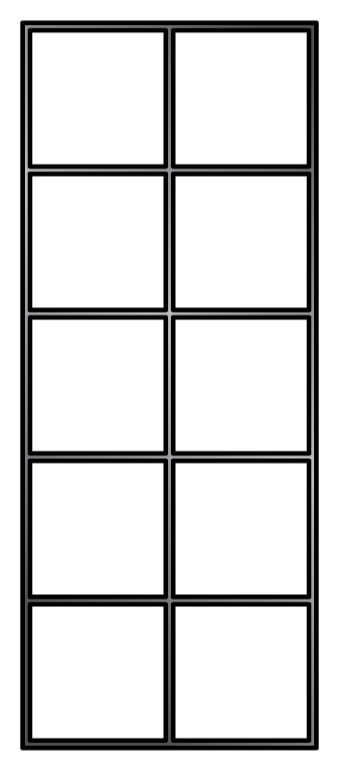
7
-
1
=
6

Slide 4
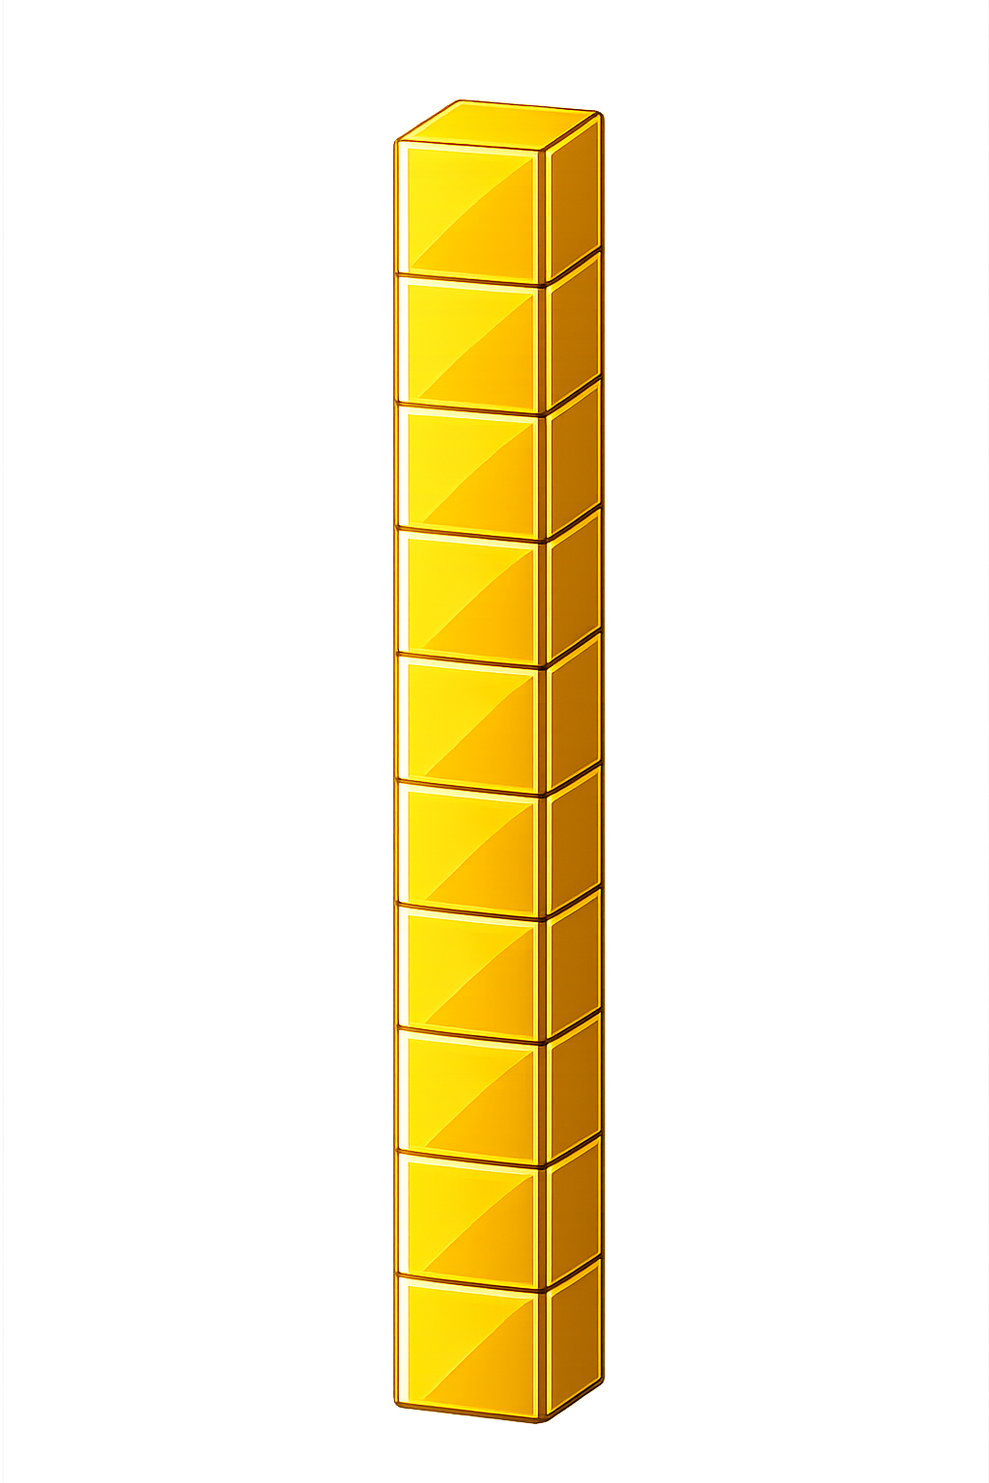

What number is shown below?
25
24
- 1 = ?

Slide 5
What number is shown below?
33
32
- 1 = ?

Slide 6

60
61
62
63
64
?
66
67
68
69
70
65
66
-
1
=
65

Slide 7


Your Turn
26 - 1 = ?
25
36
2) 37 - 1 = ?
17
3) 18 - 1 = ?
83
4) 84 - 1 = ?
5) 49 - 1 = ?
48

Slide 8

True or False
When you subtract 1, the number gets bigger.
False

