Slide 1


Lesson 3:
Convert units of length
(m, cm & mm)
www.arithmagicians.com

Slide 2

Recap:
10
1 cm = ? mm
Tip: Use the ruler to help you

Slide 3

100
1m = ? cm
10 cm
1m
Tip: Use the diagram to help you

Slide 4
1m = 100 cm
To change metres into centimetres, ______ by 100.
multiply
To change centimetres into metres, ______ by 100.
divide

Slide 5
x 100
1m = 100 cm
550
5.5m = ? cm
x 100

Slide 6
÷ 100
1m = 100 cm
? m = 360 cm
3.6
÷ 100

Slide 7

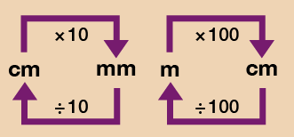
Your Turn
Solve:
500 cm
5 m = ? cm
850 cm = ? m
4.5 m = ? cm
3000 mm = ? m
Use the conversion chart to help you.
8.5 m
450 cm
3 m

Slide 8
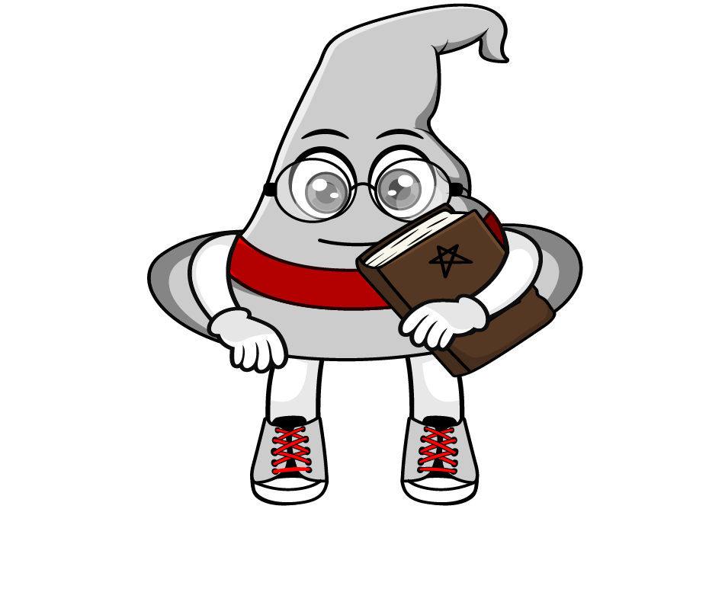
True or False
When changing cm into m, the answer is always smaller.
True: Can you explain why?

