Slide 1

Lesson 4:
Subtract 2 from
any number
www.arithmagicians.com

Slide 2


-1
-1
-1
-1
-1
-1
-1
-1
-1
-1
0
1
2
3
4
5
6
7
8
9
10
Get ready to count back in 1s

Slide 3

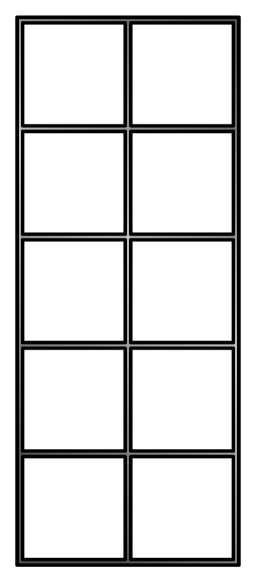
7
-
2
=
5

Slide 4
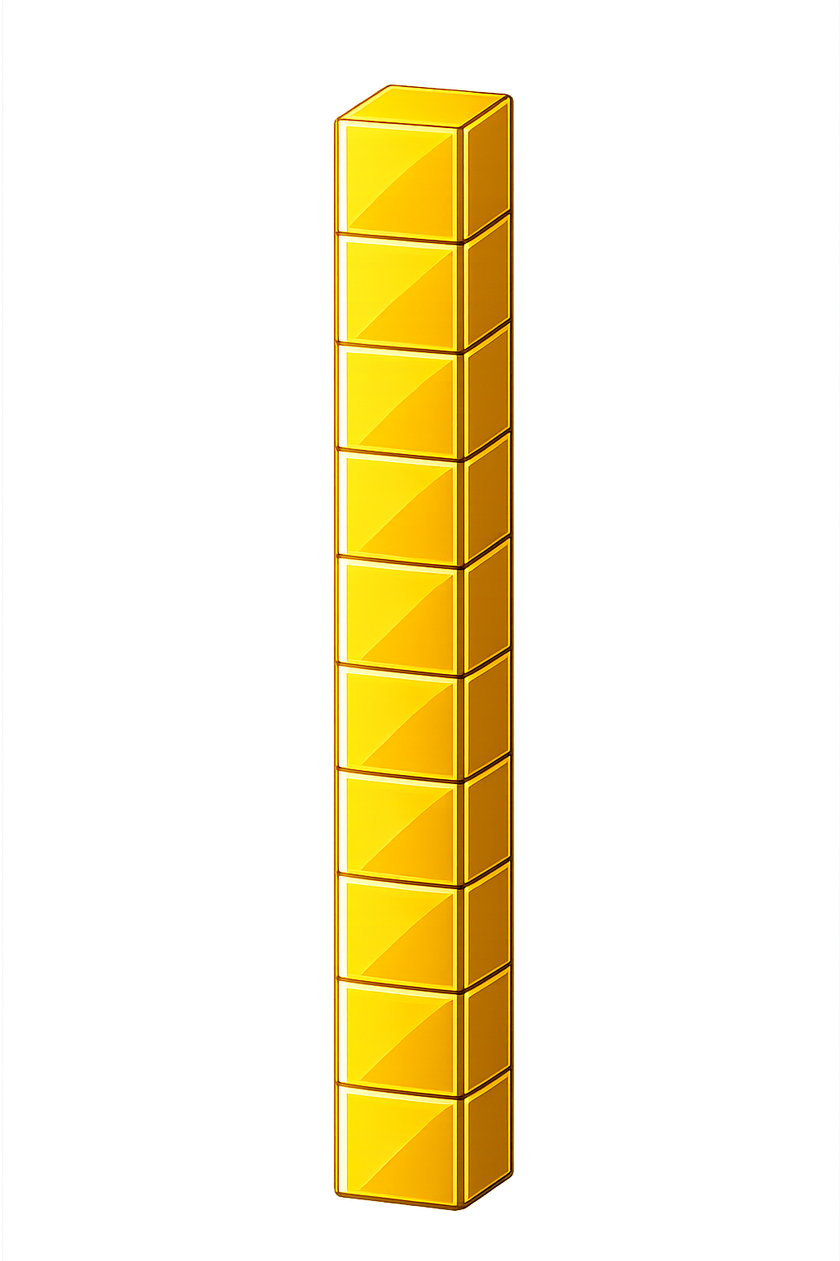

What number is shown below?
25
23
- 2 = ?

Slide 5
What number is shown below?
33
31
- 2 = ?

Slide 6

60
61
62
63
?
65
64
?
66
67
68
69
70
66
-
2
=
64

Slide 7


Your Turn
26 - 2 = ?
24
35
2) 37 - 2 = ?
16
3) 18 - 2 = ?
82
4) 84 - 2 = ?
5) 49 - 2 = ?
47

Slide 8

True or False
When you subtract 2, you move two spaces back on the number line.
True

