Slide 1


Lesson 4:
Convert units of length
(km & m)
www.arithmagicians.com

Slide 2

Recap:
10
1 cm = ? mm
Tip: Use the ruler to help you

Slide 3

Recap:
100
1m = ? cm
10 cm
1m
Tip: Use the diagram to help you

Slide 4
1000 m
1 km = ? m
100m
Tip: Use the diagram to help you

Slide 5
1km = 1000 m
To change km into m, ______ by 1000.
multiply
To change m into km, ______ by 1000.
divide

Slide 6
x 1000
1 km = 1000 m
5.2 km = ? m
5200
x 1000

Slide 7
÷ 1000
1 km = 1000 m
0.36
? km = 360 m
÷ 1000

Slide 8

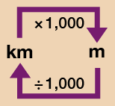
Your Turn
Solve:
5 km = ? m
8000 m = ? km
2.5 km = ? m
3500 m = ? km
5000 m
Use the conversion chart to help you.
8 km
2500 m
3.5 km

Slide 9
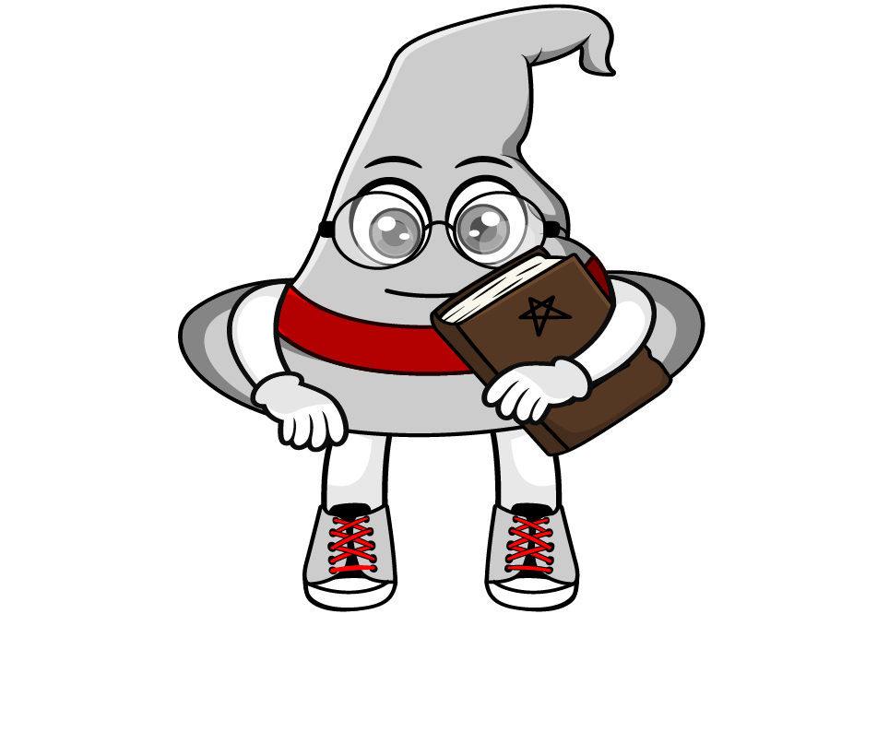
True or False
When changing km into m, the number is always bigger.
True: Can you explain why?

