Slide 1


Lesson 4:
Read time shown in Roman numerals
www.arithmagicians.com

Slide 2


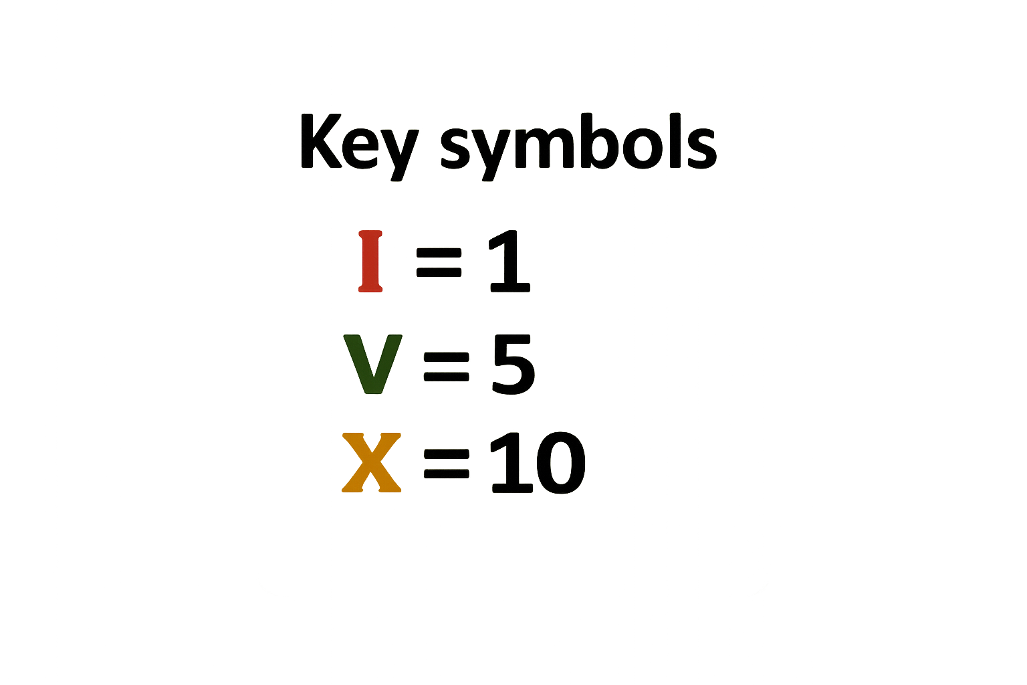
Roma numerals use letters
With just these 3 symbols, we can make all the numbers up to 12.

Slide 3

Write the Roman numerals from 1 to 12.
I = 1
II = 2
III = 3
IV = 4
V = 5
VI = 6
VII = 7
VIII = 8
IX = 9
X = 10
XI = 11
XII = 12

Slide 4

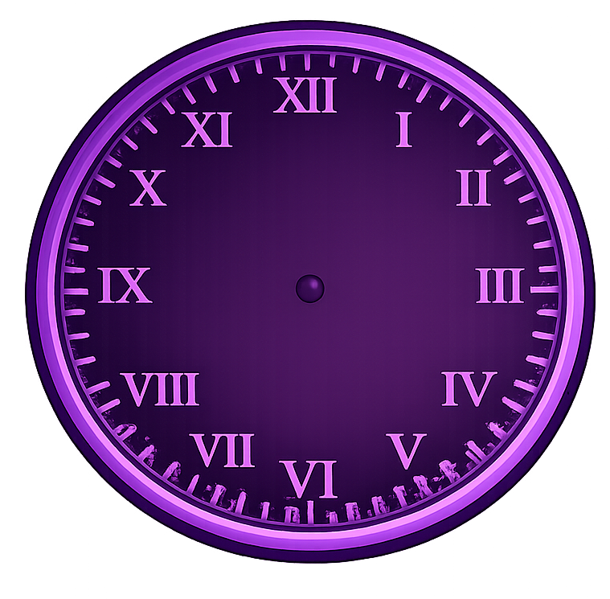
What time is shown by the clock?
12 o’clock

Slide 5
What time is shown by the clock?
8 o’clock

Slide 6
What time is shown by the clock?
Half past 4

Slide 7

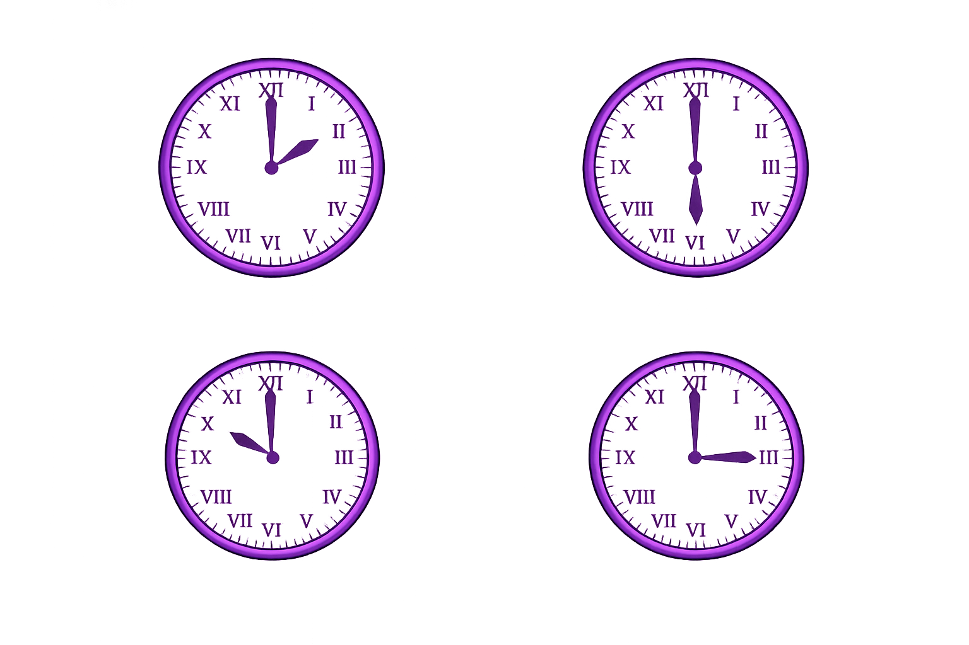
Your Turn
2 o’clock
Half past 10
a)
b)
c)
d)
3 o’clock
Half past 4

Slide 8
True or False
There is a Roman numeral for zero.
False: Roman numerals do not have a symbol for zero.

