Slide 1


Lesson 4:
Tenths on a place value chart
www.arithmagicians.com

Slide 2

Get ready to
count up in tenths
0
1
$\frac{\text{0}}{\text{10}}$
$\frac{\text{1}}{\text{10}}$
$\frac{\text{2}}{\text{10}}$
$\frac{\text{3}}{\text{10}}$
$\frac{\text{4}}{\text{10}}$
$\frac{\text{5}}{\text{10}}$
$\frac{\text{6}}{\text{10}}$
$\frac{\text{7}}{\text{10}}$
$\frac{\text{8}}{\text{10}}$
$\frac{\text{9}}{\text{10}}$
$\frac{\text{10}}{\text{10}}$

Slide 3

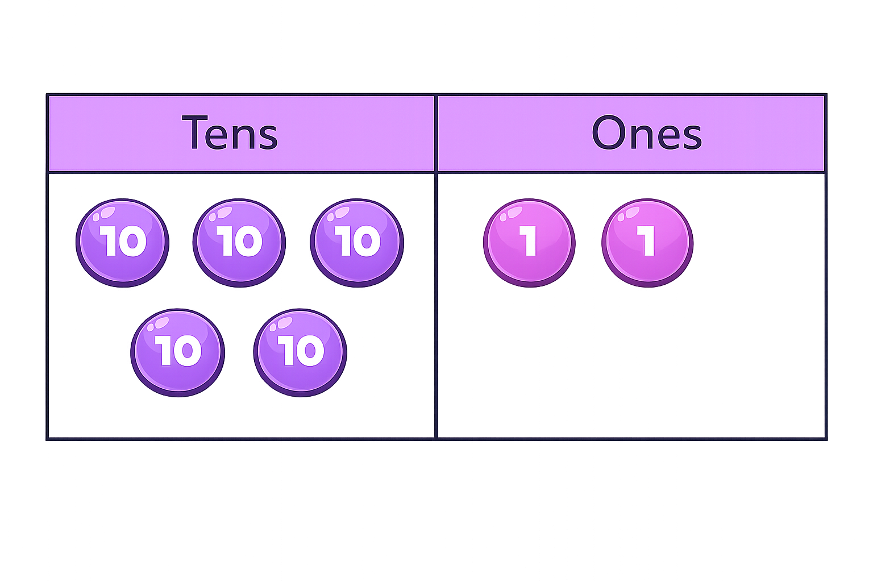
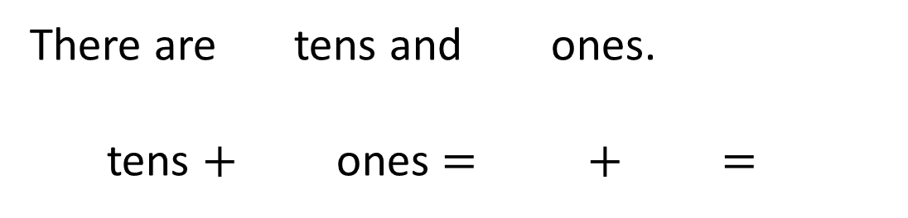
There are tens and ones.
tens $+$ ones $=$ $+$ $=$
5
2
5
2
50
2
52

Slide 4
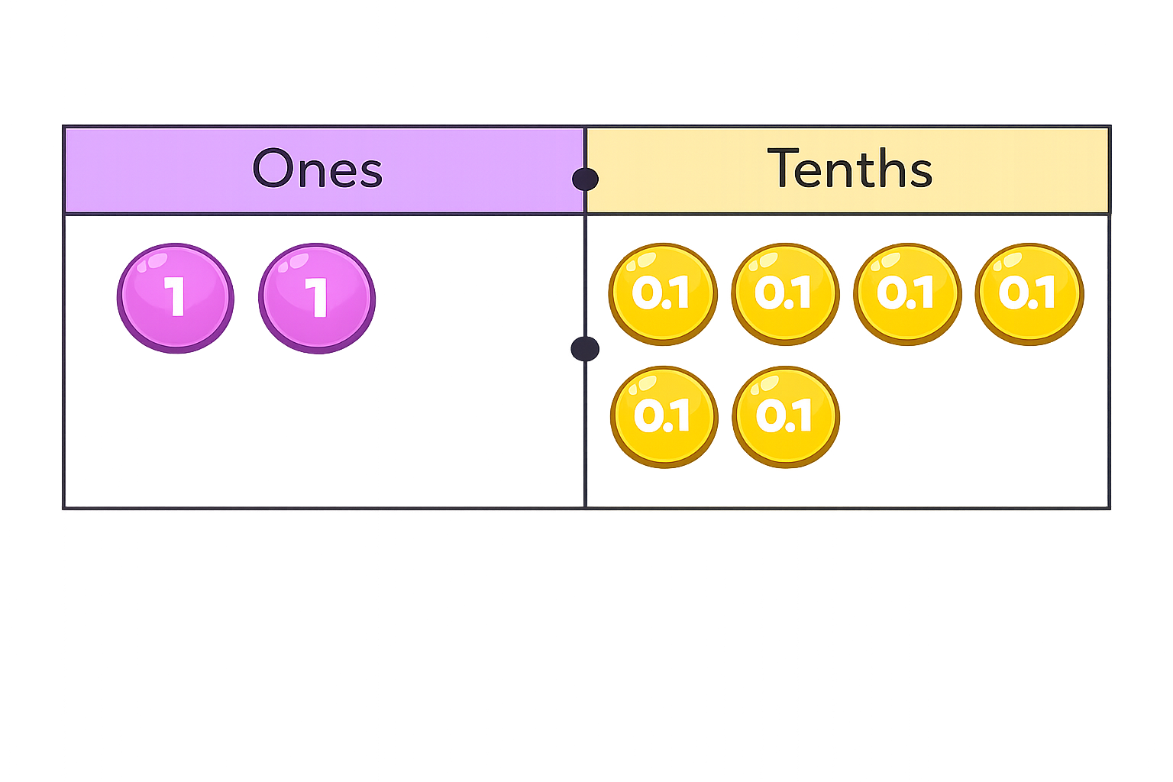
There are wholes and tenths.
The number is
2
6
2.6

Slide 5
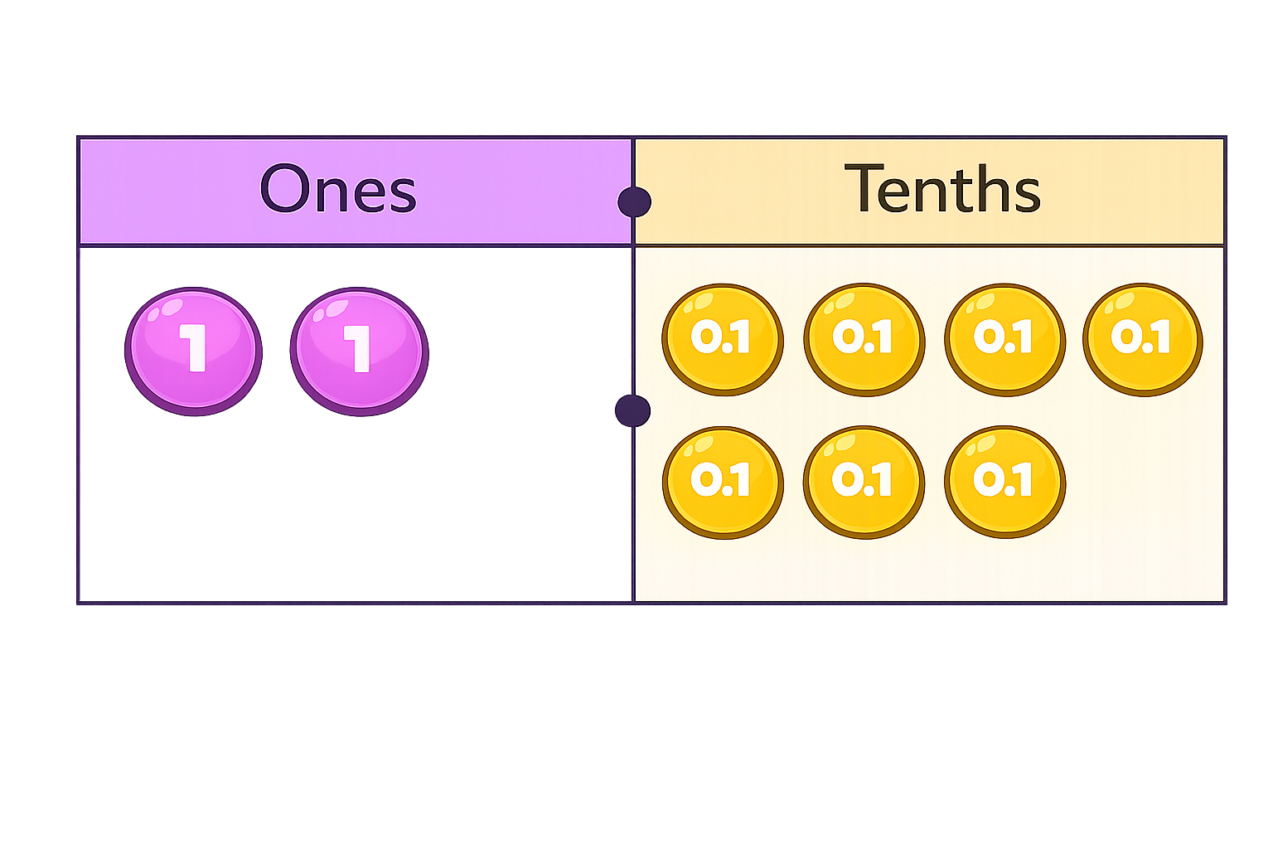

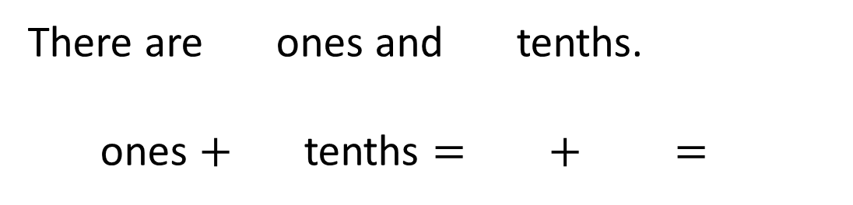
There are ones and tenths.
ones $+$ tenths $=$ $+$ $=$
0
7
0
7
0
0.7
0.7

Slide 6


Your Turn
Match the labels to the place value charts.
30 Tenths
Ones | Tenths
0 | 3
23 Tenths
Ones | Tenths
3 | 2
32 Tenths
Ones | Tenths
3 | 0
3 Tenths
Ones | Tenths
2 | 3

Slide 7
True or False
Complete the number track.
0.6 | 0.7 | 0.8 | 0.9
1
1.1
1.2
The next three numbers will be 0.10, 0.11 & 0.12 because the number track is counting up in tenths.
False: Can you explain why?

