Slide 1


Lesson 5:
Assess and Review
www.arithmagicians.com

Slide 2

Recap:
10
1 cm = ? mm
Tip: Use the ruler to help you

Slide 3

Recap:
100
1m = ? cm
10 cm
1m
Tip: Use the diagram to help you

Slide 4
Recap:
1000 m
1 km = ? m
100m
Tip: Use the diagram to help you

Slide 5

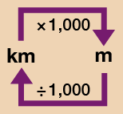
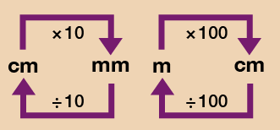
33 mm
a) 3.3 cm = ? mm
b) 80 mm = ? cm
c) 2.7 m = ? cm
d) 1.5 km = ? m
e) 900 m = ? km
8 cm
Use the conversion chart to help you.
270 cm
1500 m
0.9 km

