Slide 1


Lesson 5:
Assess and Review
www.arithmagicians.com

Slide 2


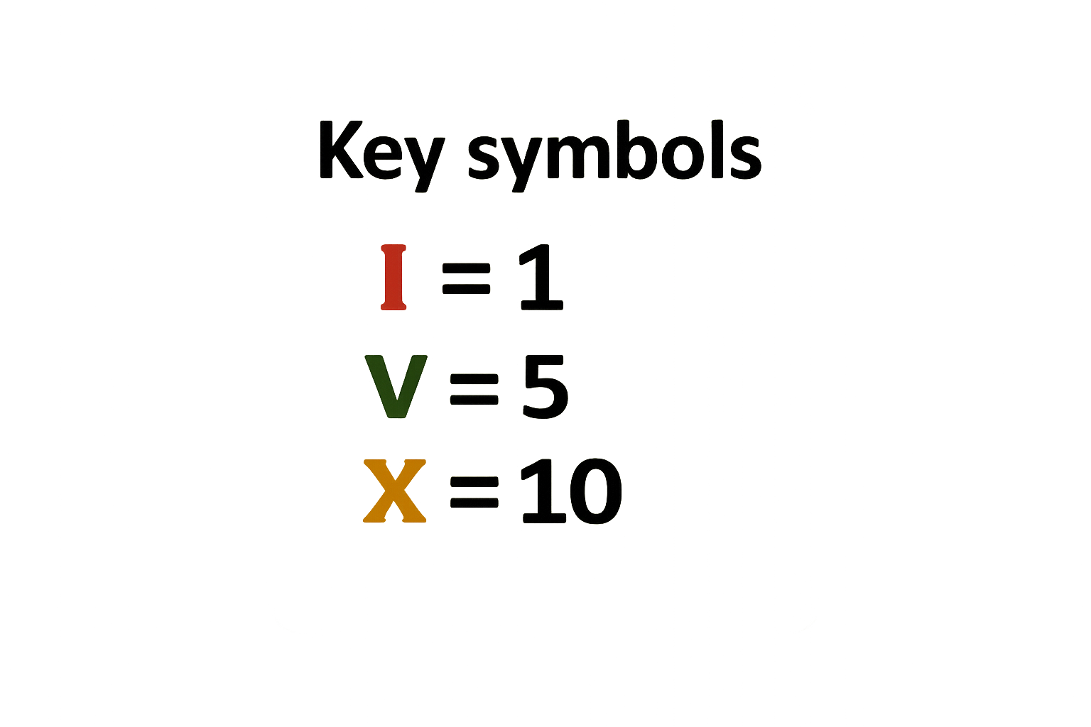
Roma numerals use letters
With just these 3 symbols, we can make all the numbers up to 12.

Slide 3

Write the Roman numerals from 1 to 12.
I = 1 VII = 7
II = 2 VIII = 8
III = 3 IX = 9
IV = 4 X = 10
V = 5 XI = 11
VI = 6 XII = 12

Slide 4

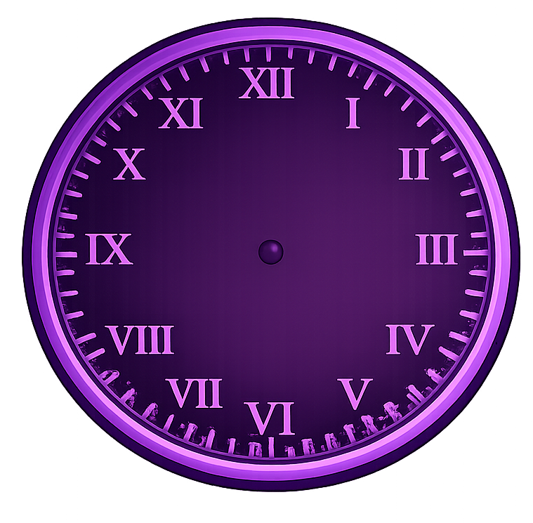
What time is shown by the clock?
11 o’clock

Slide 5
What time is shown by the clock?
6 o’clock

Slide 6
What time is shown by the clock?
Half past 1

Slide 7

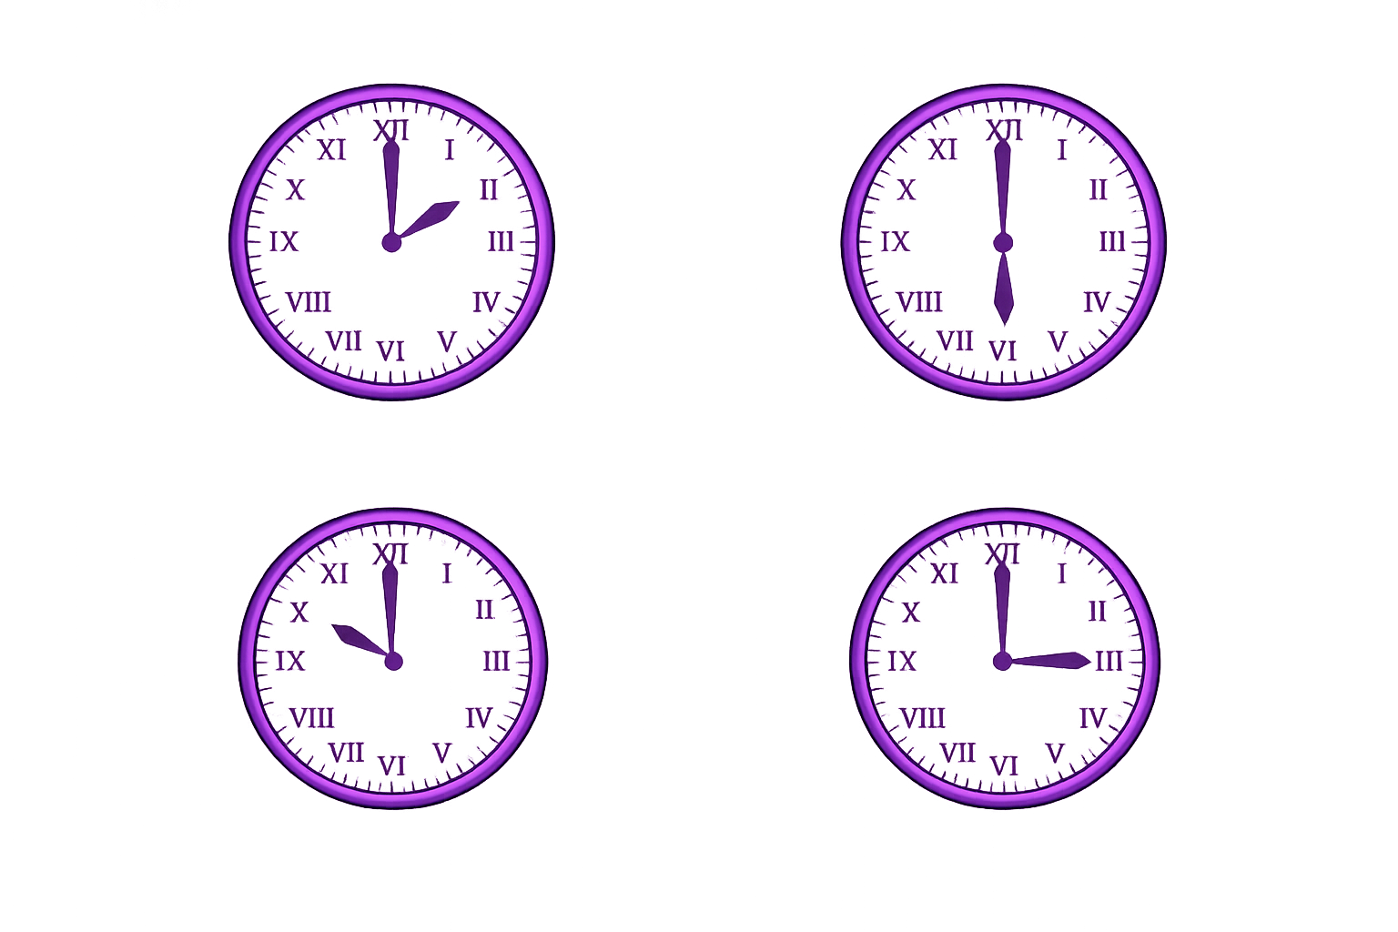
Your Turn
10 o’clock
Half past 12
a)
b)
c)
d)
3 o’clock
Half past 3

